Slide 1
Lab #2: Caesar Cipher
CMPUT 229
Notes:
In this lab you will be implementing a Caesar Cipher. It is a way to encrypt strings by some private key that is only known by the sender and the intended receiver.

Slide 2
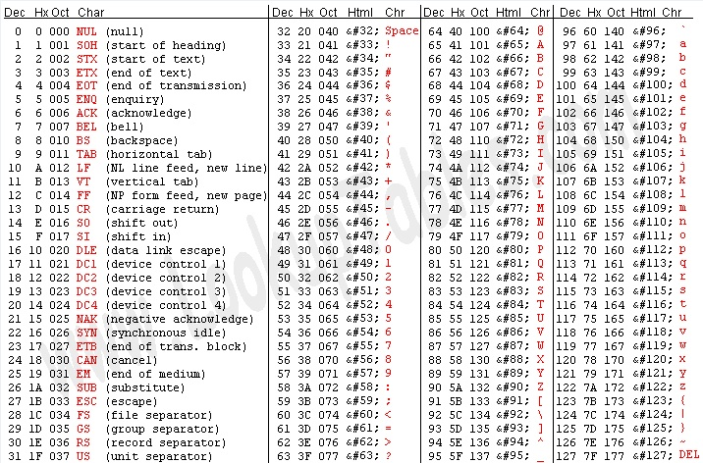
American Standard Code for Information Interchange (ASCII)
Notes:
To implement this lab, you will need to understand how characters are stored in memory. Characters are not actually stored as the characters themselves but in binary. Therefore, there must be some way of translating a character to its binary representation. This is where ASCII comes in. ASCII provides a way to represent a character in memory. Characters are stored in one byte as numbers. For example, lowercase ‘b’ is stored as the decimal number 98 in one byte of memory.

Slide 3
Strings in Assembly
Strings are arrays of characters stored in 1 byte in memory. The end of a string is indicated by a null terminator character which has a value of 0.
The string “RISC V” is represented in assembly by a pointer to the first character.
Registers | Values
t0 | 0x100
t0 points to the string “RISC V”
Address | 0x100 |  |  |  | 0x104
Value
0x52
0x49
0x53
0x43
0x20
0x56
0x00
R
I
S
C
V
\0
But remember, characters are stored as ASCII integer values.
Notes:
Another important concept to understand is how strings are stored in memory. Strings are stored as a sequence of ASCII characters. However, strings can be of any length so how does the program know when one string ends and another string starts. The null terminator character indicates to the program the end of a particular string. Appended to the end of the array of characters in the string, the null terminator character is represented by 0.
When you are implementing your lab, you must ensure you append the null terminator character to the end of your encrypted string.

Slide 4
Strings in Assembly
Strings are arrays of characters stored in 1 byte in memory. The end of a string is indicated by a null terminator character which has a value of 0.
The string “RISC V” is represented in assembly by a pointer to the first character.
Registers | Values
t0 | 0x100
t0 points to the string “RISC V”
Address | 0x100 |  |  |  | 0x104
Value | R | I | S | C |  | V | \0
But remember, characters are stored as ASCII integer values.
Notes:
NOTE: This slide (and the next one) are the same as the last slide except in a format more friendly for the PDF version of these slides. They can be ignored in the PowerPoint format.

Slide 5
Strings in Assembly
But remember, characters are actually represented by ASCII integer values
So in memory, RISC V would actually look like this:
Registers | Values
t0 | 0x100
t0 points to the string “RISC V”
Address | 0x100 |  |  |  | 0x104
Value | 0x52 | 0x49 | 0x53 | 0x43 | 0x20 | 0x56 | 0x00

Slide 6
Instructions to Manipulate Characters (Bytes)
Address | 0x100 |  |  |  | 0x104
Value | R | I | S | C |  | V | \0
…
1 byte wide
1 byte wide
lb rd, offset(rs1)
Sign-extend to 32 bits in rd
lbu rd, offset(rs1)
Zero-extend to 32 bits in rd
sb rs2, offset(rs1)
Store just the rightmost byte of rs2
Notes:
Strings are represented by a pointer to the memory location where the array of characters (and null terminator) exist. So, instructions are needed to access that memory.
It’s important to note the differences between load byte and load byte unsigned. If a character is represented by some number that starts with a 1, then load byte will sign extend that number in the remaining bits of the destination register. Likely this is not how you intended to work with the character.
Load byte (lb) is an instruction that accesses some memory location specified by rs1 and an offset. The byte in this memory location is sign extended and stored in the destination register.
Load byte unsigned (lbu) is an instruction that accesses some memory location specified by rs1 and an offset. The byte in this memory location is zero extended and stored in the destination register.
Store byte (sb) is an instruction that stores the lower 8 bits of rs2 in some memory location specified by rs1 and an offset.

Slide 7
Caesar Cipher
A Caesar Cipher is a type of substitution cipher. Every character is shifted by some key.
For this lab, we will have an uppercase key and a lowercase key that should be used to encrypt a letter depending on its case.
You should leave all spaces in their original position. There will not be any punctuation in the strings.

Slide 8
Caesar Cipher Visualized
(check lab page if you can’t watch video^^^)
Notes:
Here is a video detailing the implementation of a Caesar Cipher on the string “I Love Assembly” with an uppercase key=19 and lowercase key=4.
Some things to notice in this video:
Letters are not represented by their ASCII values, but their position in the alphabet (0-25).
Uppercase letters are scaled by the uppercase key, lowercase by the lowercase key.
When the letter + key exceeds 26, it wraps around back to the start of the alphabet (by modulus)

Slide 9
Allocating Memory
To complete this lab, you must allocate memory for the new encrypted string. You cannot simply overwrite the original string provided to your function.
Static Allocation: Reserving an area of memory where the size is known at compile time. In other words, you know the amount of memory you need without executing the program.

Slide 10
Static Allocation in RARS:
Sample Code
To access your static memory use load address:
la t0, static_space
la t1, counter
.data
buffer: .space 64
counter: .word 1
.include “common.s”
.text
# your instructions go here
# …
Notes:
This slide shows an example of how to statically allocate memory. Below the data directive, you can reserve memory. To access this memory use load address and the label associated with that space.
Notice that we must hard-code 64 as the length of this section of memory. Since strings can vary in length, we cannot guarantee that a given string will fit in 64 bytes.

Slide 11
Allocating Memory
In this lab, since the size of the input string is not known, static allocation is infeasible. Instead, a solution should use dynamic allocation.
Dynamic Allocation: Reserving an area of memory where the size does not have to be known. Depending on the execution of the program, you could have different memory sizes.
Notes:
An alternative to static allocation is dynamic allocation. This does not require the size of memory to be known at compile time. Instead, the size of memory can change depending on the execution of the program.
For this lab, you are required to allocate an area of memory the size of the input string.

Slide 12
Dynamic Allocation in RARS:
To dynamically allocate memory, set a7 to 9 and a0 to the number of bytes in memory. The ecall instruction allocates the requested space in memory. It will return a0 as a pointer to the allocated memory
Sample Code
li a7, 9 # a7 <- 9
addi a0, x0, 64 # a0 <- 64
ecall
# now a0 stores a pointer to 64 bytes of contiguous memory
# … instructions that use memory
Notes:
This slide shows an example of how to dynamically allocate memory in RARS. Dynamic allocation is done through the ecall instruction. The ecall instruction allows a user to make a system call. If you set a7 = 9, it will dynamically allocate a0 bytes of contiguous memory.

Slide 13
Modulo in RISC-V
rem rd, rs1, rs2
Stores the remainder of rs1/rs2 into rd
rem t0, t1, t2
t0 = t1 % t2
Registers | Values
t0
t1 | 9
t2 | 4
t0 = 9 % 4
t0 = 1
1

Slide 14
Testing your Lab
We have provided some test inputs and outputs for you to confirm that your lab is working.
In the Program Arguments bar in the Execute tab, enter the complete path to the test file. If your path has any spaces in it, the filename will not be read correctly by RARS.
For example, UofAstudent/cmput 229/lab 2/test3.txt is an invalid path.

Slide 15
caesarEncrypt
Parameter:
a0: pointer to a string to encrypt
a1: uppercase key
a2: lowercase key
Return Value:
a0: pointer to a newly allocated memory that contains the encrypted string.

Slide 16
What to Submit?
A single file, called caesarencrypt.s.
Make sure the file does not contain a main procedure.

