Slide 1
Lab #2: String Search
CMPUT 229

Slide 2
Important things first
GitHub Classroom
CMPUT229 Student Submission License
Private repos

Slide 3
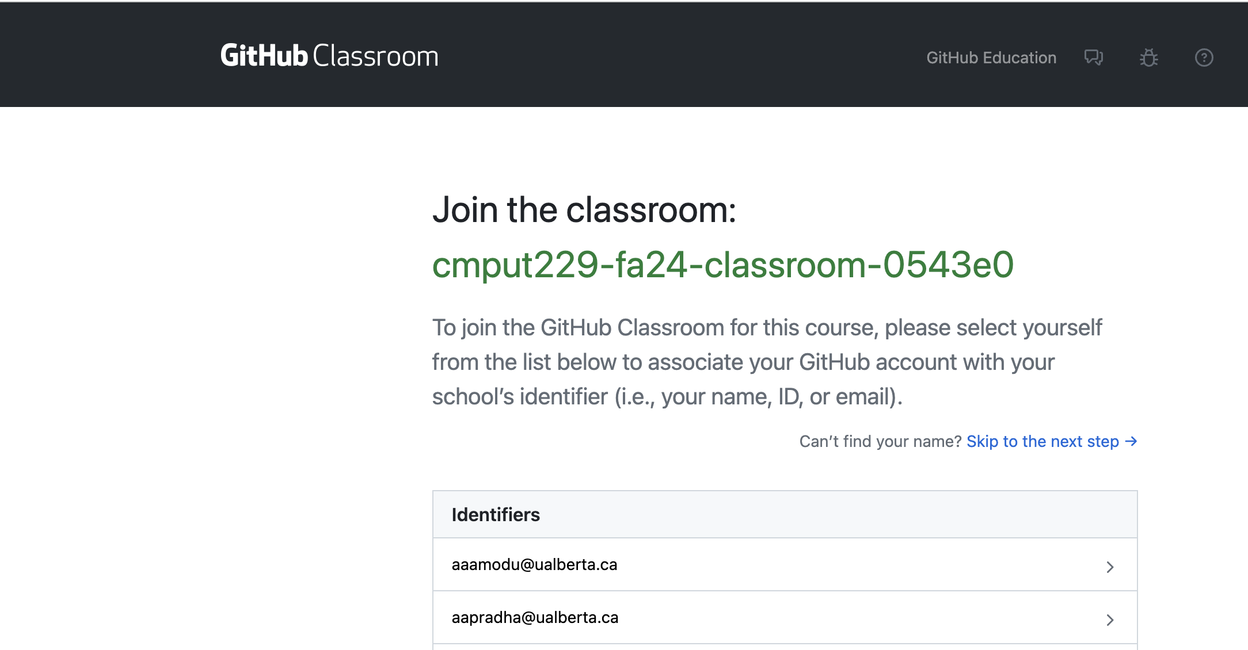
GitHub Classroom
studentA@ualberta.ca
studentB@ualberta.ca

Slide 4
Learn to git
https://cmput229.github.io/229-labs-RISCV/

Slide 5
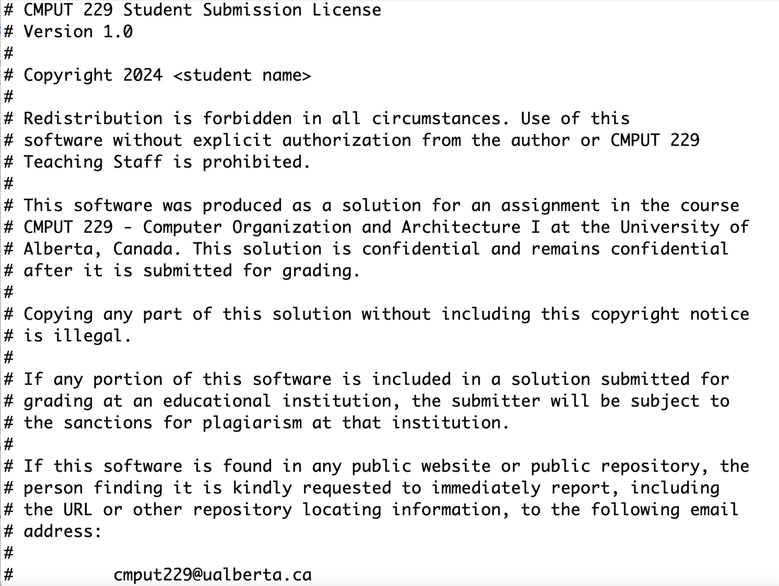

Slide 6
This solution is confidential
and remains confidential
After it is submitted for grading.
⇒ Your solution for a CMPUT 229 lab must remain
in a PRIVATE git repository.
Even AFTER you graduate from the UofA.

Slide 7
Background
CMPUT 229
Notes:
This section introduces concepts required for the lab.

Slide 8
How are Strings Represented?
Strings are represented as arrays of characters:
Each character in the string is encoded as a number.
ASCII is a standard that maps between characters and numbers.
Each ASCII character is a single byte, and characters range from 0–127.
String termination:
When passing a string to a function, we only pass a pointer to the first character.
To know when the string ends, we include a terminating character after the last character of the string.
In ASCII the terminating character is 0x00, which is often represented as ‘\0’.
Notes:
- Strings are represented as arrays of characters:
- Each character is a number.
- ASCII is a standard mapping between chars and numbers.
- Each ASCII character is a single byte.
- String termination:
- Strings are passed as pointers, need terminator.
- In ASCII, the number 0x00 (‘\0’) is used.

Slide 9
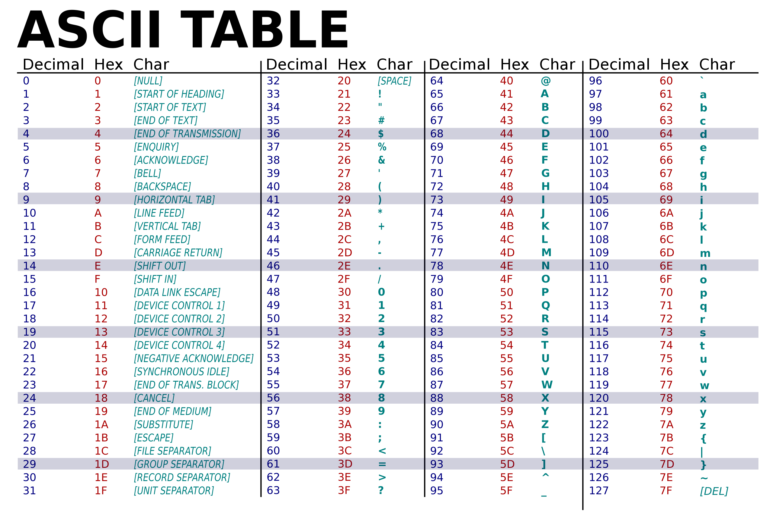
Notes:
- ASCII character table.
- Contains non-printable characters.
- Only uses numbers from 0 to 127 (first 7 bits of the byte).

Slide 10
Example String in Memory
What does the string “This is a test” look like in memory?
We are given a pointer to the first character of the string.
‘T’ | ‘h’ | ‘i’ | ‘s’ | ‘ ’ | ‘i’ | ‘s’ | ‘ ’ | ‘a’ | ‘ ’ | ‘t’ | ‘e’ | ‘s’ | ‘t’ | ‘\0’
0x54 | 0x68 | 0x69 | 0x73 | 0x20 | 0x69 | 0x73 | 0x20 | 0x61 | 0x20 | 0x74 | 0x65 | 0x73 | 0x74 | 0x00
Notes:
- What is the memory representation of the string “This is a test”?
- We refer to the string by a pointer.
- Top row shows the character.
- Bottom row shows the ASCII hex representation.
- String is terminated by the null character.

Slide 11
String Search
String search in this lab:
String search finds the locations of a query string in a search string.
Can be case sensitive, or case insensitive. This lab will be case sensitive.
Instead of returning all the locations separately, we will return their sum.
Note that the first character in the string has index 0.
Notes:
- String search
- String search finds the locations of input query string in an input search string.
- Search is case sensitive in this lab. (Eg: ‘a’ != ‘A’)
- Instead of returning all locations separately, we will return their sum.
- The first character of the string has index 0.

Slide 12
Example String Search
Consider searching for the string “young” in the following string:
S | h | e |  | w | a | s |  | y | o | u | n | g |  | t | h | e |  | w | a | y |  | a | n |  | a | c | t | u | a | l |  | y | o | u | n | g |  | p | e | r | s | o | n |  | i | s |  | y | o | u | n | g
Match at 8
Match at 32
Match at 48
We have matches at indices 8, 32, and 48. Since 8 + 32 + 48 = 88, the result of the search is 88.
Notes:
- Consider the following search for “young”:
- Match at 8
- Match at 32
- Match at 48
- Result is the sum of the match locations, and 8 + 32 + 48 = 88, which is the result.

Slide 13
Assignment
CMPUT 229
Notes:
This section describes the requirements for the lab.

Slide 14
Overview of the lab
Overview:
In this lab, you must implement a single function to perform the described string search operation.
No other functions are needed.
Notes:
- Only have to implement a single function performing string search.

Slide 15
stringSearch
Description:
This function computes the sum of all indices of the query string in the search string.
Parameters:
a0: Pointer to the query string.
a1: Pointer to the search string.
Return Value:
a0: Sum of the indices
Notes:
- Is the “main” function (entry point).
- Takes in a query string and a search string.
- Returns the sum of the indices of all the matches of the query string in the search string.

Slide 16
Testing
CMPUT 229
Notes:
- Overview of how to test your lab.
- How to create test files.
- How to run a test.

Slide 17
Testing your Solution
Give file path as program arguments:
Make sure the test file has the correct format (Next slide).
RARS may need the full path to the test file.
Notes:
- Some included tests, these tests are in the correct format.
- To test your solution, give the path to the test file in the program arguments.

Slide 18
Format of the Test File
A test file contains an input to stringSearch:
The file must have two lines, both of which are ASCII strings.
The first line is the query string.
The second line is the search string.
Notes:
- Test file has two lines, each with a number
- Trailing newline can be present or not.

