Slide 1
Lab #3: BCD Multiplcation
CMPUT 229

Slide 2
Background
CMPUT 229
Notes:
This section introduces concepts required for the lab.

Slide 3
What is Binary Coded Decimal (BCD)?
Alternative encoding system:
Instead of representing numbers in binary, represent each decimal digit separately.
Each decimal digit is represented in 4 bits.
BCD encoded digits are identical to the binary encoding but are truncated to 4 bits.
0 | 0000 | 5 | 0101
1 | 0001 | 6 | 0110
2 | 0010 | 7 | 0111
3 | 0011 | 8 | 1000
4 | 0100 | 9 | 1001
Notes:
- BCD is an alternative method for encoding integers
- Encodes each digit separately
- Represent the digits from 0-9 in 4 bits
- Same encoding as the lowest 4 bits of binary encoding
- Some space is wasted (Doesn’t use 0xa - 0xf)

Slide 4
Why do we care about BCD?
Arbitrarily large numbers:
A processor can only perform arithmetic on certain builtin types.
32-bit RISC-V only supports 32-bit integers and 32-bit floats .
We can represent arbitrarily large numbers precisely with BCD.
Control over precision and rounding:
Floating point rounding can cause many issues.
Financial and business applications require strict rounding.
Notes:
- BCD can represent integers exactly.
- Not a built-in type, so we must implement the operations (addition, multiplication, etc.) ourselves.
- Strict control over rounding is important to financial / business applications, (eg. Prices, money transfers). Can also be regulated by law.

Slide 5
Variable Length BCD Format
Why is this format needed?
A single BCD digit can only store the numbers from 0 to 9.
If we want to store larger numbers we can use multiple digits.
The digits must be stored in some standardized format.
Description of the format:
Numbers are encoded as arrays of bytes, with two BCD digits per byte.
The digit with the lower place value is stored in the lower nibble of the byte, while the digit with the higher place value is stored in the higher nibble.
The lowest byte contains the lowest two digits, and so on.
The number is terminated with the value 0xc, stored one nibble higher than the last digit.
Numbers contain no leading 0’s, except of the number 0, which is encoded as 0xc0.
Notes:
- To represent larger numbers, we store more than one digit.
- Need a standard format for interoperability.

Slide 6
BCD Format Examples
46734
334585
7
Low:
Low:
Low:
0x34
0x67
0xc4
0x85
0x45
0x33
0x0c
0xc7
High:
High:
High:
Notes:
- Low bytes at the top.
- Higher bytes as we go down.
- Number 46734:
- Lowest is 4 -> lowest nibble
- Next is 3 -> high of low byte
- Next is 7 -> low nibble of next byte
...
- Terminated by 0xc in the high nibble
- Number 334585:
- Lowest is 5 -> lowest nibble of first byte
- Next is 8 -> high nibble
...
- Terminated with 0xc, even number of digits, goes in the next byte.
- Number 7:
- Single digit 7 in first nibble
- 0xc in the high nibble

Slide 7
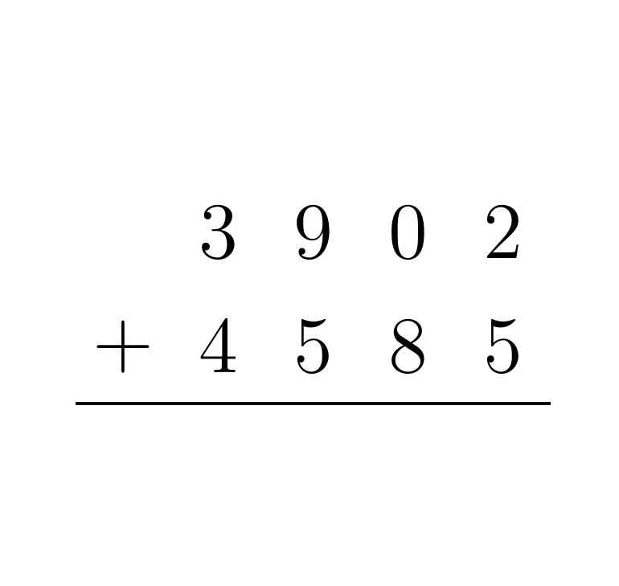
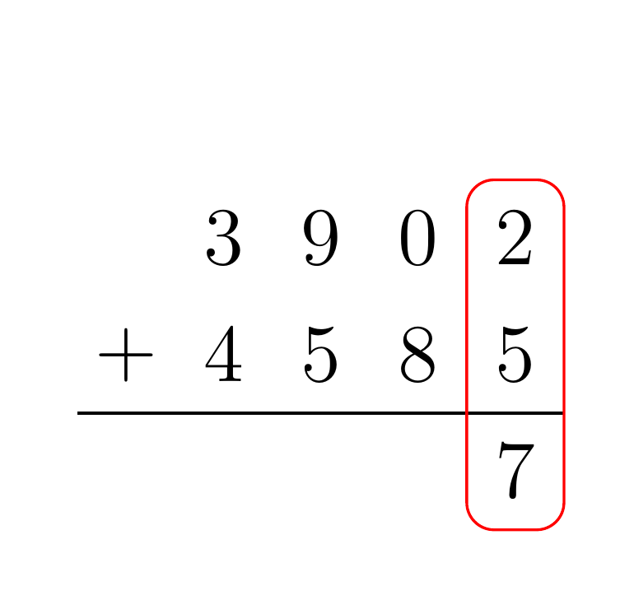
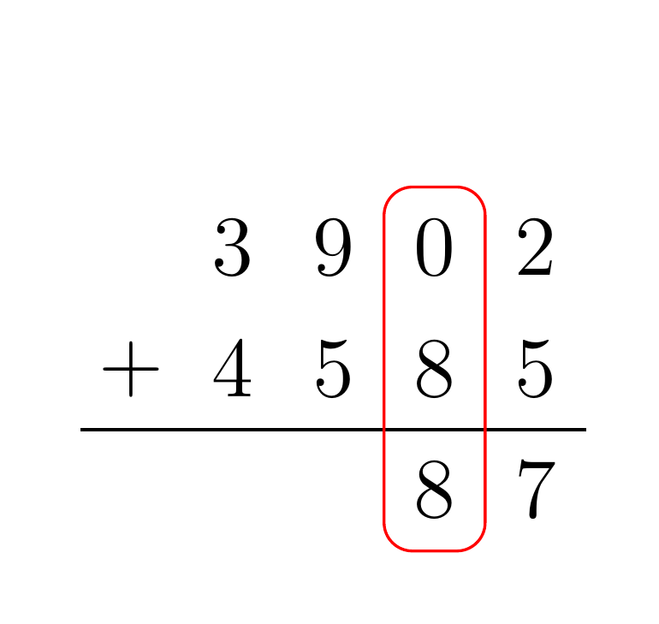
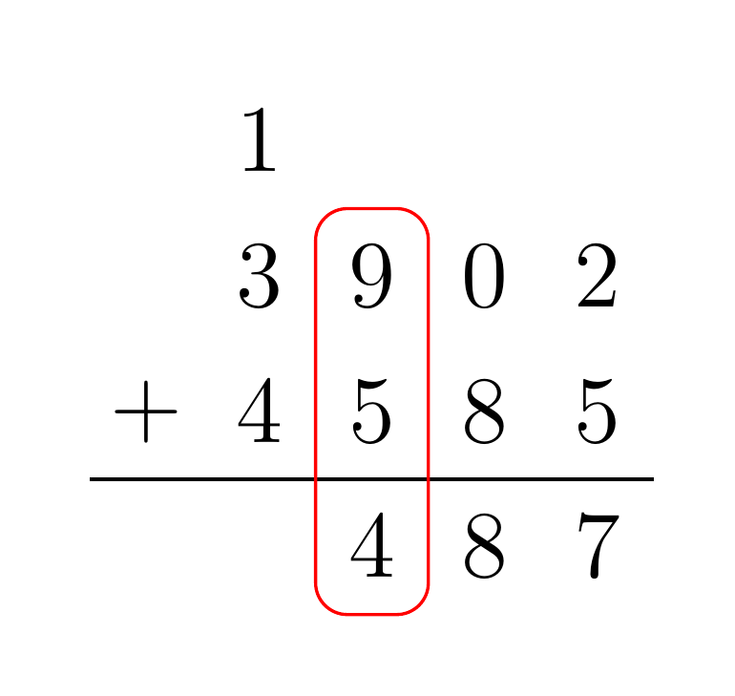
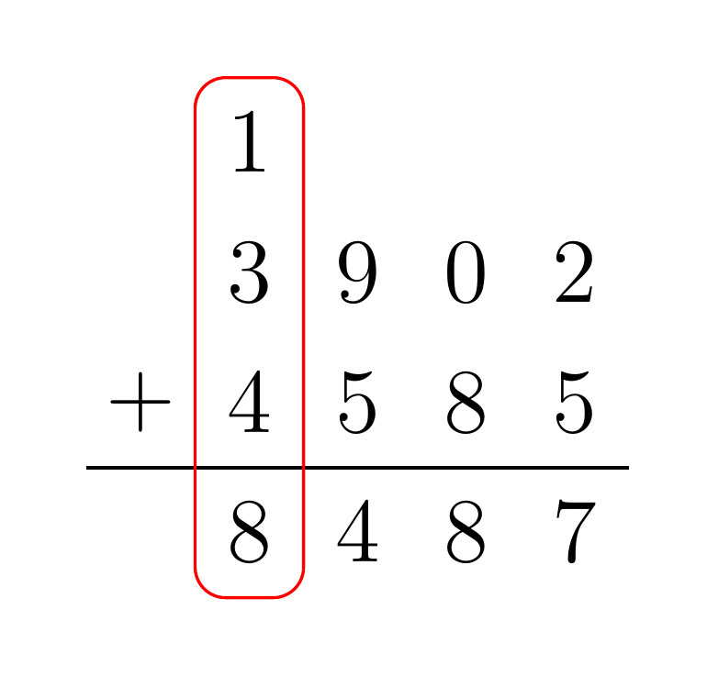
Addition algorithm
Informal description:
Assume input numbers A and B
Sum each digit pair, starting from the lowest pair.
If a number becomes larger than 10, split the number by place value and set the current result to the digit with the lower place value. Then propogate the digit with the higher place value so it is included in the next addition.
Notes:
- First column sums to 7, write that into the result.
- Next column sums to 8, write.
- Next column sums to 14, carry of 1, write 4 to result.
- Next column sums (with carry) to 8, write.

Slide 8
Multiplication algorithm
Informal description:
Assume input numbers A and B.
For each digit of B, multiply that digit by each digit of A.
Shift the partial product by the place value of the digit of B. As in, the first product should not be shifted, the should be by 1 to the left and so on.
Add the shifted partial products.
Hints:
You may find the RISC-V multiplication, division, and remainder instructions useful.

Slide 9
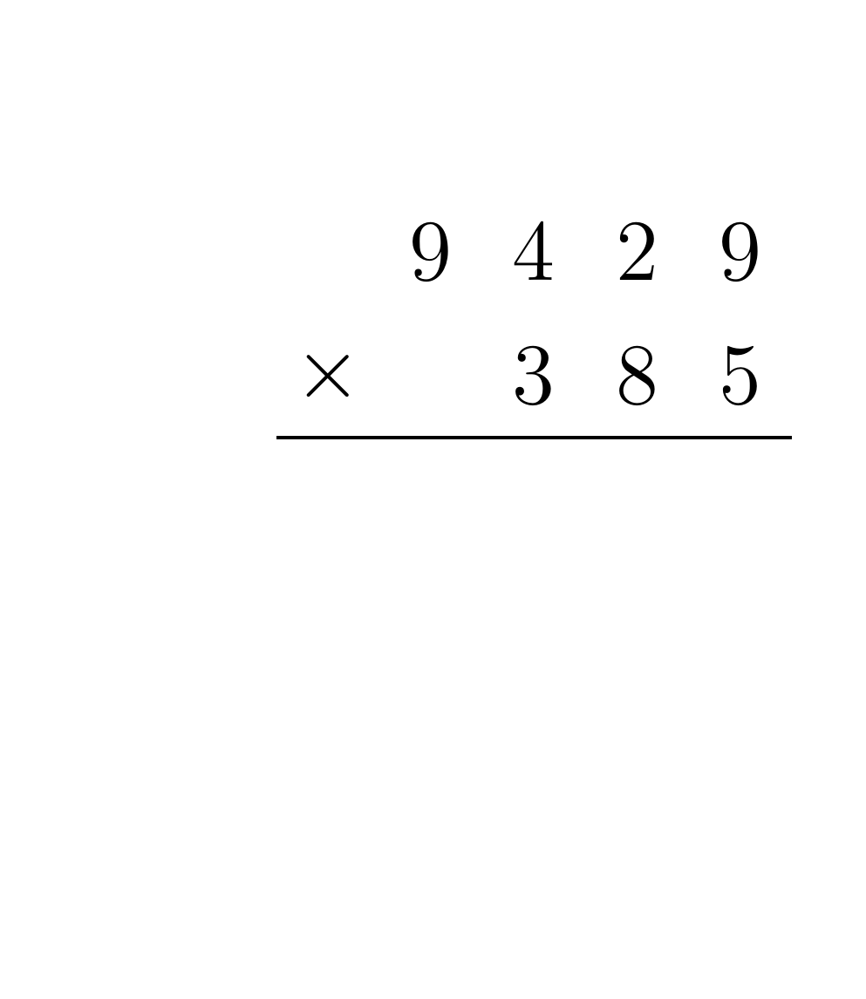
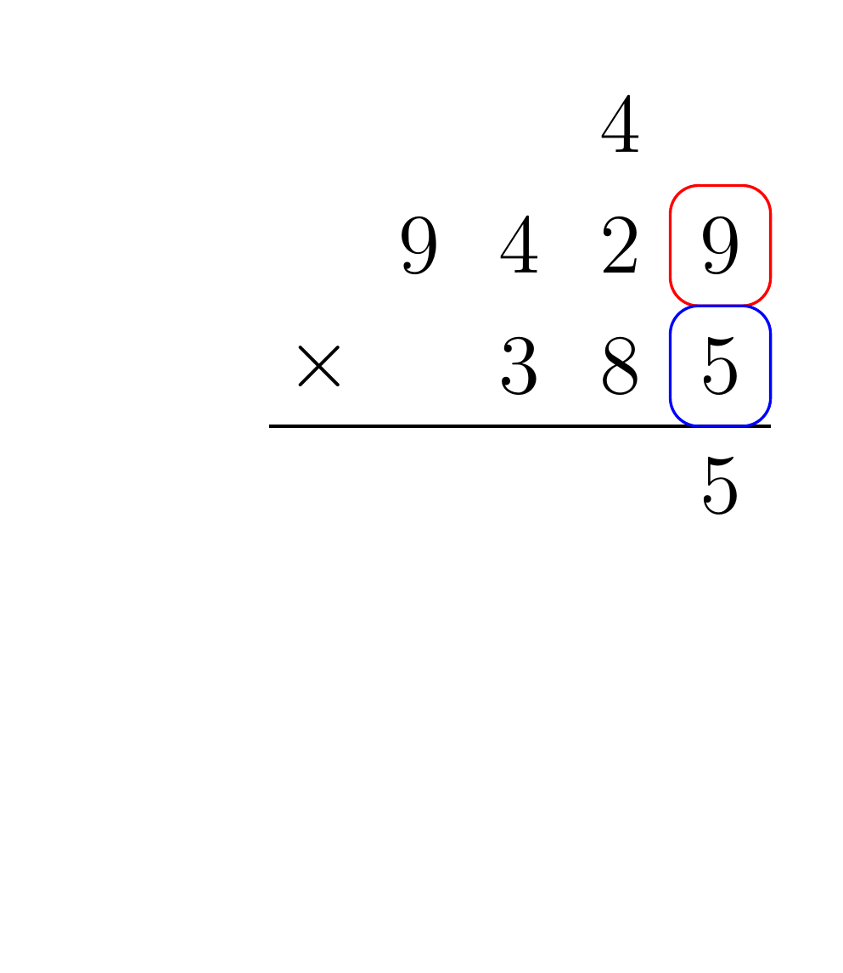
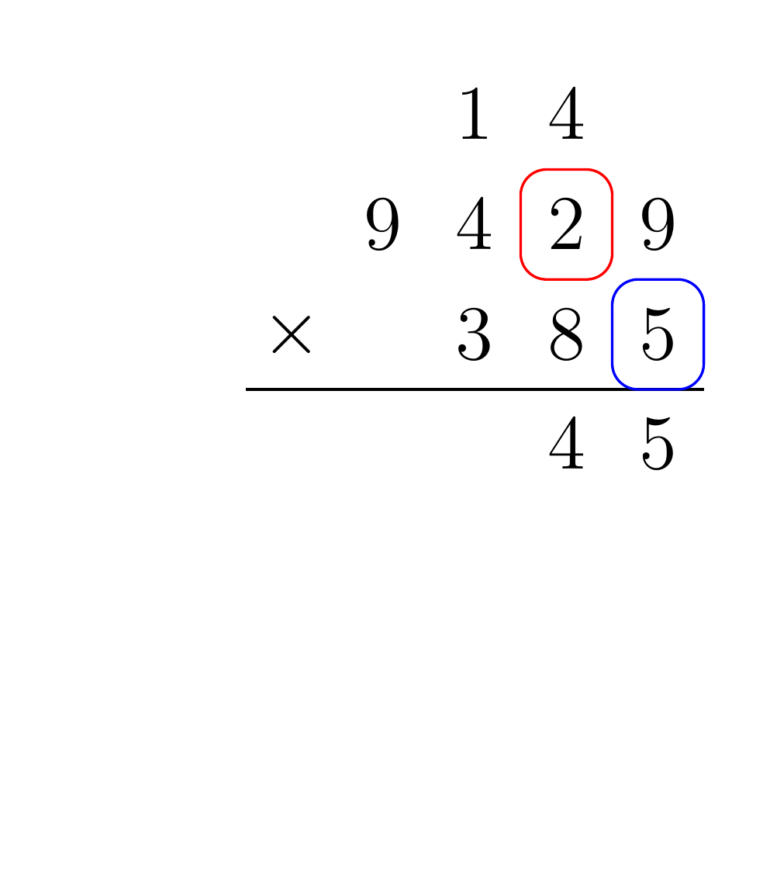
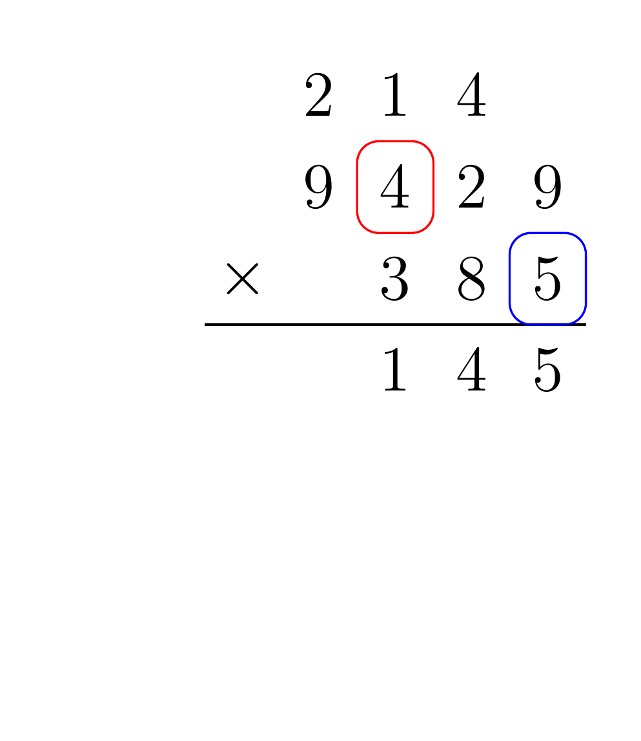
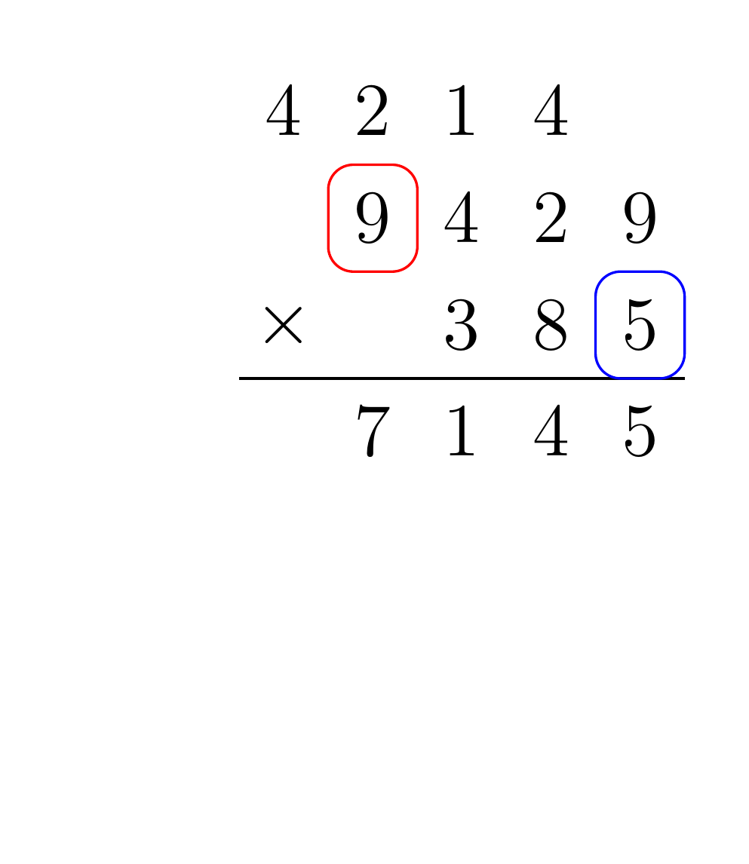
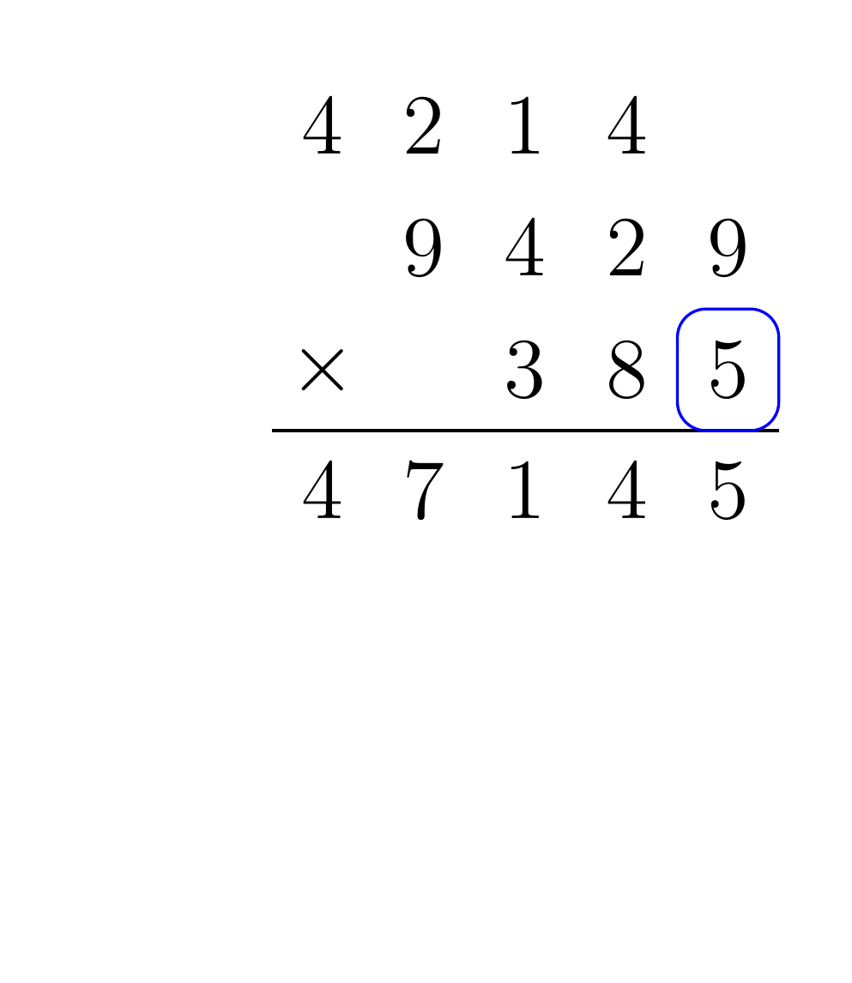
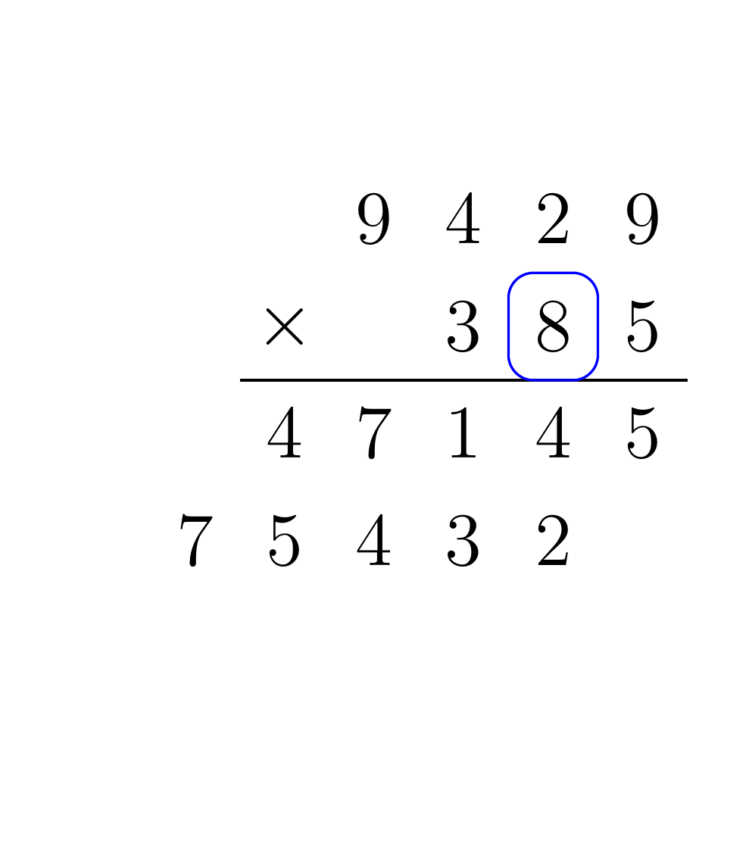
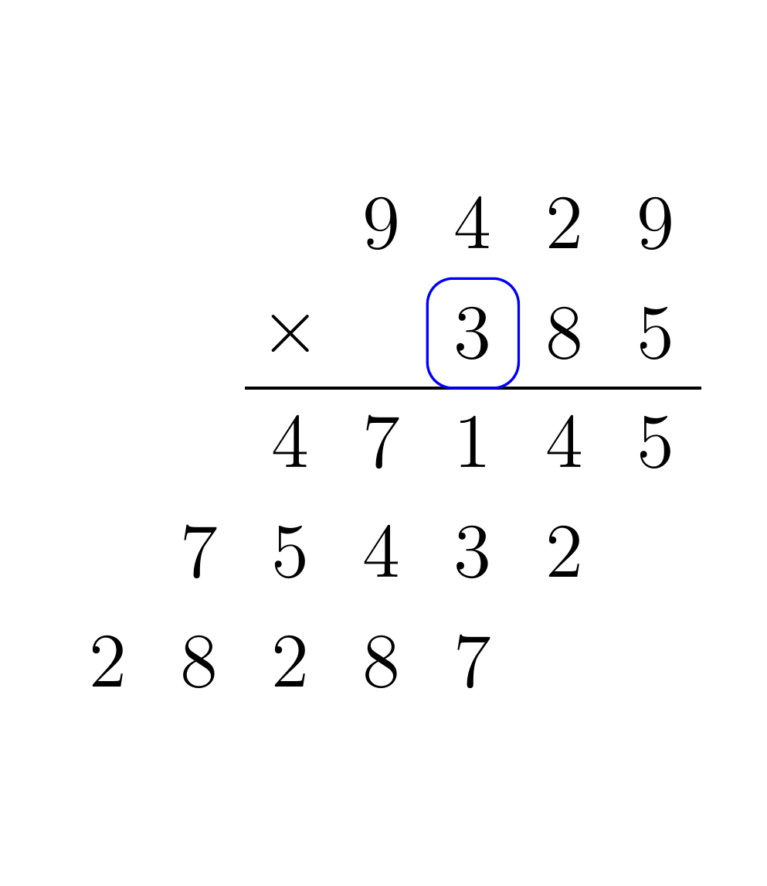
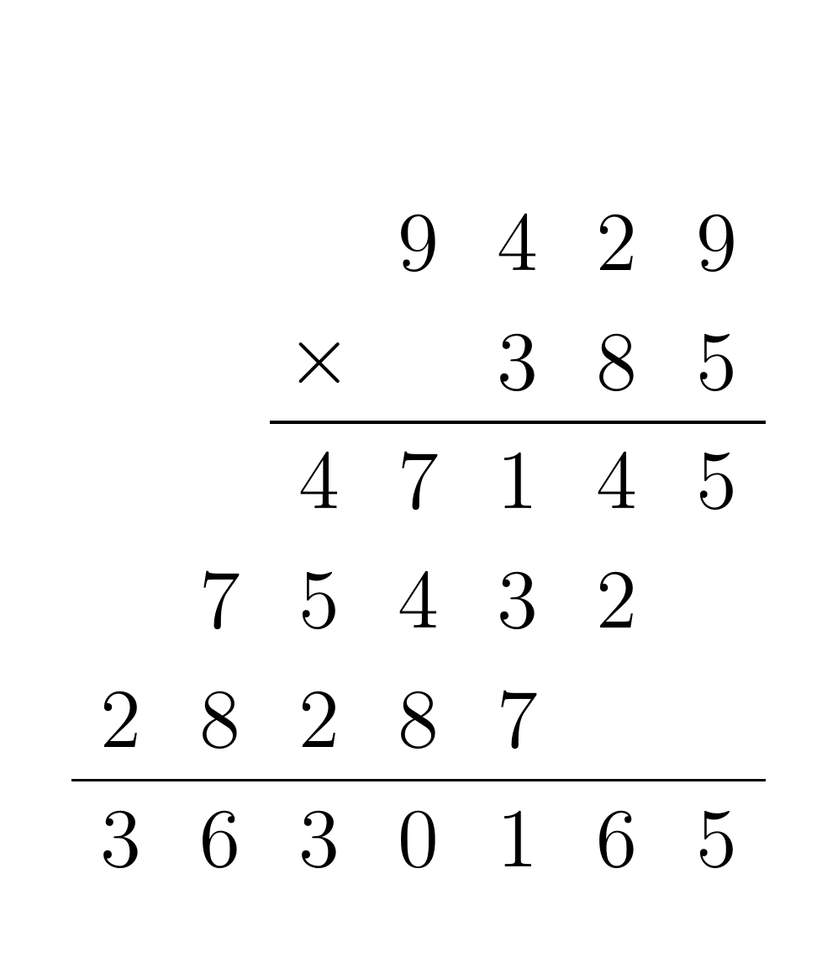
Multiplication Example
Notes:
- Example multiplication of 9429 by 385.
- Multiply top number by 5.
- Add this partial product to the result.
- Repeat for all digits in the bottom.
- Partial products are all summed.

Slide 10
Helper Functions
CMPUT 229
Notes:
- Introduction to the given helper functions

Slide 11
Helper Functions
Included Functions
We have included some functions to operate on binary BCD numbers.
These functions can get and set a particular digit of a binary BCD number, as well as compute the length of a binary BCD number.
Notes:
- We have included some helper functions to make it easier to operate on binary BCD numbers.
- Included functions for getting & setting digits, as well as computing the length.
- Functions are given in the common.s

Slide 12
getNth
Description:
Get the nth digit of a binary BCD number. The lowest digit has index 0.
Parameters:
a0: Pointer to a binary BCD number.
a1: Index of the digit to get.
Return Value:
a0: nth digit
Notes:
- Gets the nth digit of a binary BCD number.
- Index of the lowest digit is 0.
- Takes in a pointer to a BCD number & the index of the digit to get.
- Returns the digit.

Slide 13
getNth Example
Suppose getNth is called with the following inputs:
0x45 | 0x23 | 0xc1
a0 | 0x10001000
a1 | 1
Number is 12345
After the call, the result in a0 will be 4, since 4 is the 2nd digit.
Notes:
- Example call for getNth
- Number is 12345
- Index to get is 1
- After the call, a0 will be 4, since 4 is the 2nd digit of the input number.

Slide 14
setNth
Description:
Set the nth digit of a binary BCD number. The lowest digit has index 0.
Parameters:
a0: Pointer to a binary BCD number.
a1: Index of the digit to set.
a2: Digit to set the given index to
Return Value:
N/A
Notes:
- This function sets the nth digit of a BCD number.
- The index of the lowest digit is 0.
- Takes in a pointer to the input number, the index of the digit to set, and the digit to set the given index to.
- The input number is modified in place.

Slide 15
setNth Example
Suppose setNth is called with the following inputs:
0x45 | 0x23 | 0xc1
a0 | 0x10001000
a1 | 4
a2 | 9
Number is 12345
After the call, the BCD number at address 0x10001000 will be modified:
0x45 | 0x23 | 0xc9
Number is 92345
Notes:
- Example call of setNth with input number 12345, index 4, and digit 9.
- After the call, the 4th digit is set to 9, leading to the number 92345.

Slide 16
length
Description:
Get the length of a binary BCD number, including the terminating character.
Parameters:
a0: Pointer to a binary BCD number.
Return Value:
a0: Length of the input number
Notes:
- Finds the length of an input binary BCD number.
- Terminator character (0xc) is included in the count.
- Takes in a pointer to a binary BCD number.

Slide 17
length Example
Suppose length is called with the following inputs:
0x45 | 0x23 | 0xc1
a0 | 0x10001000
Number is 12345
After the call, a0 will have the value 6. This is becuase the input number has 5 digits, and the terminator is counted.
Notes:
- Example call to length with input number 12345.
- Length is 6, since there are 5 digits, and 5 + 1 = 6.

Slide 18
Assignment
CMPUT 229
Notes:
- High-level overview of the assignment.
- List of required functions.

Slide 19
Overview of the lab
Overview:
In this lab, you must implement addition and multiplication of BCD numbers, using the given format.
Additionally, you must write small functions to read from a string to the BCD format, and to print a BCD number.
Notes:
- Implement multiplication & addition algorithm for BCD numbers.
- Overall, takes in two strings & prints the product to standard out.
- Must implement supporting functions.

Slide 20
mulBCD
Description:
This function takes two BCD numbers A and B, and prints their product. Internally, the multiplication must be performed on binary BCD numbers.
Parameters:
a0: Pointer to an ASCII encoded integer (A).
a1: Pointer to an ASCII encoded integer (B).
Return Value:
N/A
Notes:
- Is the “main” function (entry point).
- Takes in two numbers as strings using the standard method.
- Prints the product.

Slide 21
mulBCD Example
Suppose mulBCD is called with the following inputs, with ‘1’ representing the ASCII character of “1”:
a0 | 0x10001000
a1 | 0x10001010
‘4’ | ‘6’ | ‘7’ | ‘3’ | ‘4’ | 0x00
‘3’ | ‘9’ | ‘1’ | 0x00
mulBCD should print the product of 46734 and 391, which is 18272994.
Notes:
- Suppose mulBCD is called with the given a0 & a1.
- Strings give the numbers 46734 & 391.
- Product of the numbers is 18272994.
- Product should be printed.

Slide 22
addBCD
Description:
This function adds two BCD numbers and writes the result to a buffer. The sum is stored as a binary BCD number.
Parameters:
a0: Pointer to the first operand in binary BCD format.
a1: Pointer to the second operand in binary BCD format.
a2: Pointer to the result buffer
Return Value:
N/A
Notes:
- Adds two numbers.
- Numbers are encoded in the BCD format, not as strings like in mulBCD.
- Takes in pointers to the two input numbers, & a buffer to write the result to.
- The result should also be written to in the BCD format.

Slide 23
readBCD
Description:
This function converts an input string into a BCD formatted number.
Parameters:
a0: Pointer to an ASCII encoded integer.
a1: Pointer to the result buffer.
Return Value:
N/A
Notes:
- This function takes a string and converts it into the BCD format.
- Should be used by mulBCD to convert from strings to BCD at the start.
- Takes in a pointer to a string, and writes the result to the given buffer.

Slide 24
readBCD Example
Suppose readBCD is called with the following inputs:
a0 | 0x10001000
a1 | 0x10001010
‘4’ | ‘6’ | ‘7’ | ‘3’ | ‘4’ | 0x00
After the call to readBCD, the memory location 0x10001010 should contain the following:
0x10001010
0x34 | 0x67 | 0xc4
Notes:
- Sample call to readBCD.
- a0: Pointer to input number.
- a1: Empty buffer.
- After the call 46734 is written into the buffer.

Slide 25
printBCD
Description:
This function prints a BCD number to standard output. A newline should be printed after the number.
Parameter:
a0: Pointer to an integer in binary BCD format.
Return Value:
N/A
Notes:
- Prints a BCD formatted number to standard out.
- Takes in a pointer to the number.
- Should print a newline after.

Slide 26
What to submit?
Submit a single file multiplyBCD.s.
Make sure to push your changes before the assignment deadline.
Notes:
- Edit the file given from the repository.
- File already has the 4 function definitions.
- Don’t create other assembly files.
- Make the final version on Github is what you want.

Slide 27
Testing
CMPUT 229
Notes:
- Overview of how to test your lab.
- How to create test files.
- How to run a test.

Slide 28
Testing your Solution
Included tests:
We have provided some test inputs and outputs.
Tests are stored in the “Tests” directory. *.txt files correspond to the inputs, while *.out files are the expected outputs.
Give file path as program arguments:
Give the path to the *.txt file in the program arguments.
Make sure the test file has the correct format (Next slide).
RARS may need the full path to the test file.
Notes:
- Some included tests, these tests are in the correct format.
- To test your solution, give the path to the test file in the program arguments.

Slide 29
Format of the Test File
A test file contains an input to mulBCD:
The file must have two lines, each with a number.
The numbers in a test file must be valid inputs as given by the specification.
Notes:
- Test file has two lines, each with a number
- Trailing newline can be present or not.

