Slide 1
Cache Simulator
CMPUT 229 Lab 3
Author: Max Leontiev

Slide 2
Introduction
Lab solution simulates a two-way set associative cache
Simulates updates to LRU bits, valid bits, tags
Tracks number of hits and misses, logging them as they occur
Input: list of memory accesses (loads/stores with addresses)
Represents accesses that a program performs during its runtime
Output: each hit and miss is logged, and the total number of hits, misses, and hit rate is printed at the end of the simulation
Goal: understand how caches work

Slide 3
Background

Slide 4
Locality
Programs perform many (billions!) of memory accesses during runtime, but …
Principle of locality: At any instant in time, programs only access a small subset of available memory
Temporal locality (locality in time): If an item is referenced, it is likely to be referenced again soon
Spatial locality (locality in space): If an item is referenced, items whose addresses are close by are likely to be referenced soon

Slide 5
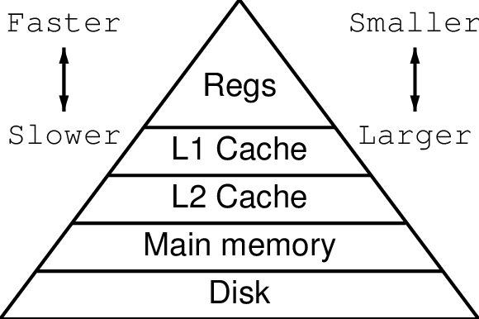
Memory Hierarchy
Memory hierarchy uses principle of locality to provide fast access to memory (on average), while minimizing hardware cost
Memory Hierarchy (textbook definition): A structure that uses multiple levels of memories; as the distance from the processor increases, the size of the memories and the access time both increase while the cost per bit decreases.
Higher $/bit
Smaller
Faster
Larger
Lower $/bit
Slower
Image source: https://cgi.cse.unsw.edu.au/~reports/papers/0321.pdf

Slide 6
Cache Memory
Cache Memory: High-speed memory that is small in size (on the order of KB or MB) and high in the memory hierarchy
Stores a subset of main memory data that processor is likely to need soon
May store data that has recently been written, depending on caching scheme
Block AKA line: Unit of transfer between levels of hierarchy
Consists of multiple (eg. 4) words
Block size: Number of words/block

Slide 7
Cache Hits and Misses
Cache hit: When processor finds requested data in the upper level of memory hierarchy
Cache miss: When processor does not find requested data in upper level of memory hierarchy
Requested data must be fetched from a lower level
Hit rate: Fraction of memory accesses satisfied by upper level
Example: 95% L1 (level 1) cache hit rate
95% of memory accesses satisfied by L1 cache
Requests to lower level in hierarchy are required for remaining 5% of memory accesses
Miss rate: Fraction of memory accesses not satisfied by upper level
Miss rate is 1 - hit rate; if hit rate is 95%, miss rate is 5%

Slide 8
Cache Organization

Slide 9
Associativity
Associativity: Number of locations in the cache where a given block of memory can be stored
In an n-way set associative cache, each memory address maps to a set of blocks in the cache, and the data at that address can be in any of the blocks in the set
Each set contains n blocks, also known as ways
This lab simulates a two-way set associative cache
Cache consists of many sets which each contain two blocks

Slide 10
Finding an address in a set associative cache
Address of access is split up into the tag, index, and offset
Index identifies set that requested address maps to
Tag is used to look over the blocks in the set and determine if there is valid data in the cache for the requested address
Each block has a valid bit which is 1 if block contains valid data
Cache hit occurs if valid bit of block is 1 and tag of block matches tag of access
Offset is used to identify where requested word is located within the block by acting as a byte offset from the beginning of the block
If word size is 4 bytes, then offset = 0 corresponds to first word in block, offset = 4 corresponds second word in block, etc.

Slide 11
Finding an address in a set associative cache: example
Example: 32 KB 2-way set associative cache with block size of 4 on 32-bit machine
18 tag bits, 10 index bits, 4 offset bits (see lab description for how to calculate this)
Request address: 0xB1E2E3F4
1011 0001 1110 0010 11
10 0011 1111
0100
Tag
(bits 31-14)
Index
(bits 13-4)
Offset (bits 3-0)

Slide 12
Replacement Policy
Capacity of cache is a lot smaller than main memory
Data in cache must occasionally be replaced with data that is needed in the moment
Replacement policy is used to decide which data to replace
Least-Recently Used (LRU) replacement policy: Replace blocks that were used (read/written to) least recently
According to principle of temporal locality, most recently used blocks are likely to be used again soon, so keep them in the cache
This is the policy used in this lab

Slide 13
LRU Replacement Policy Implementation
In an n-way set associative cache, implementing an LRU replacement policy requires a mechanism to keep track of which of the n ways in a set was used least recently
When a new block is fetched into that set, the least-recently used block in the set is replaced
In a two-way set associative cache (like in this lab), the LRU policy is implemented with a single LRU bit for each set that indicates which of the blocks in the set was used least recently
If block 0 was used least recently, LRU bit is 0
If block 1 was used least recently, LRU bit is 1

Slide 14
Write Strategy
Write strategy: Policy for dealing with writes (stores)
Write hit: When processor writes to a block that is in the cache
Write miss: When processor writes to a block that is not in the cache
In this lab:
The write-back policy is used on a write hit
The write-allocate with write-back policy is used on a write miss

Slide 15
Write Strategy (on a hit): the write-back policy
Processor
Dirty bit:
indicates
line is dirty
Only write to cache
Cache
Must write-back to memory when entry is evicted
Memory
Cache line copy
in memory is stale

Slide 16
Write Strategy (on a miss): write-allocate with write-back
Processor
Now line is dirty
Processor issues write
Cache
But line is not in the cache
Cache line copy
in memory is stale
Memory
Must fetch line from memory
And then write on it

Slide 17
Your Task: Creating a Cache Simulator

Slide 18
Cache Simulator
This lab consists of implementing four functions that simulate a two-way set associative cache given a list of requests (loads/stores with addresses):
simulateCache
simulateRequest
simulateHit
simulateMiss
These functions use the requests, tags, and meta_bytes arrays provided by common.s
Notes:
The requests, sets, and meta bytes arrays will be described later.

Slide 19
simulateCache
# -----------------------------------------------------------------------------
# simulateCache:
#
# Simulates a two-way set associative cache.
#
# simulateCache must loop over the requests array, calling simulateRequest
# for each request and counting the number of hits and misses that occur.
# simulateCache must return the total number of hits and the total number of
# misses.
#
# Args:
# a0: N, the number of requests to memory in the input
#
# Returns:
# a0: the total number of hits that occurred
# a1: the total number of misses that occurred
#
# Register usage:
# insert your register usage for this function here
# -----------------------------------------------------------------------------
Loops over requests array
Calls simulateRequest for each request
Counts number of hits and misses that occur using simulateRequest return value
Returns total number of hits and total number of misses
Notes:
The students will have to read the full headers themselves when they read the lab description.
Do not read the whole function header when presenting, just read the summary on the side (same for the slides for the other functions).

Slide 20
simulateRequest
# -----------------------------------------------------------------------------
# simulateRequest:
#
# Simulates a single request, given a pointer to a request in the REQUESTS
# array. First, simulateRequest must call getTag, getIndex, and getOffset to
# get the tag, index, and offset of the requested address.
#
# Then, simulateRequest must determine if the request is a hit or a miss by
# comparing the tag of the requested address with the tags of the valid blocks
# in the set at the index of the requested address. If block 0 is valid (the
# valid0 bit is 1) and the tag of block 0 matches the tag of the requested
# address, then there is a hit on block 0. Similarly, if block 1 is valid
# (the valid1 bit is 1) and the tag of block 1 matches the tag of the
# requested address, then there is a hit on block 1. Otherwise, the request
# results in a miss.
#
# If the request results in a hit, simulateRequest must call simulateHit and
# return 1. If the request results in a miss, simulateRequest must call
# simulateMiss and return 0.
#
# Args:
# a0: pointer to a request in the requests array
#
# Returns:
# a0: 1 if the request resulted in a hit, 0 if the request resulted in a miss
#
# Register usage:
# insert your register usage for this function here
# -----------------------------------------------------------------------------
Determines if request is a hit or miss
Calls simulateHit or simulateMiss accordingly
Returns 1 if request resulted in a hit, 0 if request resulted in a miss

Slide 21
simulateHit
# -----------------------------------------------------------------------------
# simulateHit:
#
# Given the block that the hit occurred on (block 0 or block 1),
# simulateHit must set the LRU bit to the opposite block (if the hit was on
# block 0, the LRU bit should be set to 1; if the hit was on block 1, then the
# LRU bit should be set to 0).
#
# If the request was a load, the dirty bit of the requested block must be left
# unchanged. If the request was a store, then simulateHit must set the dirty
# bit of the requested block to 1.
#
# simulateHit must call logHit to print information about the hit.
#
# Args:
# a0: 0 if the request is a load, 1 if the request is a store
# a1: tag of the requested address
# a2: index of the requested address
# a3: offset of the requested address
# a4: pointer to meta_bytes[index]
# a5: 0 if the hit is on block 0, 1 if the hit is on block 1
#
# Register usage:
# insert your register usage for this function here
# -----------------------------------------------------------------------------
Simulates a cache hit
Updates LRU bit
Sets dirty bit to 1 if request was a store
Calls logHit helper function to print information about the hit

Slide 22
simulateMiss
# -----------------------------------------------------------------------------
# simulateMiss:
#
# simulateMiss must determine which block to replace by checking the LRU bit
# of the set (if the LRU bit is 0, replace block 0; if the LRU bit is 1,
# replace block 1). Then, simulateMiss must check the valid bit and dirty bit
# of the replaced block to determine if a write-back should occur (if the
# valid bit is 1 and the dirty bit is 1, then write-back; otherwise, don't
# write-back).
#
# simulateMiss must set the dirty bit of the replaced block to
# 0 if the request is a load or 1 if the request is a store.
#
# simulateMiss must call logMiss to print information about the miss and
# whether or not a write-back occurred.
#
# simulateMiss must replace the tag of the replaced block with the tag of the
# request, and set the valid bit of the replaced block to 1. Lastly,
# simulateMiss must update the LRU bit of the set to the non-replaced block
# (if block 0 was replaced, then the LRU bit should be set to 1; if block 1
# was replaced, then the LRU bit should be set to 0).
#
# Args:
# a0: 0 if the request is a load, 1 if the request is a store
# a1: tag of the requested address
# a2: index of the requested address
# a3: offset of the requested address
# a4: pointer to tags[index]
# a5: pointer to meta_bytes[index]
#
# Register usage:
# insert your register usage for this function here
# -----------------------------------------------------------------------------
Simulates a cache miss
Checks LRU bit to determine which block to replace
Checks valid and dirty bit of replaced block to determine if write-back occurs
Calls logMiss helper function to print information about the miss
Sets dirty bit of replaced block to 0 if request was load, 1 if request was store
Replaces tag of block with tag of request
Sets valid bit of replaced block to 1
Updates LRU bit
Notes:
This function is the hardest part of the lab, because the logic and bit manipulation for updating the valid/LRU/dirty bits and tag is relatively complex.

Slide 23
Recommended lab completion flow
Implement simulateCache
Not too hard, just a loop over the REQUESTS array
Implement simulateRequest
A bit more difficult, requires checking the tags in the set at the index of the requested address to determine if hit or miss
Implement simulateHit
Simpler than simulateMiss, so implement it first
Implement simulateMiss last
Most complicated part of the lab (will take the most time)

Slide 24
Tips for completing the lab
Carefully read the function headers! This will save you time!
This includes the functions you have to implement, as well as helper functions
Use the helper functions:
logHit for printing information about a cache hit
logMiss for printing information about a cache miss
getTag for getting the tag of an address
getIndex for getting the index of an address
getOffset for getting the offset of an address
A correct lab solution must call logHit and logMiss to print required output
Don’t forget to fill out the register usage section in the header of all four functions that you implement
Notes:
The headers for each function describe the logic in detail. Students don’t have to figure it out themselves!

Slide 25
Data Structures

Slide 26
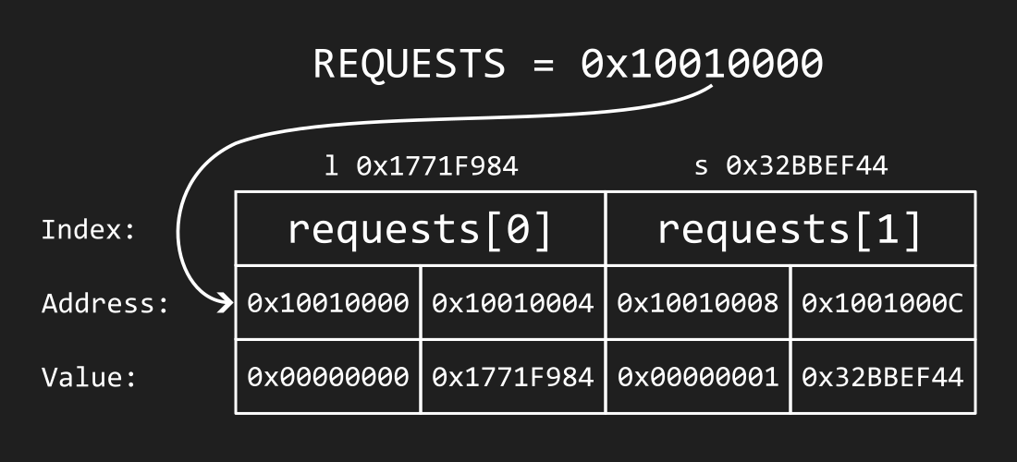
requests array
Example: load_and_store.txt test case consists of two requests:
l 0x1771F984
s 0x32BBEF44
Assuming REQUESTS = 0x10010000,the requests array would look like this:
Contains information about each request passed as input
Initialized by common.s
REQUESTS global variable points to base address of the array
la t0, REQUESTS
Each request is represented by two 32-bit words:
0 if the request is a load, 1 if the request is a store
The requested address
Notes:
The student’s solution should never write to this array.

Slide 27
tags array
Contains tags for the blocks in each set
Initialized to 0 by common.s
TAGS global variable points to base address of the array
la t0, TAGS
Each element tags[i] of the tags array consists of two 32-bit words:
Tag of block 0 in the set with index i
Tag of block 1 in the set with index i
Lab solution must update the tags in the tags array when simulating a cache miss
Notes:
The least significant NUM_TAG_BITS bits of the tag words contain the tags, and the remaining bits are 0 (the tag can never be 32 bits because there are a non-zero number of index and offset bits).

Slide 28
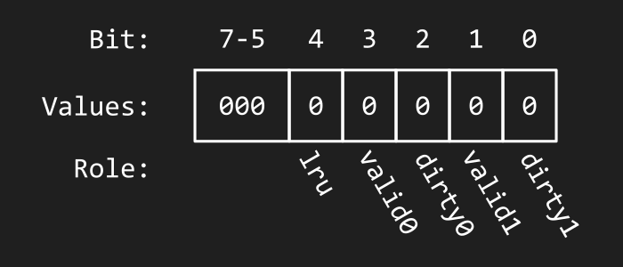
meta_bytes array
Contains LRU bits for each set, and valid and dirty bits for each block
Initialized to 0 by common.s
META_BYTES global variable points to base address of the array
la t0, META_BYTES
Each element of meta bytes array is a meta byte, where:
Bits 7-5 are not used
Bit 4 is the LRU bit for the set
Bit 3 is the valid bit for block 0
Bit 2 is the dirty bit for block 0
Bit 1 is the valid bit for block 1
Bit 0 is the dirty bit for block 1
Notes:
The illustration shows a meta byte that has been initialized to 0. Every meta byte in the array looks like this before the lab solution is called.

Slide 29
Testing and Final Remarks

Slide 30
Test case format
A small number of tests are provided in the Tests directory
The provided tests are not extensive: you should create your own tests to ensure that your solution is correct
Expected output for the test files is given in the *.out files
The format of the test input (*.txt) files is as follows:
[N (# of requests)] [S (# of sets)]
[# of tag bits] [# of index bits] [# of offset bits]
[request 1]
[request 2]
⋮
[request N]

Slide 31

Running a test
To run a test, provide test file as a program argument to RARS
Program arguments must be enabled using pa flag if running test via terminal, or RARS graphical interface if running test with RARS
Example: To run the load_and_store.txt test case:
rars cacheSimulator.s nc pa Tests/load_and_store.txt
Or, using the RARS graphical interface, enter the path in the program arguments field before assembling and running the program:
Notes:
See lab description for how to enable program arguments in the RARS GUI.

Slide 32
Final Remarks
Read the lab description carefully!
Watch the videos in the lab description!
Create your own test cases for edge cases
Pay attention to the Testing section and the Assumptions and Notes section in the lab description to create valid test cases
Read the marksheet (link in the Marking Guide section of lab description) to see how your lab will be graded
Don’t be afraid to ask questions
Style marks are an easy 20%

