Slide 1
Introduction to Lab Data Compression
José Nelson Amaral

Slide 2
Data Compression
Converting data into a smaller form for storage or transmission
Lossy Compression
Lossless Compression

Slide 3
Dictionary Compression
Lossless compression
Method of reducing redundancy in data
Copies common patterns in a data structure called a dictionary
Replaces occurrences of those patterns with a small reference to the dictionary element containing the full copy

Slide 4
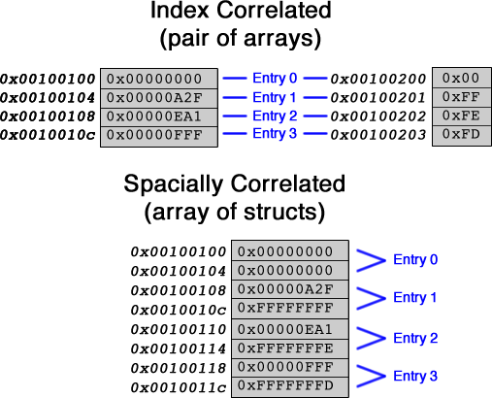
Tables in Memory
Notes:
This lab requires an index correlated solution
While it would be possible to design this lab using spacially correlated tables, it would be less efficient because one table contains words and the other contains bytes
4

Slide 5
Input
An array of words stored in memory
The end of the array is signaled by a sentinel word
common.s:
reads a text file and stores in memory as an array of words
passes address of first word to buildTables and encode functions

Slide 6
Conversion of Input Text File into
Array of Words Memory
twinkle_twinkle_little_star!
Address | Word
0x10010800 | twin
0x10010804 | kle_
0x10010808 | twin
0x1001080c | kle_
0x10010810 | litt
0x10010814 | le_s
0x10010818 | tar!
0x1001081c | \0\0\0\0
Notes:
This lab takes in an input file as an argument
The common file will put the data within the file into memory and passes that to the functions that the student will write
The contents of the input file will be stored as sequences of words in memory (like an array)
In this lab, both the input and output files will end with an end-of-file sentinel word that is just a full word of zeroes, or 4 null bytes
The end-of-file sentinel word is not counted in the size of a file
It’s very important that students don’t consider sequences of characters that cross the RISC-V word boundary (like “wink”)
Each word from the input can be obtained with lw
6

Slide 7
Lab Compression Format Workflow
Input Array
Helper Tables
To be implemented in this lab
Dictionary
Encoding
Output Array
Notes:
7

Slide 8
Word Table
Stores each unique word from the input file exactly once, in the order that they first appeared in the file
twinkle_twinkle_little_star!
(Index) | Address | Word
00000000 | 0x10011000 | twin
00000001 | 0x10011004 | kle_
00000010 | 0x10011008 | litt
00000011 | 0x1001100c | le_s
00000100 | 0x10011010 | tar!
Notes:
The index column is not actually part of the table and isn’t stored in memory, it’s just a visual demonstration
The index for any word can be found by taking the address of the word, subtracting the address of the beginning of the table, and dividing by 4 since words take 4 bytes (if you don’t divide by shifting, watch out for division by zero for the first word)
The end-of-file sentinel word is not to be added to any table
8

Slide 9
Count Table
Contains the number of times that each word appears in the input
Each count is stored as a byte
Count Table is index correlated to the Word Table
twinkle_twinkle_little_star!
Word Table
Count Table
Address | Word
0x10011000 | twin
0x10011004 | kle_
0x10011008 | litt
0x1001100c | le_s
0x10011010 | tar!
(Index)
00000000
00000001
00000010
00000011
00000100
Address | Count
0x10021000 | 2
0x10021001 | 2
0x10021002 | 1
0x10021003 | 1
0x10021004 | 1
Notes:
Again, the index column is not a table nor is it stored in memory
In this example, it looks like the Count Table is sorted in non-increasing order, but this is just a coincidence. Count Table is ordered according to the ordering of the correlated words in Word Table
9

Slide 10
Dictionary
Table containing up to 128 words from the Word Table
Needs to be part of the output for decoding to be possible
To avoid taking too much space, only includes words that occur multiple times in the input
Words are picked using the Count Table
A function to build a dictionary is provided to you
twinkle_twinkle_little_star!
(Index) | Address | Word
00000000 | 0x100120fc | twin
00000001 | 0x100120fd | kle_

Slide 11
Creating the Compressed Sequence
For each word in the input
If the word does not have a copy in the dictionary, output the word as-is
If there is a copy in the dictionary, instead output a dictionary reference byte
The decompressor can tell that a byte is a reference to the dictionary because the most-significant bit (MSB) of the byte is 1.
Dictionary reference byte to index 1:
10000001
bit [7]: 1
bits [0-6]: the index in the dictionary containing the word being referenced
Notes:
Every ASCII character has a 0 in bit 7, which is how the decoder can differentiate between character bytes and dictionary reference bytes
11

Slide 12
Compressed Sequence
Input:
twinkle_twinkle_little_star!
(28 bytes)
(Index) | Address | Word
00000000 | 0x100120fc | twin
00000001 | 0x100120fd | kle_
Dictionary:
10000001
Compressed Sequence:
[ref0][ref1][ref0][ref1]little_star!
(16 bytes)
10000000
Notes:
The compressed sequence needs to include the end-of-file sentinel word found at the end of the input file
This is not counted in the size of file
12

Slide 13
Output Format
Place entire dictionary at the beginning of the output
Place a null character byte (0) to signal end of dictionary
Place the compressed sequence
Place the end-of-array sentinel word
00000000
twinkle_[null][ref0][ref1][ref0][ref1]little_star!
(25 bytes)
dictionary
compressed sequence
Notes:
(input file was 28 bytes large)
13

Slide 14
Decoding
Replace dictionary reference bytes with the referenced word in the dictionary
twinkle_[null][ref0][ref1][ref0][ref1]little_star!
twinkle_twinkle_little_star!

Slide 15
Lab Assignment
buildTables: generate word table and index-correlated count table
buildDictionary – provided to students: generates a dictionary based on the word and count tables generated in buildTables
encode: generate the output
Notes:
common.s will use the student’s functions to write two files: tables.txt which contains the result of buildTables, and encoding.txt which is the output file containing the encoding generated by the encode function
15

Slide 16
Testing
print-tables.o: prints tables generated by student solution column by column
print-encoding.o: prints encoding generated by student solution in a human-readable format
decode.o: decodes the encoding and prints it
CheckMyLab
Notes:
There are tools available to students for testing their solutions
Running these programs in the same directory as the files generated by the solution will use them as input
If the student’s solution is correct, decode.o should print the original test file
16

