Slide 1
Tokenizer
Compiler
Parser
Generator

Slide 2
Parser
Recursive Descent
Abstract Syntax Tree

Slide 3
Tokenizer
Interpreter
Evaluator

Slide 4
Evaluator
Precedence Climbing
Expression Result

Slide 5
Task:
Take a file containing an expression, return the value of the expression

Slide 6
Tokenization:
Convert string of characters to “tokens”, containing meaning in them

Slide 7
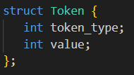

Slide 8
Expression:
3
+
5
*
2
Corresponding tokensArray:
Values:
TOKEN_INT
3
TOKEN_PLUS
TOKEN_INT
5
TOKEN_MUL
TOKEN_INT
2
TOKEN_EOE
Index:
0
1
2
3
4
5

Slide 9
Parsing:
Convert tokens to something else
In compilers, this is an AST
Useful for representing source code structure
In interpreters, this is evaluation

Slide 10
Binary Operator
Node
+
Left Node
Binary Operator
Node/Right Operand
3
*
Left Operand
Right Operand
5
2

Slide 11
+
3
*
3
+
5
*
2
5
2

Slide 12
Precedence:
Operators have precedence
Says when operator must be evaluated
Unary operators evaluated innermost to outermost
Example on webpage

Slide 13
Tokens | Precedence
TOKEN_PLUS (+) | 1
TOKEN_MINUS (-) | 1
TOKEN_MUL (*) | 2
TOKEN_DIV (/) | 2
TOKEN_BITWISE_AND (&) | 3
TOKEN_BITWISE_OR (|) | 4
TOKEN_SHIFT_LEFT (<<) | 5
TOKEN_SHIFT_RIGHT (>>) | 5
TOKEN_LOGICAL_AND (&&) | 6
TOKEN_LOGICAL_OR (||) | 7

Slide 14
Associativity:
Some operators have same precedence
Example: 1 - 2 + 3
Left-associative: parsed as (1 - 2) + 3
Right-associative: parsed as 1 - (2 + 3)
All operators are left-associative in this lab

Slide 15
Algorithm:
Pseudocode on webpage

Slide 16
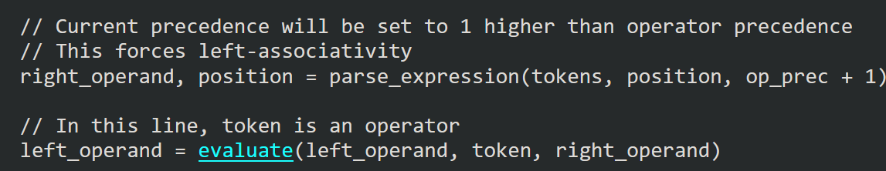
Evaluation
evaluate() section replaced by operations, in webpage

Slide 17
Functions:
parse
precedence
parse_expression
parse_factor

Slide 18
parse:
Main entry point of program
Arguments:
a0: Pointer to expression string
a1: Length of string
Returns:
a0: Result of expression

Slide 19
precedence:
Calculates precedence of an operator
Arguments:
a0: Token type
Returns:
a0: Precedence if valid operator, -1 if not

Slide 20
parse_expression:
Evaluates an expression
Arguments:
a0: Pointer to array of tokens
a1: Position in tokens array
a2: Current precedence
Returns:
a0: Result of expression
a1: Position in tokens array

Slide 21
parse_factor:
Evaluates an integer/expression with unary operators
Arguments:
a0: Pointer to array of tokens
a1: Position in tokens array
Returns:
a0: Result of integer/expression
a1: Position in tokens array

