Slide 1
Lab #3: Fractal
CMPUT 229

Slide 2
Background
CMPUT 229
Notes:
This section introduces concepts required for the lab.

Slide 3
Overview
Rendering the Mandelbrot Fractal:
In this lab you will write functions to render the Mandelbrot fractal.
The Mandelbrot fractal is definied using complex numbers.
To perform computations on complex numbers, we will have to use RISC-V’s floating point capabilities.
Rendering will be performed using the GLIR library.
Notes:
- The goal of this lab is to render a portion of the Mandelbrot fractal.
- To do this, we will need the following:
- An understanding of complex numbers, which the Mandelbrot set is defined using.
- Use the floating point capapilites of RISC-V to for complext number calculations.
- GLIR library, for graphics.

Slide 4
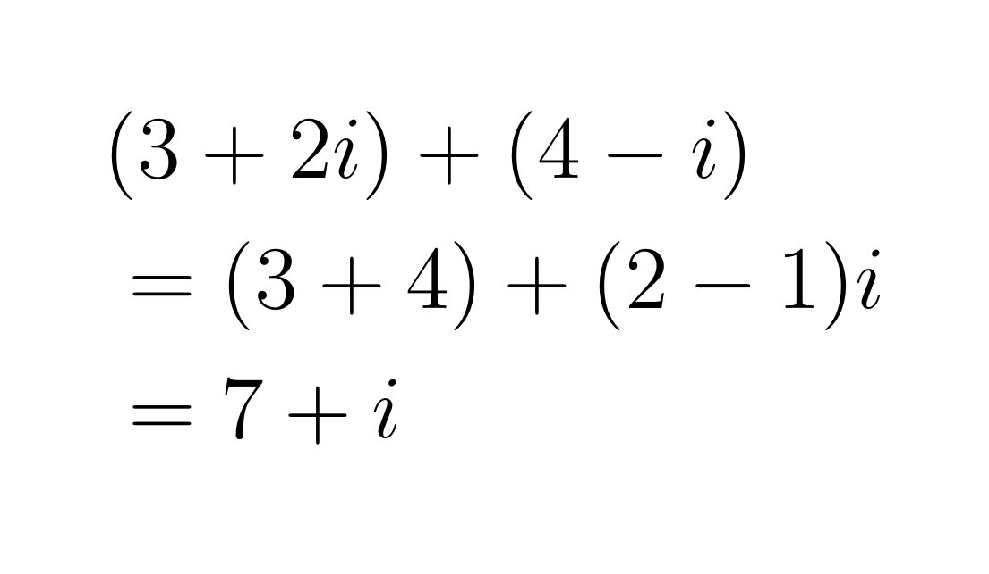
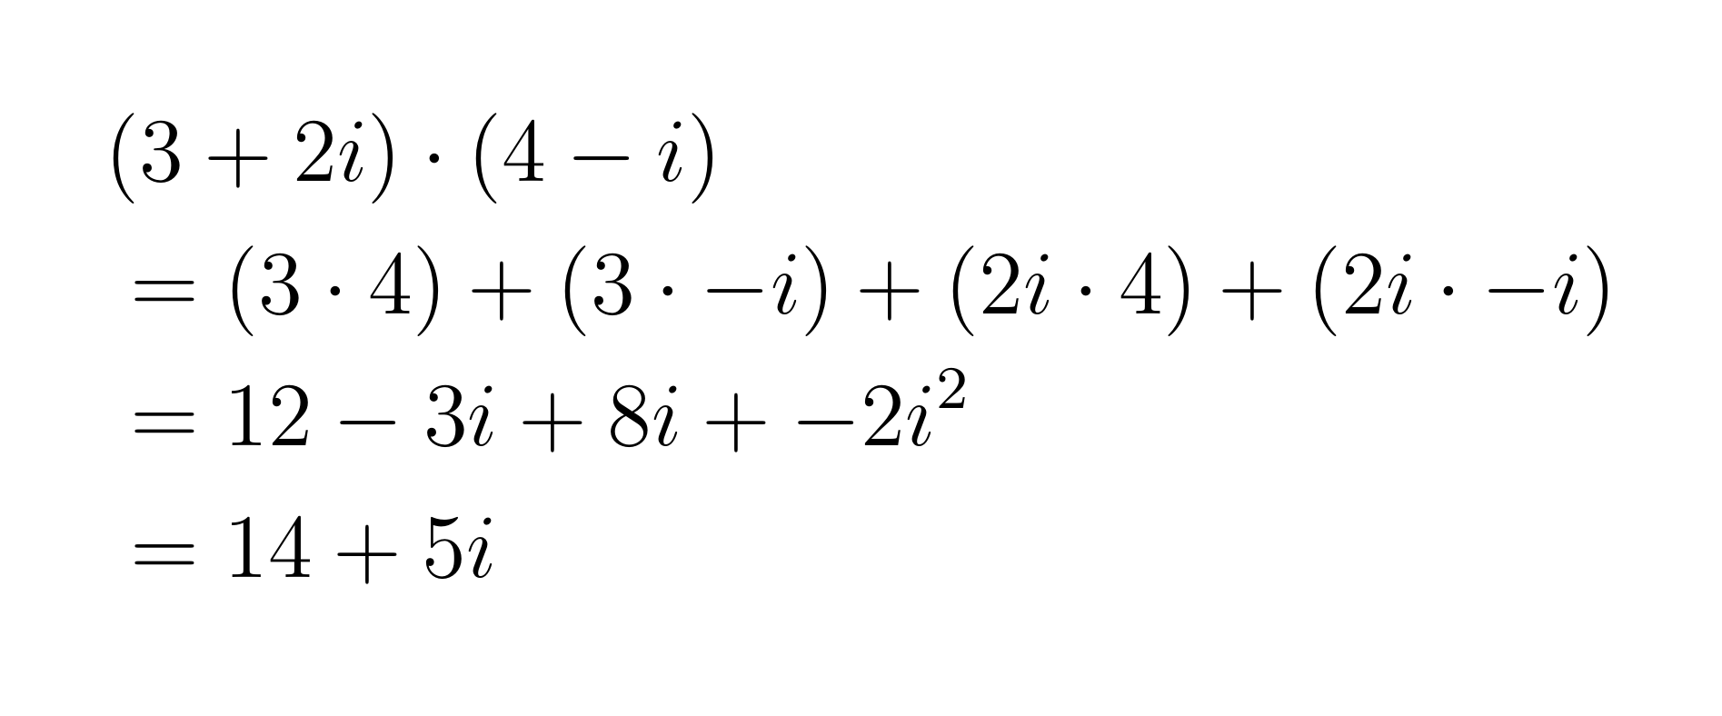
Complex Numbers
What are Complex Numbers:
Complex numbers have a real and imaginary part. For example, the number 2 + 3i has real part 2 and imaginary part 3.
The special value i statisfies i² = -1.
Algebraic operations on complex numbers work the same as on real numbers, if i is treated as a variable, and i² = -1.
Complex addition:
Complex Multiplication:
Notes:
- Complex numbers have a real and immaginary part.
Eg: 2 + 3i, then Re = 2, Im = 3.
- We have that i² = -1.
- Aritmatic works the same as on the real numbers, if you treat i like a variable and replace occurances of i² with -1.
- Example addition:
- Add the real parts of both, and the Imm parts of both.
- Example multiplication:
- Distribute.
- Collect like terms.
- Replace i² with -1.

Slide 5
The Mandelbrot Set
What is the Mandelbrot Set
The Mandelbrot set is a set of complex numbers definied by a recursive function:
z0 = c
zn = z²n-1 + c
A given complex number c belongs to the Mandelbrot set if zn does not tend to infinity as n increases.
It is known that no complex number z such that |z| ≥ 2 is in the Mandelbrot set. Thus only iterations where |zn| < 2 need be computed.
Notes:
- The Mandelbrot set is a set of complex numbers defined by a recursive function.
- z0 = c, for some input complex number c
- zn = x²n-1 + c
- c belongs to the Mandelbrot set if zn does not tend to infinity as n increases.
- We know that no complex number z is in the Mandelbrot set if |z| ≥ 2.
- Thus if during the calculation we find that |zn| ≥ 2, we can stop iterating.

Slide 6
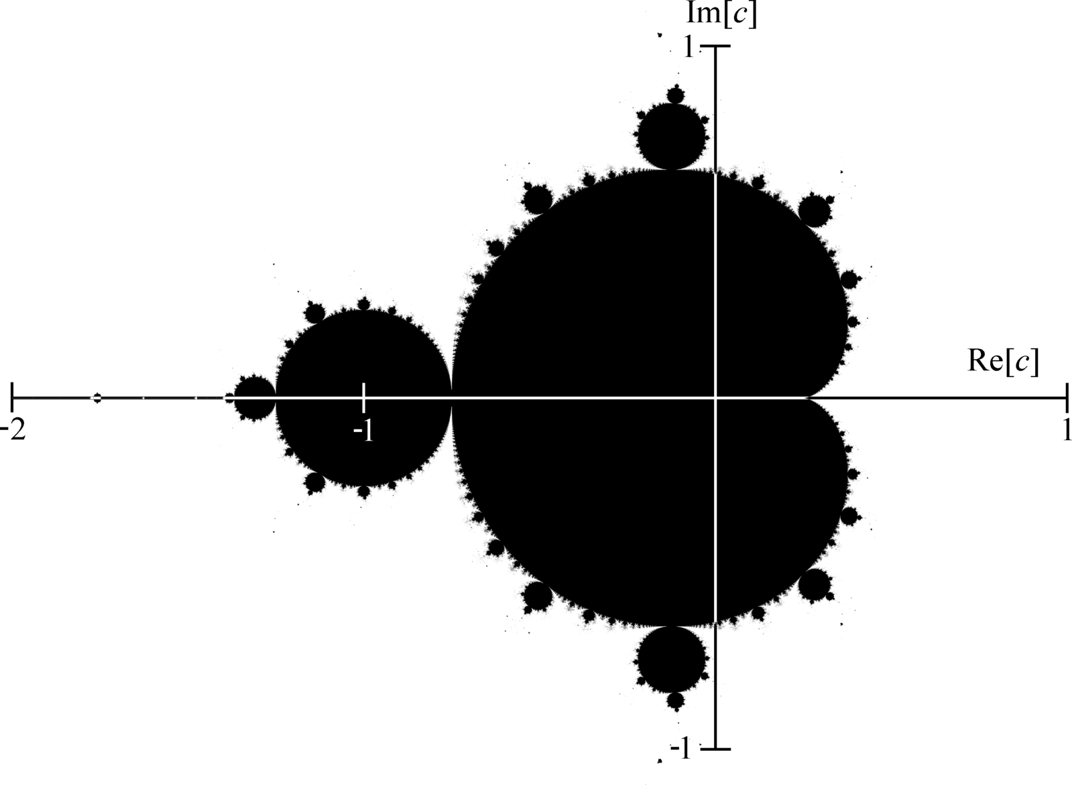
The Mandelbrot Set
Notes:
This graphic shows a rendering of the Mandelbrot Set.
- Complex numbers in the set are in black.
- Numbers not in the set are in white.
- Axis inverts these rules.

Slide 7
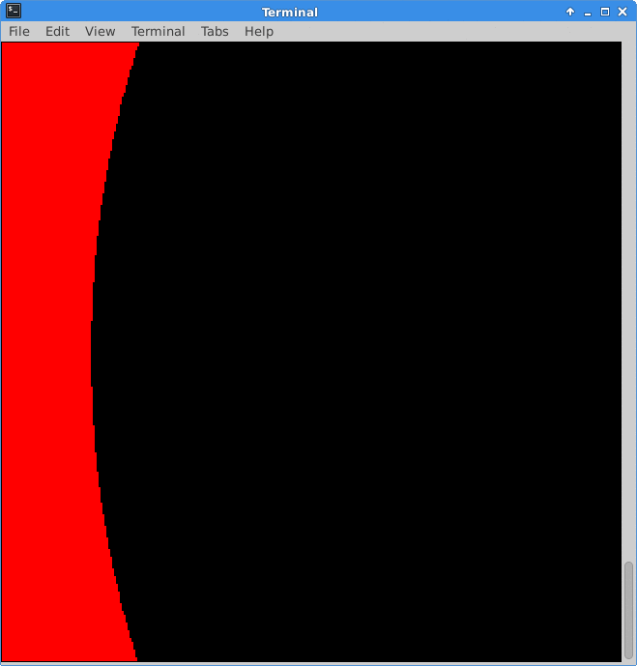
Mandelbrot Animations
Animating the Mandelbrot Set
The number of iterations until |zn| > 2 is called the escape time.
For a given complex number, we can colour that point based on the escape time.
Notes:
- The number of iterations until |zn| > 2 is called the esacpe time.
- We can colour the points in a region based on the escape time.
- The following animation shows renderings of a region while the maximum number of iterations is increased.

Slide 8
GLIR
GLIR – Graphics Library for RISC-V
Graphical output will be handled with GLIR.
GLIR emulates graphics by printing cells onto the terminal window.
Each cell can have a character (symbol), a foreground colour, and a background colour.
Notes:
- Introduction to the GLIR library.
- The graphical output of the lab will be done using GLIR.
- GLIR emulates graphics using the terminal.
- GLIR can set the character, foreground colour, and background colour of a cell.

Slide 9
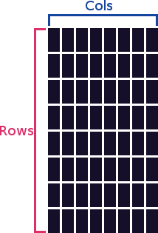
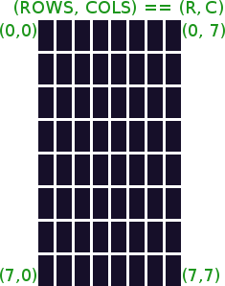
The Terminal
Form of the Terminal
Grid of cells, with rows and columns.
Cells are rectangular
Coordinates are of the form (row, column).
Notes:
- The terminal is a grid of cells.
- Has rows and columns.
- Cells are rectangular, not square.
- Coordinates are of the form (rows, cols).

Slide 10
Coordinate Systems
There are two coordinates systems in this assignment:
Complex coordinates, used by the Mandelbrot fractal.
Terminal coordinates, used to draw to the terminal.
To render the fractal, we must convert between coordinates.
Notes:
This assignment uses two coordinate systems.
- Complex coordinates → Mandelbrot fractal.
- Terminal coordinates → used to render to the terminal.

Slide 11
Mandelbrot Coordinates
Mandelbrot Coordinates -> Complex Plain:
The Mandelbrot set is defined on the complex plane.
We can represent a rectangular region of the complex plain using two intervals: one for the range of real values, and another for the range of imaginary values.
We will use the notation [min_r, max_r] to refer to the range of real values, and [min_i, max_i] for the range of imaginary values.
The entire region can be described by: ([min_r, max_r], [min_i, max_i]).
Notes:
- The Mandelbrot set is defined on the complex plain.
- We can represent a rectangular region of the complex plain using two intervals, one for the real range and one for the immaginary range.
- We will use the [min, max] notation for this range.
- The entire region is a pair of ranges.

Slide 12
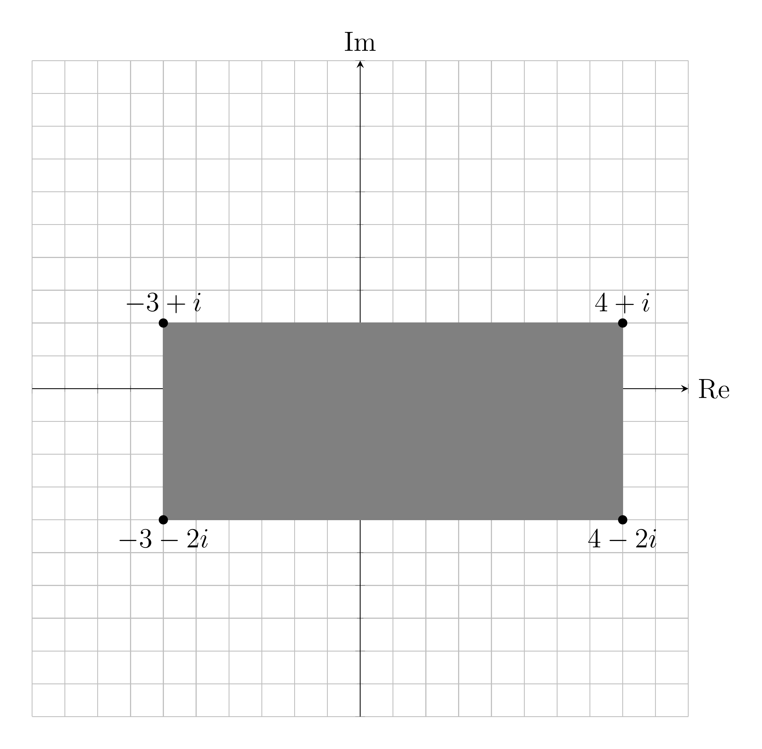
Mandelbrot Coordinates
Consider the region given by: ([-3, 4], [-2, 1]).
Notes:
- Example region of ([-3, 4], [-2, 1])
- Real numbers go from -3 to 4.
- Imaginary part goes from -2 to 1.

Slide 13
Terminal Coordinates
Terminal Window:
The terminal has a number of rows and columns.
The row position represents the vertical distance from the top of the screen.
The column position represents the horizontal distance from the left side of the screen.
Translation:
Each cell is represented by the point at its top left corner.
Terminal cells are mapped directly to the complex plain.
The function getStep computes the step size used in this mapping.
Notes:
- Use the row / column position as terminal coordinates.
- Each tile represents a region in the complex plane.
- Thus we will use the point at the top left corner.
- This point will be mapped directly to the complex plain.
- The assignment function getStep assists in this computation.

Slide 14
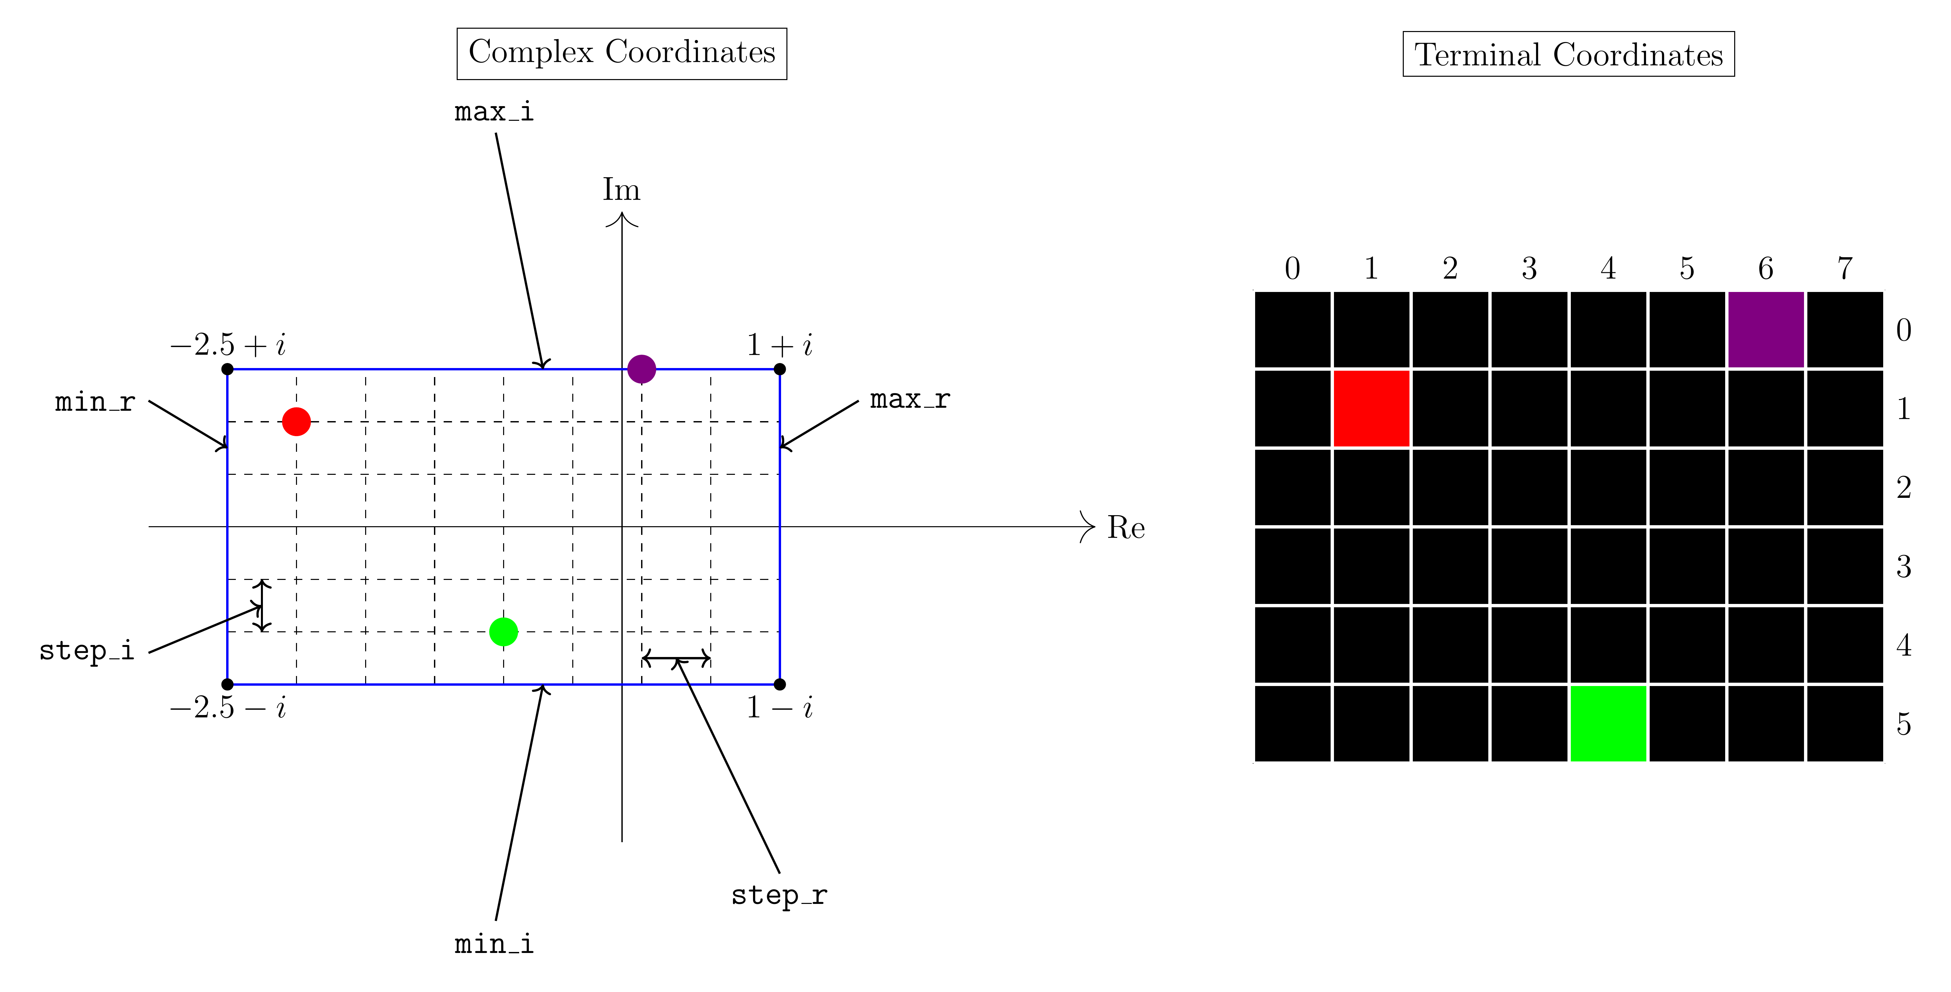
Example Mapping
Consider the mapping between the region ([-2.5, 1], [-1,1]) to a 6 by 8 terminal:
Notes:
Example mapping between the complex region ([-2.5, 1], [-1, 1]) to a 6 by 8 terminal.
- Red dot at (1, 1)
- Green dot at (5, 4)
- Purple dot at (0, 6)

Slide 15
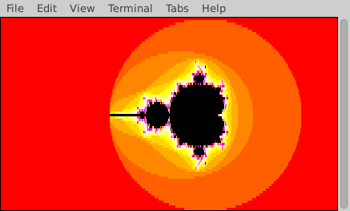
Changing The Region
Notes:
This animation shows the effect of changing the complex region while keeping the terminal size the same.

Slide 16
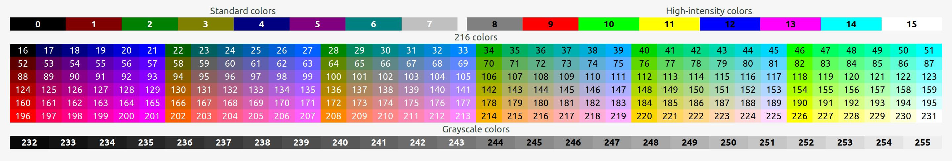
Symbols & Colour
Colour Palette:
GLIR uses ANSI escape codes, which modify properties of the text in the terminal.
GLIR abstracts away the details of ANSI escape codes, and allows you to select colours from a lookup table:
The colours used for the fractal are stored at the palette variable. Points that don’t escape are coloured using the value of the in_color variable.
Notes:
- GLIR uses ANSI escape codes for text formatting.
- GLIR abstracts away the details, allowing us to select the colour that we want from a table.
- The colours used are stored at the palette variable.
- Points that are part of the set use the in_color variable.

Slide 17
Symbols
Characters in the Terminal:
GLIR can print strings to the terminal.
The characters used in this assigment are stored starting at the symbols label.
The number of symbols is in symbol_size.
Notes:
- GLIR can also print strings to the terminal.
- The characters used in this assignment are stored at the symbols label.
- Number of symbols is stored in symbol_size.

Slide 18
Rendering
Using Colours and Symbols to Render the Mandelbrot Set:
In this lab, you will use both colours and symbols for rendering.
There are a finite number of colours and symbols, but infinite possible escape times.
Thus we find escape_time mod palette_size and use that to index into the tables.
This causes the colours and symbols to repeat in sequence.
Notes:
- You will render the fractal with both colours and symbols.
- Use the escape_time mod table size to select the colour.

Slide 19
Floating Point
RISC-V Support For Floating Point:
Floating point is supported in RISC-V through the “F”, “D”, and “Q” extensions.
In this lab we are concerned with the “D” extension, which adds support for 64-bit floating point (double precision).
We use double precision floats rather than single precision to allow us to render the fractal in greater detail, and to reduce numerical issues.
Floating point extension:
The “D” extension adds 32 additional floating point registers, each of which can hold a 64-bit float.
The extension adds instructions for floating point conversion, arithmatic, control, and data movement.
We will use rd, rs1, and rs2 as the integer destination and source registers.
We will use fd, fs1, and fs2 as the floating point destination and source registers.
Notes:
- RISC-V supports floating point through the use of extensions.
- We will be using the D extension in this lab.
- The D extension adds support for 64-bit floating point.
- Double precision floats allow use to render in greater detail, and reduce the effects of numerical errors.
- The RISC-V floating point extension adds 32 additional floating point registers, each of which can hold a 64-bit float.
- Adds instructions for various floating point operations.

Slide 20
Conversion Instructions
fcvt.d.w fd, rs1
Convert the value in rs1 to a 64-bit float and store in fd.
fcvt.w.d rd, fs1
Convert the value in fs1 to 32-bit signed integer and store the result in rd.
Notes:
- Instructions for converting between floating point and integers.
- Can convert a 32 bit integer to a 64 bit float.
- Can convert from a 64-bit float to an 32-bit signed integer.

Slide 21
Arithmetic Instructions
fadd.d fd, fs1, fs2
Sum fs1 and fs2, then store the result in fd.
fsub.d fd, fs1, fs2
Subtract fs1 and fs2, then store the result in fd.
fmul.d fd, fs1, fs2
Multiply fs1 and fs2, then store the result in fd.
fdiv.d fd, fs1, fs2
Divide fs1 by fs2, then store the result in fd.
Notes:
- Includes instructions for basic arithmatic on floats.
- Can add, substract, multiply, and divide.

Slide 22
Control Instructions
We cannot branch directly on floating point conditions. Instead the following instructions store a 1 or 0 depending on the condition.
feq.d rd, fs1, fs2
Set rd to 1 if fs1 = fs2, set to 0 otherwise.
flt.d rd, fs1, fs2
Set rd to 1 if fs1 < fs2, set to 0 otherwise.
fge.d rd, fs1, fs2
Set rd to 1 if fs1 ≥ fs2, set to 0 otherwise.
Notes:
- Includes instruction to change control flow.
- Can’t branch directly, instead, the floating point control instructions write a 0 or 1 depending on the condition.
- Can do equality, less than, and greater than or equal to comparisons.

Slide 23
Data Movement Instructions
fmv.d fd, fs1
Copy the value in fs1 to fd.
fld fd, X(rs1)
Load into fd the value at rs1 + X.
fsd fd, X(rs1)
Store into memory at rs1 + X the value in fd.
Notes:
- Includes instructions for data movement.
- Can copy the data in one register to another.
- Can load and store floats.

Slide 24
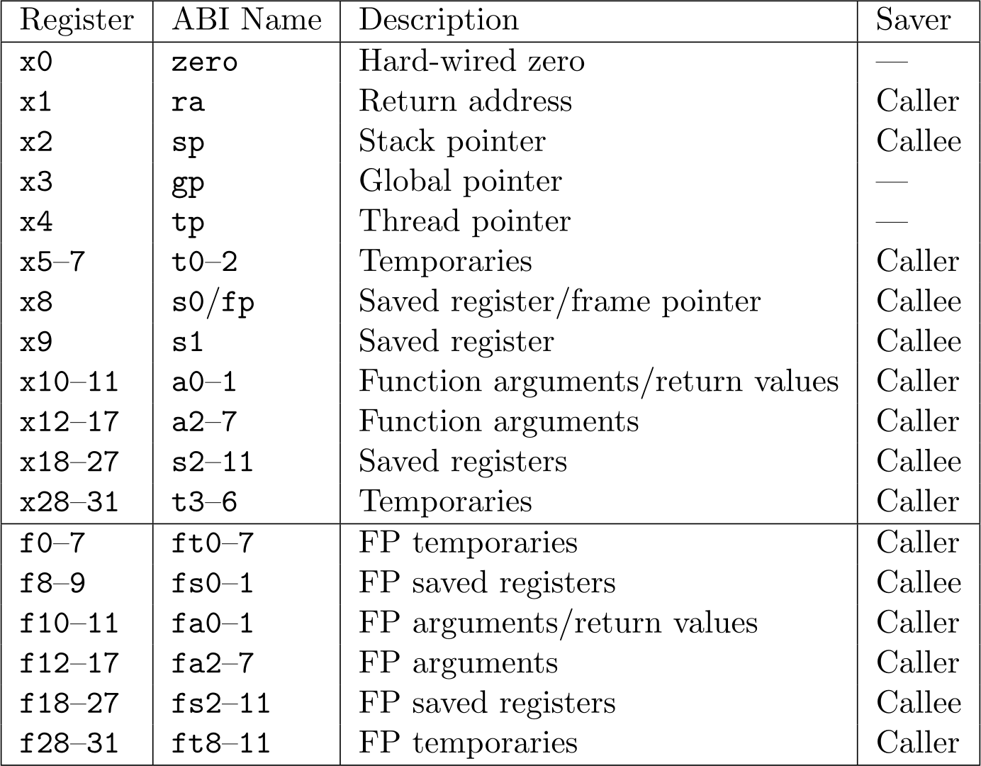
Calling Conventions
RISC-V Floating Point Calling Convetions:
The RISC-V floating point registers are logically partitioned into temporary, saved, and argument groups.
These groups function in the same way as the integer registers.
Notes:
- Floating point registers have associated calling conventions.
- The floating point registers are logically grouped into temporary, saved, and argument groups.
- These groups function in the same way as the integer registers.
- The following graphic shows the mapping.
- Notice that there is no floating point constant-zero register.

Slide 25
Example Floating Point Code
We have provided some sample programs in the Code/Examples directory.
Notes:
- We have provided some sample floating point code.
(You as the presenter should go through the example code & explain it)

Slide 26
Assignment
CMPUT 229
Notes:
This section describes the requirements for the lab.

Slide 27
Overview of the lab
Overview:
In this lab, you must implement a series of functions to render the Mandelbrot fractal.
You are required to implement all of the following functions.
Notes:
- Must implement the functions to render a given portion of the Mandelbrot fractal.

Slide 28
renderFractal
Description:
This function renders a portion of the the Mandelbrot fractal.
Parameters:
a0: Number of rows.
fa0: max_i
a1: Number of columns.
fa1: min_i
a2: Maximum iterations.
fa2: max_r
fa3: min_r
Return Value:
N/A
Notes:
- Is the “main” function (entry point).
- Takes in the size of the terminal, the maximum number of iterations, and the bounds of the region
- Is repsponsibe for rendering the entire fractal.

Slide 29
calculateEscape
Description:
Calculate the escape time up to the given maximum for a complex number c.
Parameters:
a0: Maximum number of iterations.
fa0: Real part of c.
fa1: Imaginary part of c.
Return Values:
a0: 1 if c escaped before max iterations, 0 otherwise.
a1: Number of iterations before escape. If the maximum number of iterations was reached, this should be the maximum number of iterations.
Notes:
- Calculates the escape time for a given complex number.
- Takes in the maximum number of iterations, and a complex number.
- Returns in a0 1 if c escaped & 0 otherwise.
- Returns in a1 the number of iterations before escape. If the point doesn’t escape before the max was reached, return the max.

Slide 30
getStep
Description:
Compute the real and immaginary step sizes.
Parameters:
a0: Number of rows.
fa1: min_i
a1: Number of columns.
fa2: max_r
fa0: max_i
fa3: min_r
Return Value:
fa0: Real step size.
fa1: Immaginary step size.
Notes:
- Computes the real and immaginary step sizes used in mapping between the complex plain and the terminal.
- Takes in the size of the terminal, and the bounds of the region.
- Returns the real and immaginary step sizes.

Slide 31
Testing
CMPUT 229
Notes:
- Overview of how to test your lab.
- How to create test files.
- How to run a test.

Slide 32
Testing your Solution
Included tests:
We have provided some test inputs and outputs.
Tests are stored in the “Tests” directory. *.txt files correspond to the inputs, while *.out files are the expected outputs.
Format of the test file:
Make sure the test file has the correct format (refer to the website).
RARS may need the full path to the test file.
Notes:
- Some included tests, these tests are in the correct format.
- To test your solution, give the path to the test file in the program arguments.

