Slide 1
Introduction to Hash Table Lab
CMPUT 229
José Nelson Amaral

Slide 2
Lab Requirements
RISC-V
Function calls and register convention.
Loading and storing from memory.
General
Hash tables, key/value stores.
Hashing.
Linked Lists.
Dynamic Memory Allocation.
Notes:
This is an overview of the concepts that you will be learning and using for this lab

Slide 3
Overview
Functions
“Number of students enrolled in a course”
Insert (aka. Add, Append)
Key
Value
CMPUT 229
154
Find (aka. Get)
STAT 151
98
Delete (aka. Remove)
CHEM 101
248
Notes:
In this lab, you will be implementing a hash table. It is a type of key/value store, meaning that you will be using some sort of key (like a string in our case) to access a value (like an integer in our case). Some other key/value stores you may have used include maps in Java or C++, objects in JavaScript, and dictionaries in Python
Your job will be to implement 3 functions for the hash table. One that inserts a value, one that finds a value, and one that deletes a value. Note that for all of these, we give it just the key as the input (with the exception of insert), and it returns a value.

Slide 4
Hashing Functions
Calculates the same hash for each unique input.
Predictable outputs.
Hard to reverse the process.
Multiple inputs can have the same hash.
Pseudorandom.
Some popular hashing algorithms
MD5
SHA256
Notes:
A hashing function is a special function that calculates a value called a hash. It takes in an input (like a string in our case) and returns some sort of value like a string or integer (an integer in our case).
What is unique about this process is that each input will always have the same input, but it is hard to reverse the process. That means it is hard to come up with a string from a hash number. Finally, hashing functions are pseudorandom, meaning that the numbers appear to be statistically random, but in actuality are not.

Slide 5
Hash Table
“Number of students enrolled in a course”
Hash
Value
Key
Hash Function
0
1
CMPUT 229
…
12
248
STAT 151
…
23
154
CHEM 101
…
44
98
…
63
Notes:
A hash table is a specific kind of key/value store. All the values are stored in an array of a specified length, in our case, 64 items. A hashing function is used to calculate the index of that array.
This might mean that certain hashes will have no value stored in it, and some hashes might be shared by some keys. When two keys have the same hash, that is known as a collision and we will be touching on that in a few slides
Sidenote: the reason we use hash functions to calculate an index is because it is either constant or near constant time complexity to determine the hash, and therefore the index of the item. This is much faster compared to methods like sequential search

Slide 6
(Singly) Linked Lists
Start of list
Two parts: data and pointer to next item.
Easy to grow and shrink.
Don’t need to know the full size at creation.
Slower than typical arrays, where data is right next to each other.
Data
Data
Data
Notes:
A linked list is a sequential data structure, meaning that items are in a specific order, similar to an array. Unlike arrays, the data is not stored right next to each other in memory.
Each linked list “node” consists of 2 parts: the data you would like to store, and a pointer to the next item in the list.
Linked lists are easy to grow and shrink depending on the use case, especially in the middle. You can change the order just by linking the pointers to different “nodes”
Unlike an array, you do not need to know the size of the array before you begin using it.
Compared to arrays, linked list are slower to skim through. Since arrays store data contiguously, you can perform operations, like mathematical operations, to determine the location of an item. For example, the the 4th item in a 32-bit integer array is located 12 bytes after the start of an array (index 3 * 4 bytes per int). With linked lists, you must sequentially search every item.

Slide 7
Dynamic Memory Allocation
If you don’t know how much memory you need while you’re writing the program, you can ask the OS to allocate memory for you dynamically, or while the program is running.
Requires you to manage memory in code (needing to allocate and deallocate/free).
For part 3 of this lab, you can call the function alloc to provide you with an area of memory that you can use to grow the list.
Notes:
Sidenote: the alloc function in this lab is simulated, meaning it does not work like a real alloc. You might notice (if you look through common.s) that we are simply using a large buffer (array) to store the extra entries

Slide 8
Creating a Hash Table in RISC-V
This lab is split into 3 parts:
Part 2: Implement a
Hash Table
Part 3: Implement a
Hash Table with Collisions
Part 1: Helper Functions
hash
insert
insert_col
equals
find
find_col
delete
delete_col
Detailed videos on how each of the algorithms work are embedded on the lab page.
Notes:
The lab is split into 3 parts. You can do the tasks within each part in any order, but you must complete the parts in order as the earlier parts rely on the previous parts to function.
We will briefly discuss the parts in these slides, but there are more detailed videos on how each of the algorithms work in the instructions online

Slide 9
Representing the Entries as an Array
Every block in the diagram is 1 word or 4 bytes long.
In this lab, you are given an array for storing items in the hash table.
We have to represent a 2D array in memory, which is one dimension.
The layout is different in part 2 and part 3, so pay attention!
PART 2
hash = 0
key
value
hash = 0
hash = 1
hash = 2
hash = 1
key
value
key
value
key
value
key
value
hash = 2
key
value
PART 3
hash = 0
key
value
next
hash = 0
hash = 1
hash = 1
key
value
next
key
value
next
key
value
next
key
hash = 2
key
value
next
Notes:
Sidenote: we have to store the key AND the value, because multiple items may have the same hash. When we find or delete an item, we have to make sure it’s actually the item we want to locate.

Slide 10
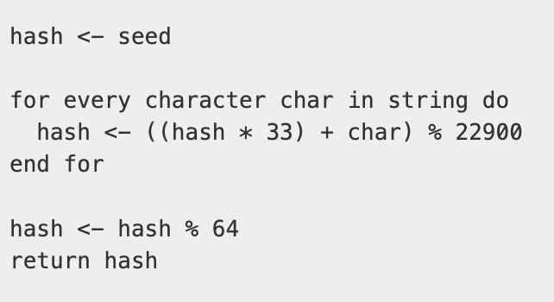
Part 1
You will implement the functions hash and equals.
The hash algorithm is a modified version of djb2, using the seed 5381.
equals checks if 2 strings are equal.

Slide 11
Part 2
You will implement a hash table (insert, find, delete), with no collisions.
You must call functions hash and equals.
hash is used to calculate the index of the array.
For find and delete, you must first check that the key in the hash table matches the key that is given in the function using equals.
We will not try to insert 2 items with the same name or the same hash (no collisions).

Slide 12
Part 3
You will implement a hash table, with collisions
You must call hash, equals, and alloc.
Collisions occur when you try to insert two items that have the same hash.
We will use a linked list to store overflow (extra) entries. You can call alloc to allocate room for the overflow entries.
There are a lot of edge cases in these scenarios, so be vigilant!

Slide 13
Register Convention in RISC-V
You will be using and possibly writing functions in this lab.
Review your notes on using the stack pointer and register convention.
taken from slides V0C

Slide 14
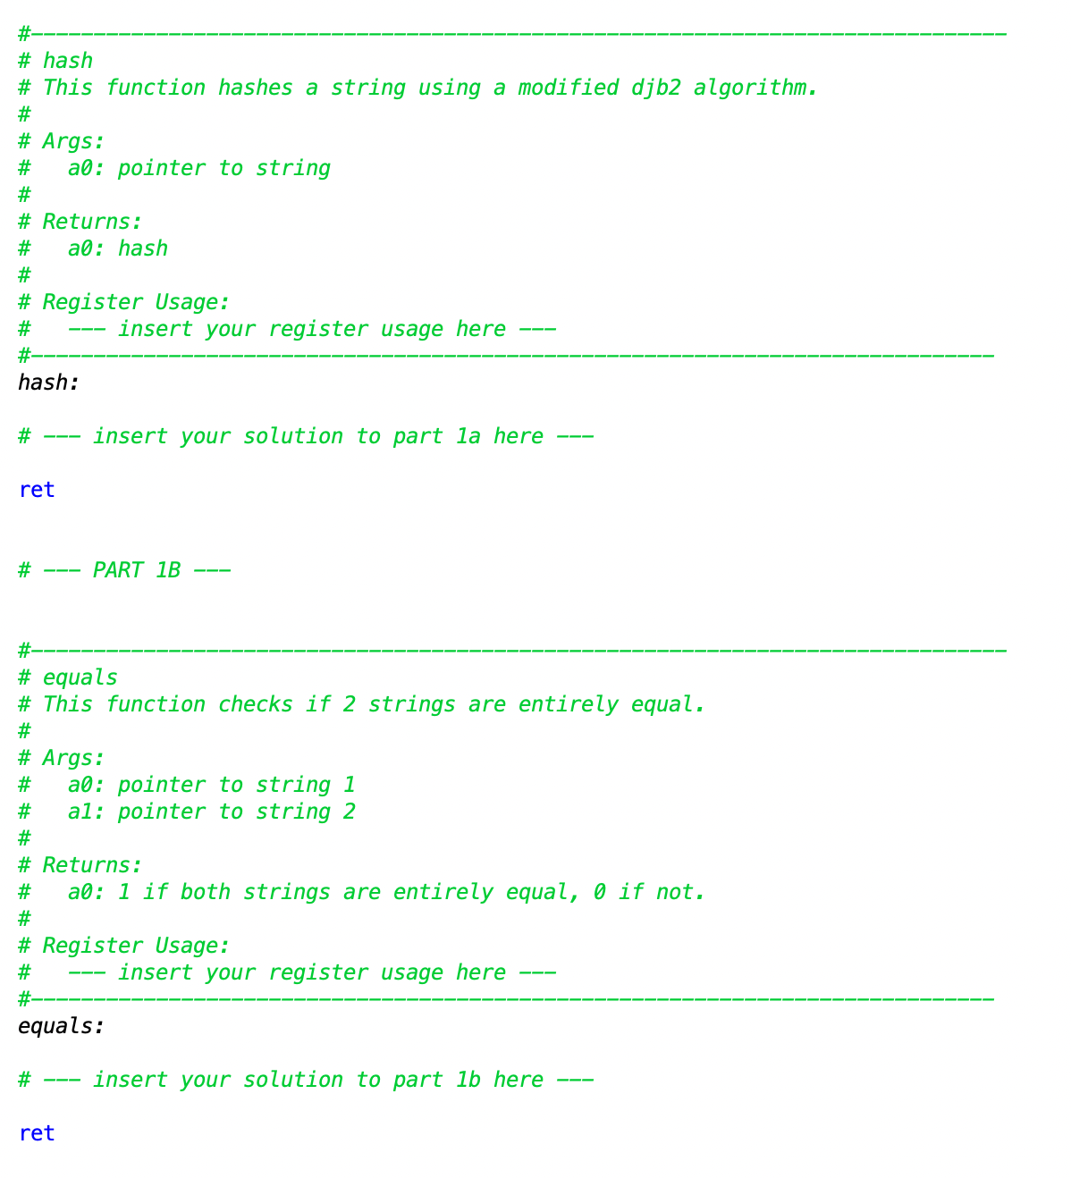
File Templates
Write your solution in hashtable.s.
Do not rename this file. We will be marking this file only.
Function headers and incomplete comment blocks are provided.
Notes:
In your repo, you are given 6 assembly files. 3 of these files begin with “common”. These are helper files that work with the other files.
The most important file is hashtable.s. This is where your solution will go. Please do not rename or move any files when you submit, as we need them to be exactly the same for our marking scripts to run correctly.
We also provide basic function headers and a starting blocks for you to write your solution in.

Slide 15
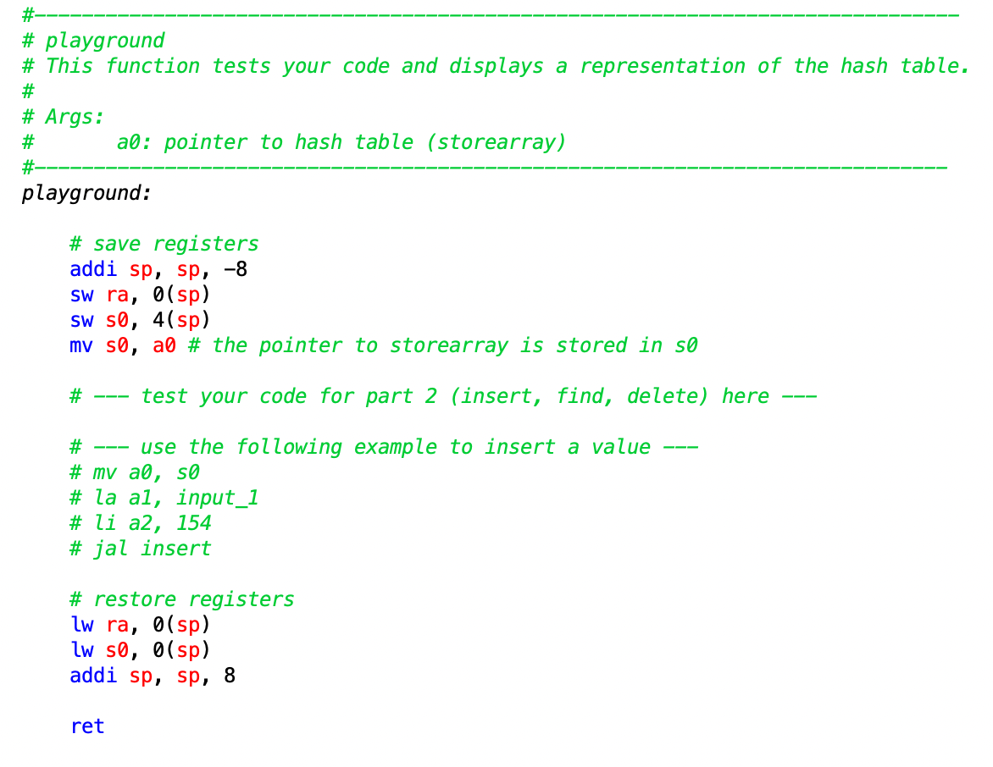
Testing
Integrated test cases in RARS.
They do not cover every case!
playground.s and playground_col.s can be used to test your functions.
Notes:
The testing for this lab is a bit unique, with the nature of what you are making. We have provided multiple ways to test this lab as such.
First, if you build and run your hashtable.s file, you will see some integrated test cases in the command output. Please note that these are not extensive at all. There will be many edge cases that you will have to test your self.
Second, we have provided 2 files: playground.s and playground_col.s for part 2 and part 3 respectively. Here, you can call your implemented functions and see if the output is what is expected. When you run those files, a human-readable representation of the hash table will be displayed in the output.

Slide 16
Final Remarks
Watch the videos on the instruction page!
You can do the tasks within each part in any order.
Write your own test cases in the playground files that handle edge cases.
Don’t be afraid to ask questions.
Review the marksheet to see what cases we are testing for.
Style marks are an easy 20%.

Slide 17
