Slide 1
Lab 4: Image Blurring
CMPUT 229
University of Alberta

Slide 2
Lab Requirements
Function calls and register conventions
Loading and storing from memory
Loops and control flow
Bit manipulation

Slide 3
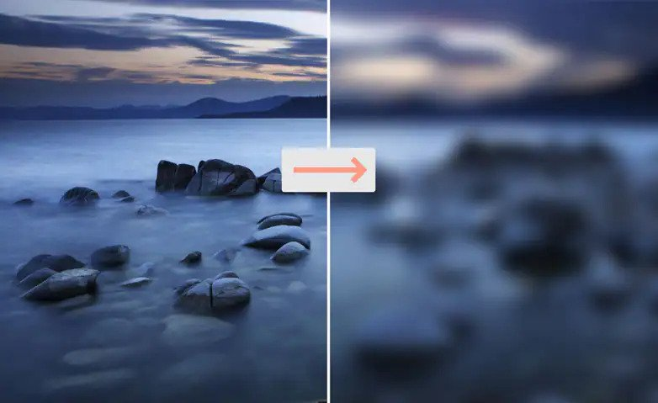
Background
Common technique to hide key information
Distort the detail of an image to make it less clear

Slide 4
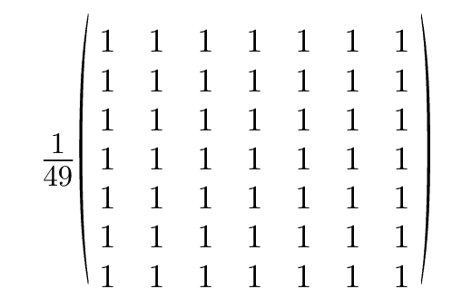
Box Blur

Slide 5
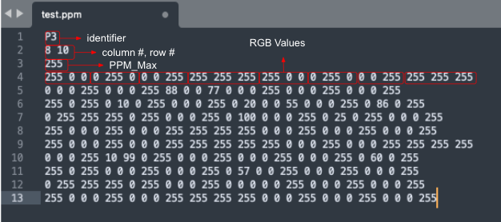
PPM format:

Slide 6
The Assignment
Part 1:
digitToAscii
copyImage
asciiToDigit
Part 2:
readNextNumber
storeNumber
Part 3:
pixelKernelMul
blurImage

Slide 7
readNextNumber
asciiToDigit
copy
blurImage
pixelKernelMul
storeNumber
digitToAscii

Slide 8
Subroutines
digitToAscii:
This function returns the ASCII value of the digit.
Arguments:
a0: a single digit represented as an integer, between 0 and 9
Return:
a0: the ASCII value of the digit, between 48 (0x30) and 57 (0x39)

Slide 9
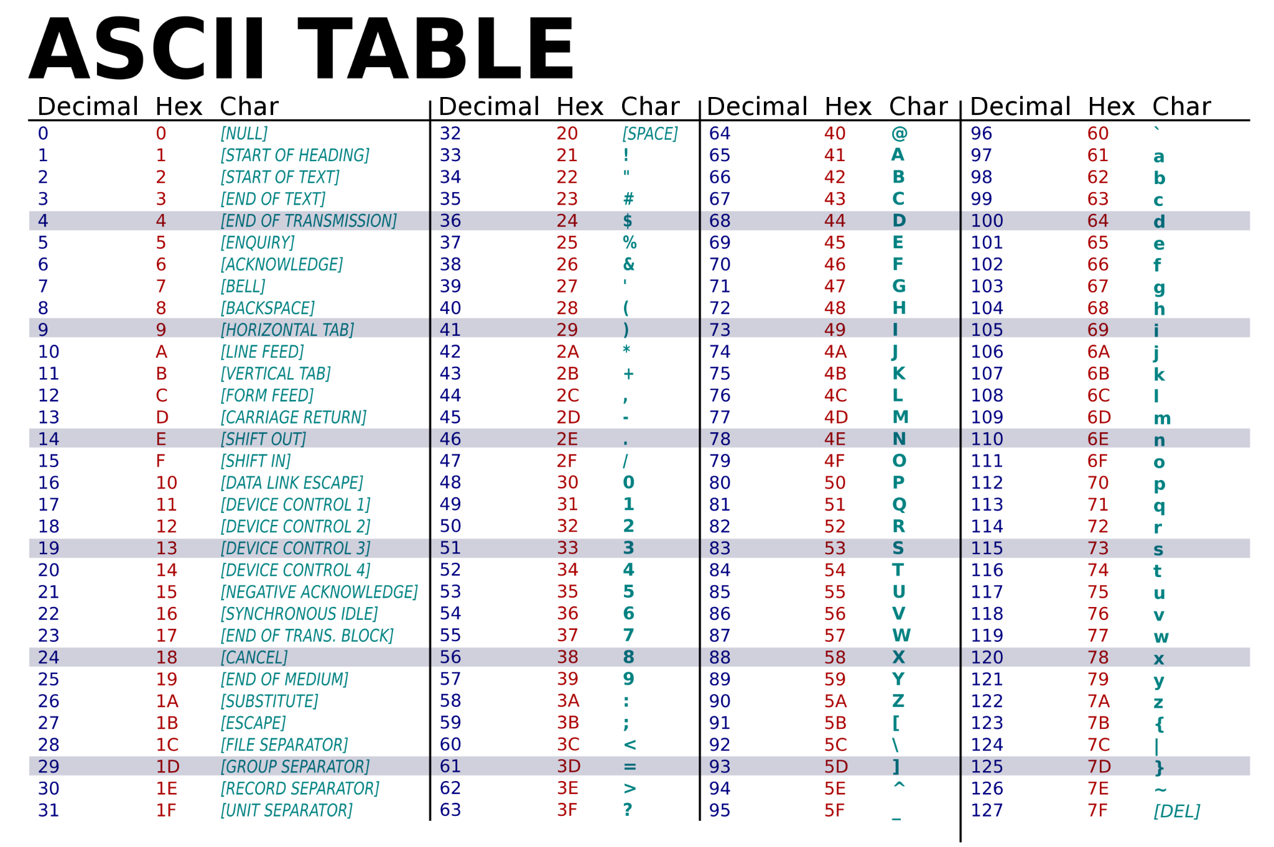

Slide 10
Subroutines
copy:
This function copies all the RGB values to another address.
Arguments:
a0: address of the start of RGB values (where to copy from)
a1: address of the start of where to copy to
a2: length in words

Slide 11
Subroutines
asciiToDigit:
This function returns the digit for the given ASCII value
Arguments:
a0: the ASCII value of the digit, between 48 (0x30) and 57 (0x39)
Return:
a0: a single digit represented as an integer, between 0 and 9

Slide 12
Subroutines
readNextNumber:
It reads a string of ASCII characters and converts the first number it finds into an integer. It is guaranteed to only have ASCII numbers between 0 and 255. The function skips any whitespace before the number, then reads until it encounters a whitespace character including:"space" or "\n" or "\r" or "\t"
Arguments:
a0: the current address to start reading
Return:
a0: the address to start reading the next number
a1: the number represented as an integer

Slide 13
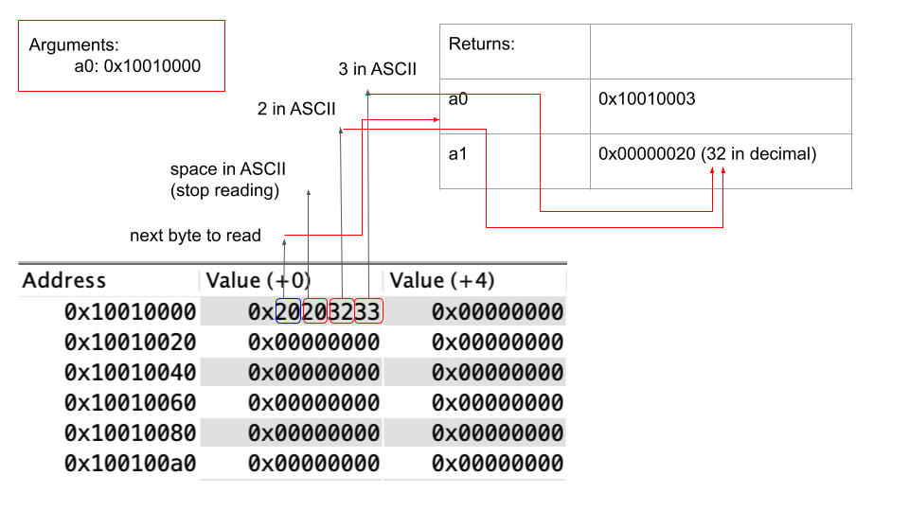
Example:

Slide 14
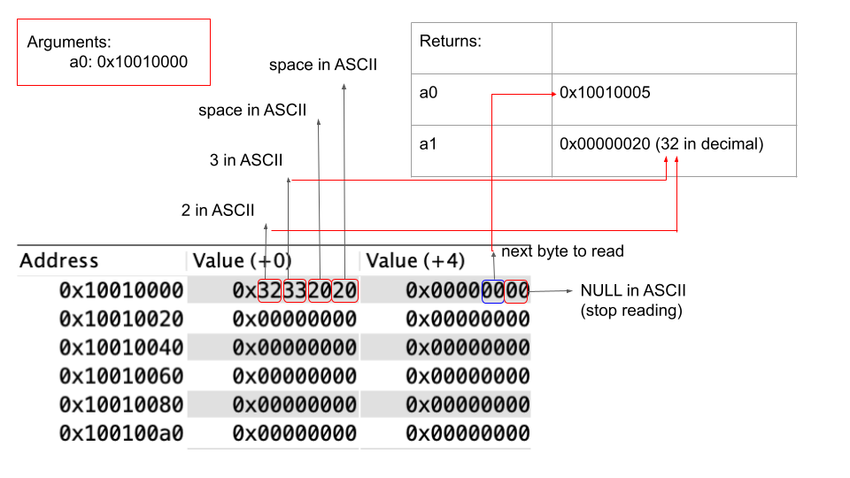
Example:

Slide 15
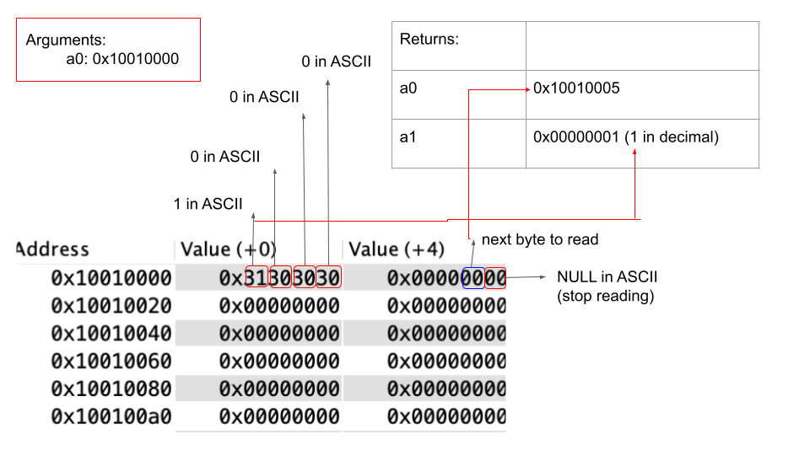
Example:

Slide 16
Example:

Slide 17
Subroutines
storeNumber:
This function converts the integer(at most 3 digits) to ASCII and then store their ASCII to the address. Store the leftmost digit first, consider using the function digitToAscii.
Arguments:
a0: the number represented as an integer
a1: address for the integer to be stored
Return:
a0: the next address that's available to be stored

Slide 18
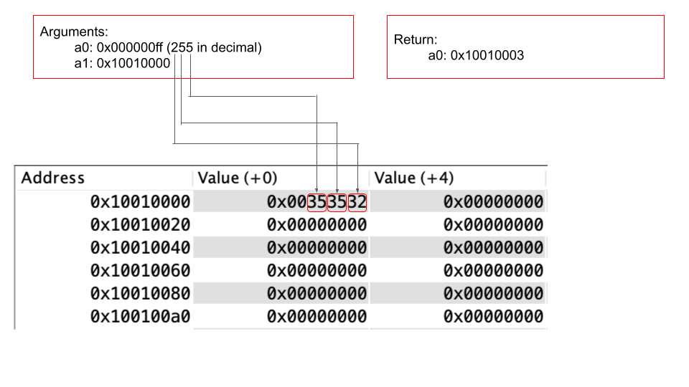
Example:

Slide 19
Subroutines
pixelKernelMul:
This function calculate the average for each of the R, G, B values and store the value.
Arguments:
a0: address of the start of RGB values, store the calculated RGB values in this region (a0 is the base address)
a1: address of the start of the copy of RGB values
a2: row # of the current pixel to blur
a3: col # of the current pixel to blur
a4: total row (may not be used)
a5: total col

Slide 20
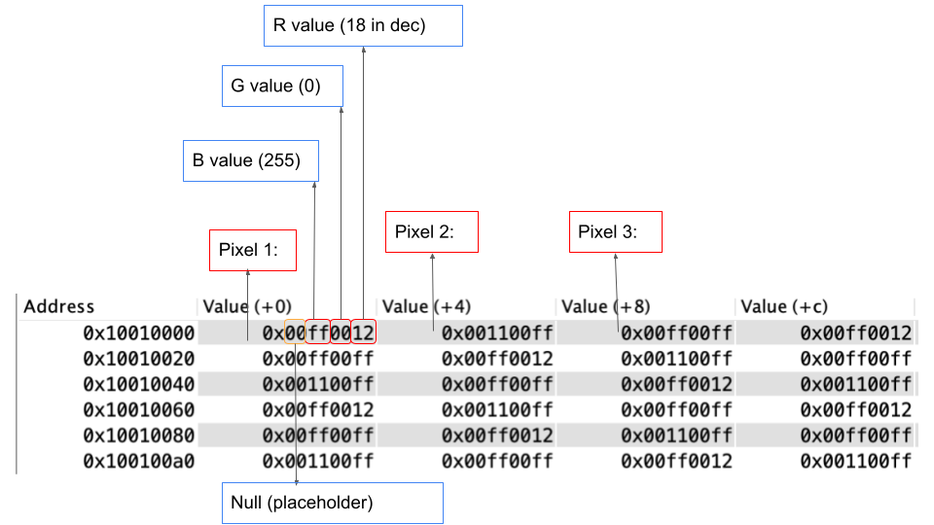
The pixels in memory:

Slide 21
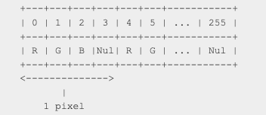
Big-endian:

Slide 22
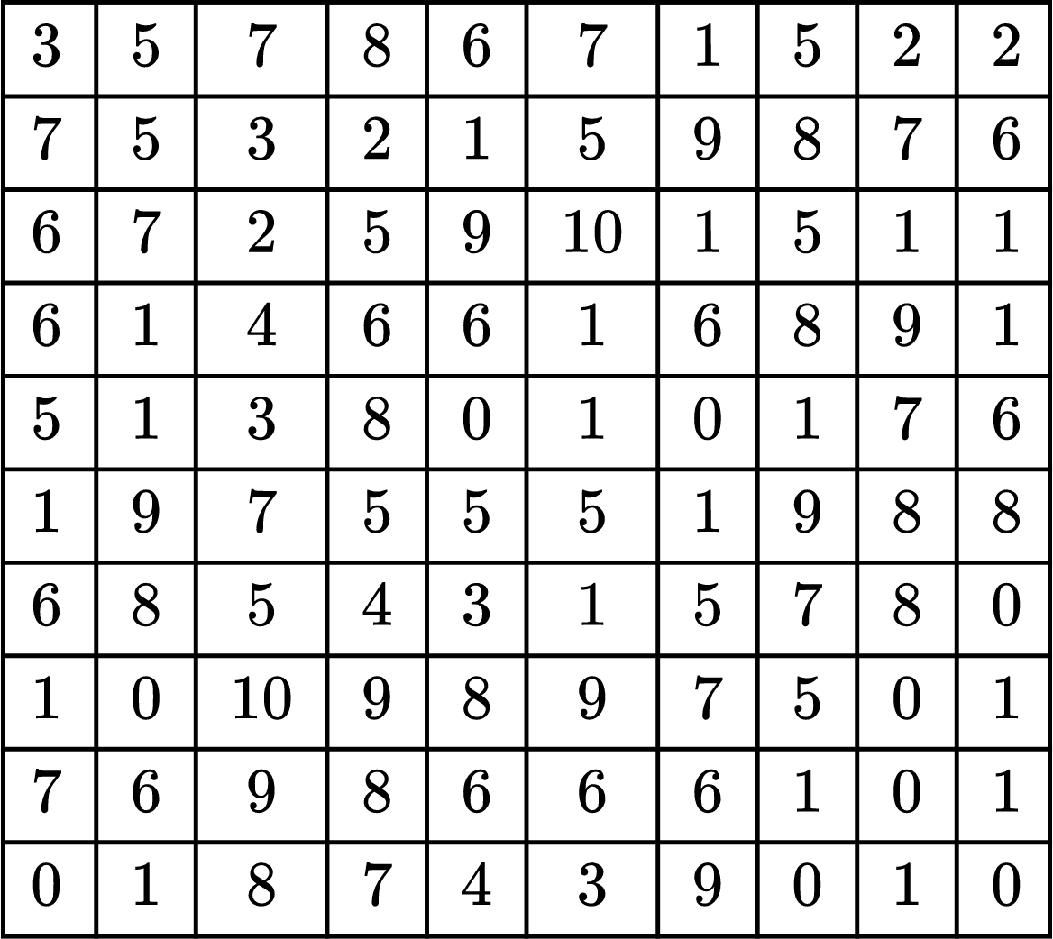
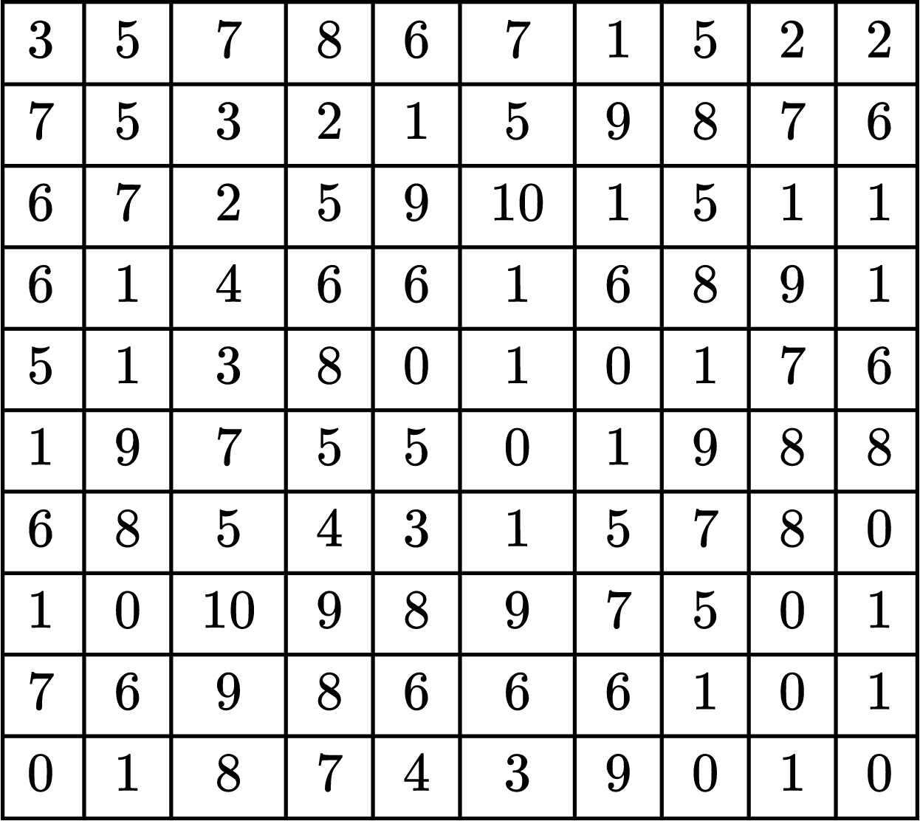
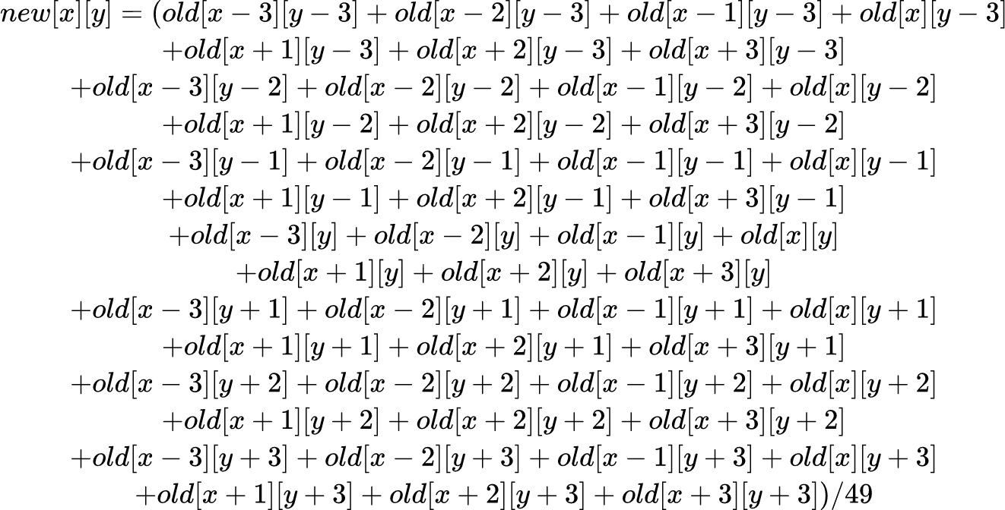
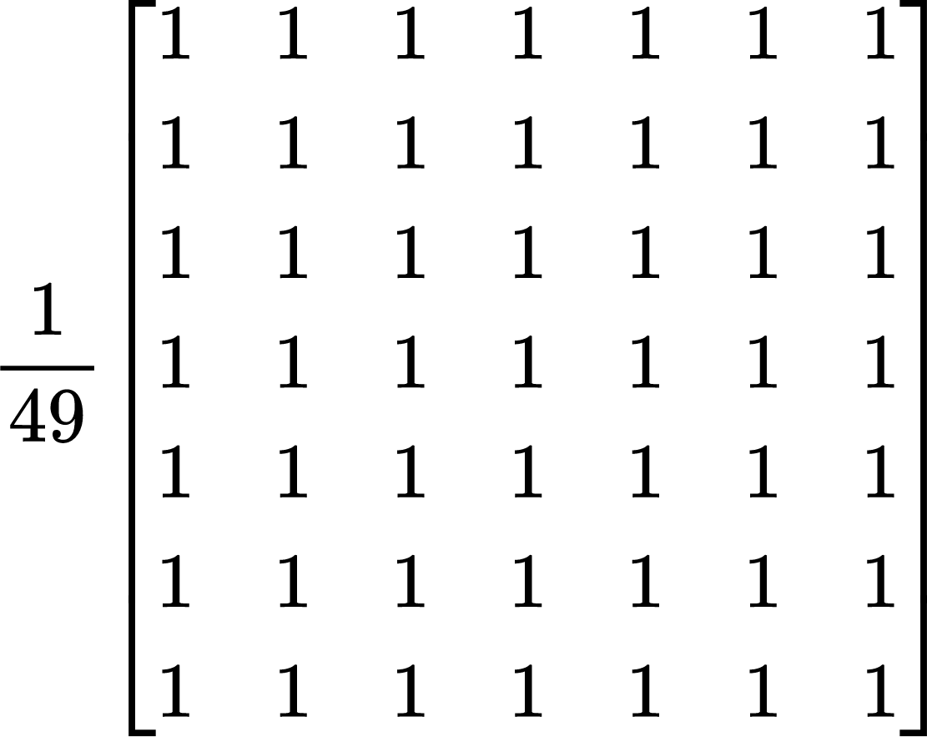
Copy:
Original:
new[x][y] = average of all of the surrounding 49 elements

Slide 23
Subroutines
blurImage:
This function blurs the image using pixelKernelMul on all possible pixels. It will run PixelKernelMul on all pixels except for the ones on the edges and corners.
Arguments:
a0: kernel size
a1: total rows
a2: total columns
a3: address of the start of RGB values, store the calculated RGB values in this region (a0 is the base address)
a4: address of the start of the copy of RGB values

Slide 24
Pseudo Code

Slide 25
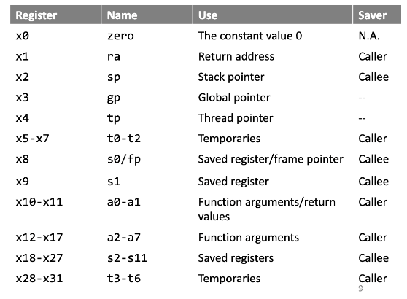
Register Conventions in RISC-V
Register conventions are required for this lab. Review your notes on using the stack pointer and register conventions.

Slide 26
Tips and Notes
Loops are a very important part of this lab. Review your notes.
For the simplicity of this lab, we are only blurring the center part of the lab and ignoring the edges and the corners.
You can make any other helper functions to break down the problem.
Read carefully about the instructions and examples provided.
Do not edit any part of common.s
Do not use any labels used in common.s

