Slide 1
Introduction to Lab Packet Forward - Checksum
J. Nelson Amaral

Slide 2
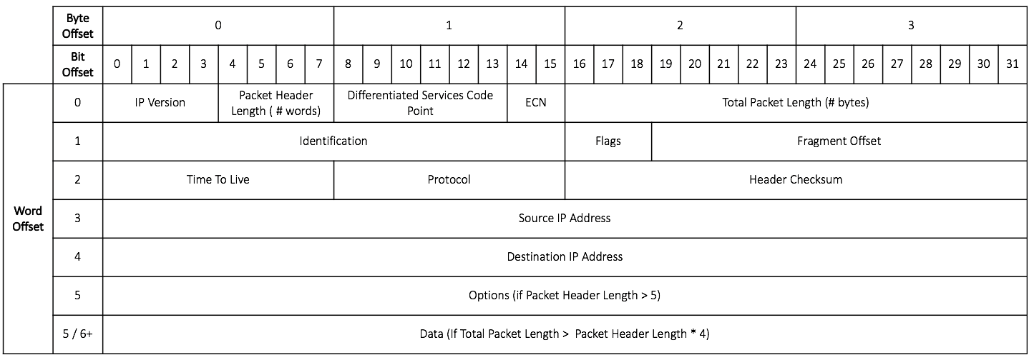
Layout of an IP Packet
Length of
the Header
(in words)
Used to determine how
many halfwords to use to compute the Header Checksum

Slide 3
What is the input to your assignment?
a0: The address of an IPv4 packet stored in memory

Slide 4
What does checksum do?
Calculate and return the Header Checksum
of an IPv4 Packet

Slide 5
Computing Header Checksum
Break the packet’s header into halfword (16 bit) values
Accumulator ← 0
for each halfword H_{i} in the header:
(CarryOut, Sum) ← Accumulator + H_{i}
Accumulator ← Sum + Carryout
Checksum ← Logical complement of Accumulator
Note: you must skip the Header Checksum field when computing the checksum

Slide 6
Computing Header Checksum (Example)
CarryOut
Sum
1000 0110 0101 1110
; Accumulator_{i}
+
1010 1100 0111 0000
; H_{i}
1
0011 0010 1100 1110
0011 0010 1100 1110
; Sum
+
1
; CarryOut
0011 0010 1100 1111
; Accumulator_{i+1}

Slide 7
Important Details
The standard for packets sent over a network is big-endian
RISC-V is little-endian.
Thus, your solution has to:
convert each halfword to little-endian before using it to compute the checksum
Return the checksum in big-endian byte order ie. Do not swap the bytes of the calculated checksum before returning the value

Slide 8
Halfword Endianess Conversion (Example)
1000 0110 0101 1110
1000 0110
0101 1110
Little Endian
Big Endian

Slide 9
You need to write three functions
checksum
Argument:
a0: address of IP packet
Returns:
a0: calculated checksum, in lower halfword in big-endian byte order.

Slide 10
You need to write three functions
flipHalfwordBytes
Argument:
a0: a value
Returns:
a0: the argument value with the order of two bytes of the lower halfword reversed

Slide 11
You need to write three functions
getHeaderLength
Argument:
a0: addres of an IP packet in memory
Returns:
a0: the value of the packet's Packet Header Length field in the lowest four bits

