Slide 1
Lab 3: Sudoku Validator
CMPUT 229
University of Alberta

Slide 2
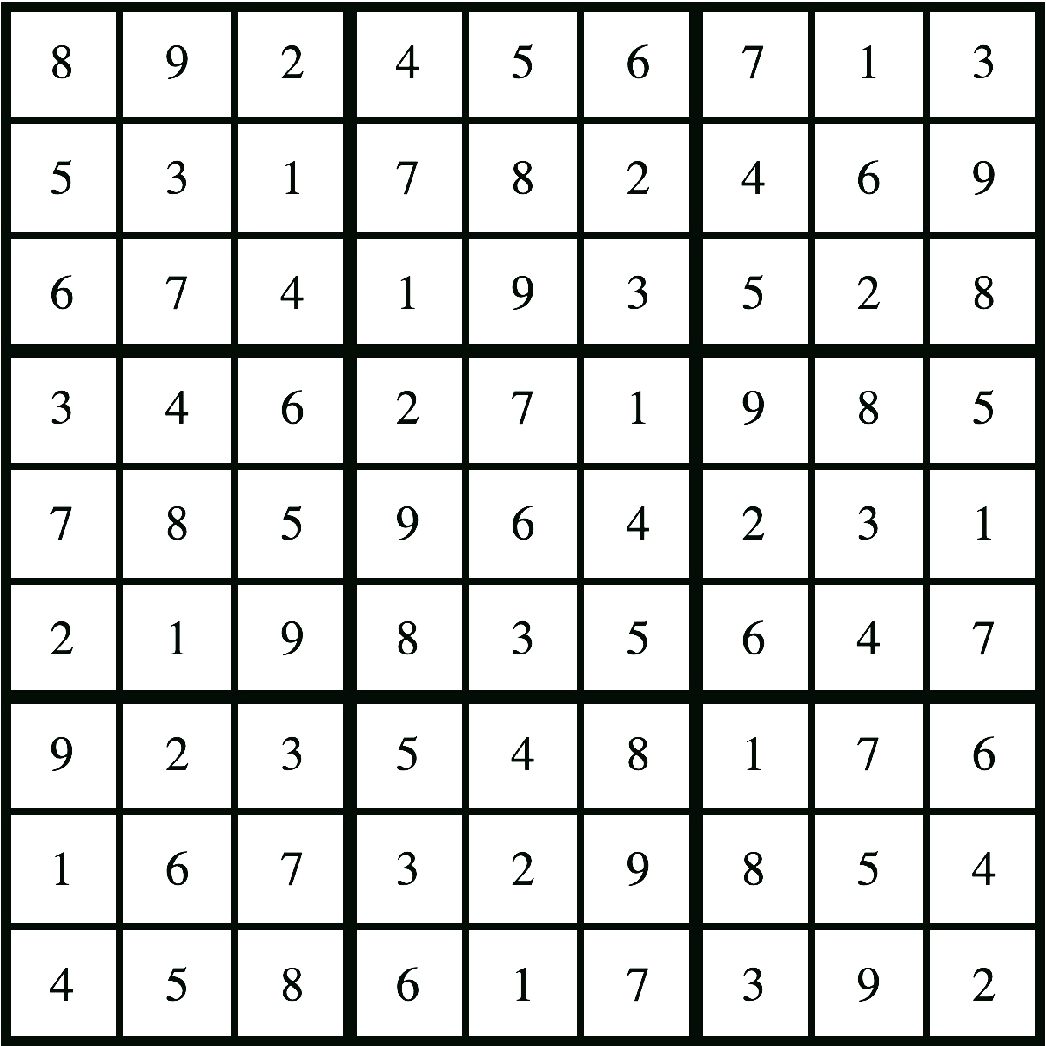
What is a Sudoku
9x9 grid where every row, column, and region contains numbers 1 to 9

Slide 3
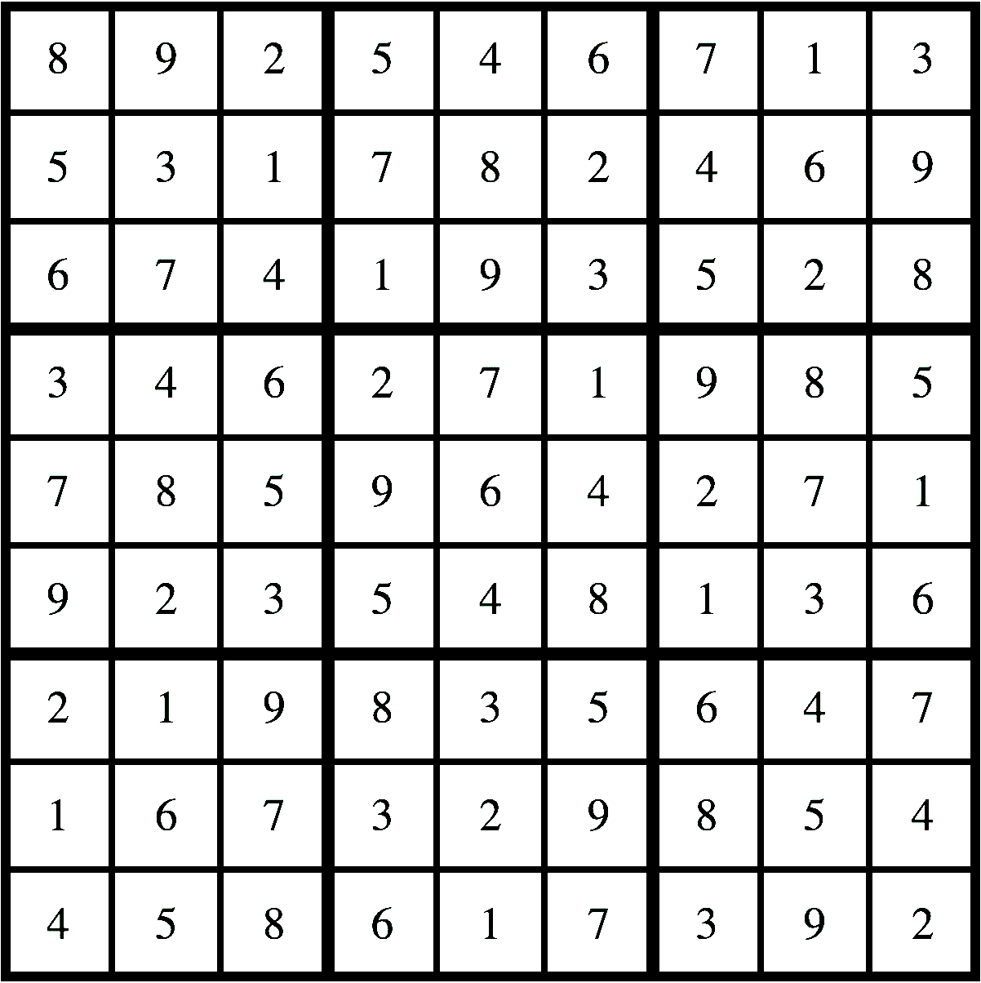
The Assignment
Given the string of a complete Sudoku, determine if it is valid or invalid. It is valid if every row, column, and region contains all digits 1 to 9 (or no digit is repeated).
Missing 3
The red boxes show invalid examples of each:
Missing 3
Missing 5

Slide 4
Subroutines
sudokuValidator:
This function checks the validity of a given Sudoku.
Input:
a0: pointer to a 2D 9x9 array of the input Sudoku where each item is a one byte integer
Output:
a0: Sudoku validity
returns 1 if valid, 0 if not
a1: valid rows (see slide 7)
a2: valid columns (see slide 7)
a3: valid regions (see slide 7)

Slide 5
Subroutines
validateArea:
This function checks if a given row, column, or region is valid.
Input:
a0: pointer to a 2D 9x9 array of the input Sudoku where each item is a one byte integer
a1: the type of area to check
0 for a row
1 for a column
2 for a region
a2: integer index of the row, column, or region to validate
Output:
a0: row, column, or region validity
return 1 if valid, 0 if not

Slide 6
sudokuValidator Bit Patterns
Working with bits increases the efficiency of programs.
Return registers a1-a3 in sudokuValidator contain the validity of each row, column, and region.
All the information can be stored directly in the register, rather than needing to point to an array.
Each row, column, and region is given an index number
The first 9 bits in each register will correspond to an index number
A bit will be 1 if its area is valid, otherwise 0
All other bits must be 0

Slide 7
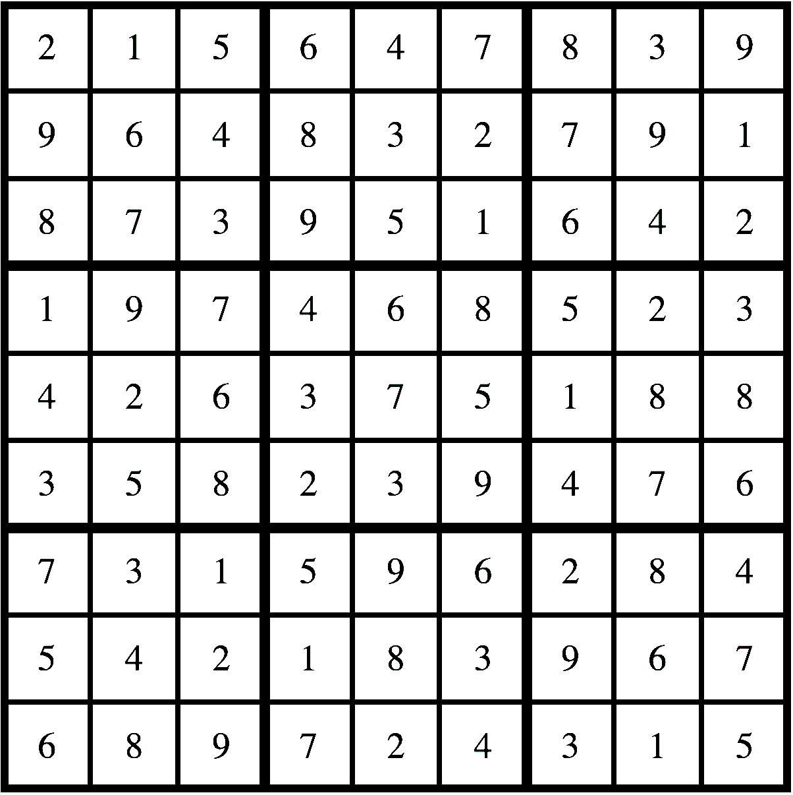
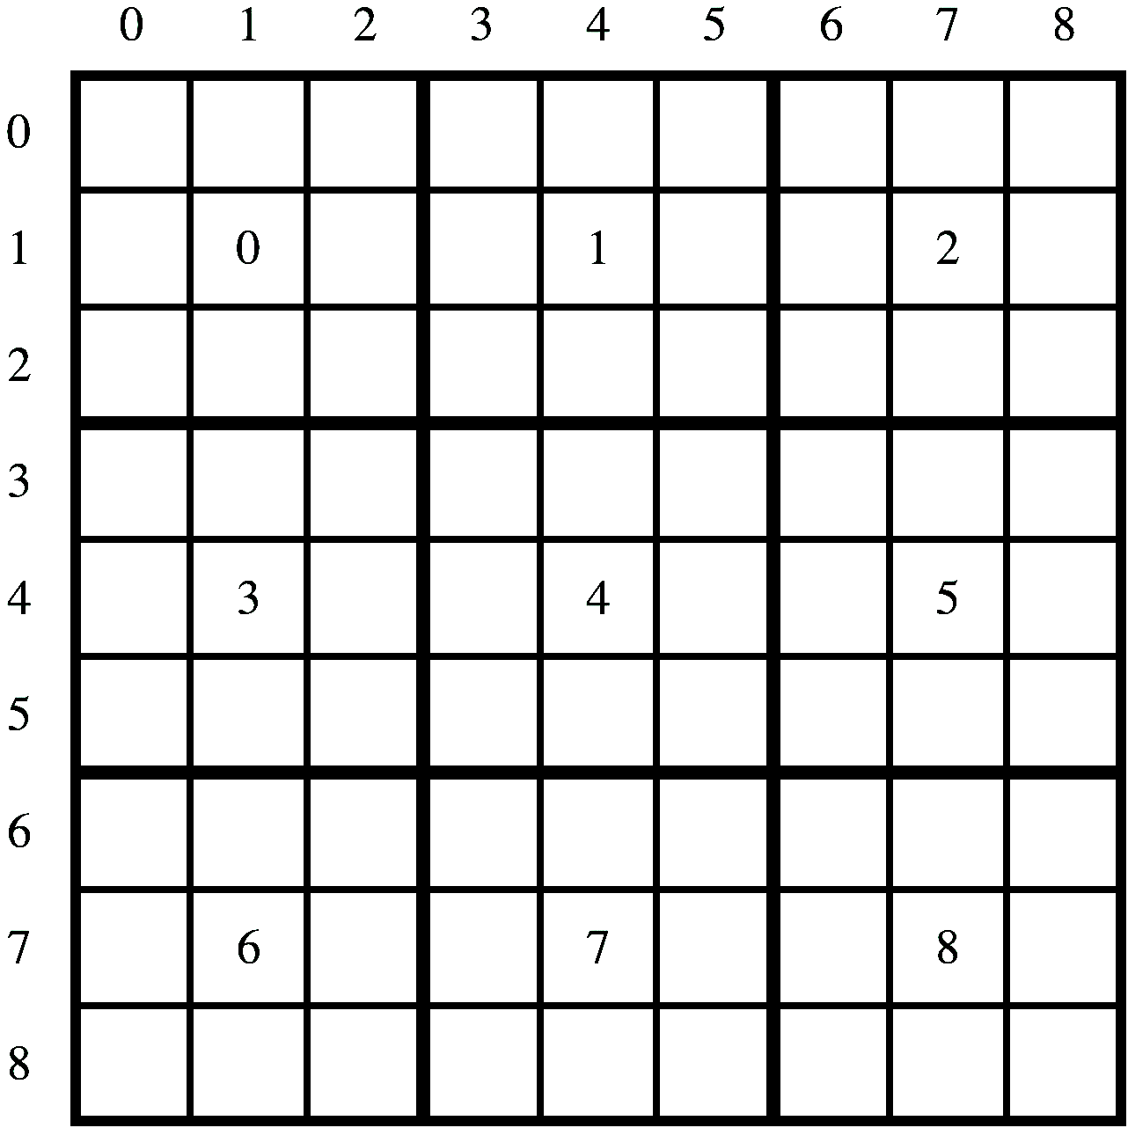
Mapping with Example
Sudoku is not valid.
Valid rows are: 00000000000000000000000111001101
Valid cols are: 00000000000000000000000101101111
Valid regs are: 00000000000000000000000111001011

Slide 8
Mapping with Example
Sudoku is not valid.
Valid rows are: 00000000000000000000000111001101
Valid cols are: 00000000000000000000000101101111
Valid regs are: 00000000000000000000000111001011

Slide 9
Mapping with Example
Sudoku is not valid.
Valid rows are: 00000000000000000000000111001101
Valid cols are: 00000000000000000000000101101111
Valid regs are: 00000000000000000000000111001011

Slide 10
Mapping with Example
Sudoku is not valid.
Valid rows are: 00000000000000000000000111001101
Valid cols are: 00000000000000000000000101101111
Valid regs are: 00000000000000000000000111001011

Slide 11
Mapping with Example
Sudoku is not valid.
Valid rows are: 00000000000000000000000111001101
Valid cols are: 00000000000000000000000101101111
Valid regs are: 00000000000000000000000111001011

Slide 12
Mapping with Example
Sudoku is not valid.
Valid rows are: 00000000000000000000000111001101
Valid cols are: 00000000000000000000000101101111
Valid regs are: 00000000000000000000000111001011

Slide 13
Mapping with Example
Sudoku is not valid.
Valid rows are: 00000000000000000000000111001101
Valid cols are: 00000000000000000000000101101111
Valid regs are: 00000000000000000000000111001011

Slide 14
Mapping with Example
Sudoku is not valid.
Valid rows are: 00000000000000000000000111001101
Valid cols are: 00000000000000000000000101101111
Valid regs are: 00000000000000000000000111001011

Slide 15
Mapping with Example
Sudoku is not valid.
Valid rows are: 00000000000000000000000111001101
Valid cols are: 00000000000000000000000101101111
Valid regs are: 00000000000000000000000111001011

Slide 16
Bit Manipulation
Make things easy by using one bit at a time:
Load bit: li t1, 1
Use sll (shift left logical) to move the bit
Combining registers:
and
or
xor

Slide 17
2D Arrays
You are given a pointer to a 2D 9x9 array.
This array will be stored in memory the same as an array of length 81 and will be done in row-major order.
Index = (row*9) + col
Only integers 1 to 9 are stored in the array, so each integer is 1 byte rather than the standard 4 bytes.

Slide 18
Functions
Function arguments are set in a0-a7 before a function call.
Function call: jal ra, myFunction
ra stores the return address.
Return values are set in a0-a7 before a function is returned.
Function return: ret
ret returns to the address in ra.

Slide 19
Register Conventions
Register conventions are required for this lab.
Only t and a registers can be different when returning from a function.
S registers, ra, and sp should be unchanged.
Register | Name | Use | Saver
x0 | zero | The constant value 0 | N.A.
x1 | ra | Return address | Caller
x2 | sp | Stack pointer | Callee
x3 | gp | Global pointer | --
x4 | tp | Thread pointer | --
x5-x7 | t0-t2 | Temporaries | Caller
x8 | s0/fp | Saved register/frame pointer | Callee
x9 | s1 | Saved register | Callee
x10-x11 | a0-a1 | Function arguments/return values | Caller
x12-x17 | a2-a7 | Function arguments | Caller
x18-x27 | s2-s11 | Saved registers | Callee
x28-x31 | t3-t6 | Temporaries | Caller

Slide 20
Stack
Example
To use s registers, or call another function, the s or ra registers need to be saved. This is done with the stack.
After the registers are saved to the stack, they can be used freely.
Before returning from the function the registers are restored from the stack
myFunction:
addi sp, sp, -12
sw ra, 0(sp)
sw s1, 4(sp)
sw s2, 8(sp)
# function code here
lw ra, 0(sp)
lw s1, 4(sp)
lw s2, 8(sp)
addi sp, sp, 12
ret

Slide 21
Tips and Notes
Loop examples (and more) found here:
https://cmput229.github.io/229-labs-RISCV/RISC-V-Examples_Public/example.html
The Sudokus used for grading will only use numbers 1 to 9 and will always be a complete 9x9 Sudoku
Make sure to return at the end of your sudokuValidator function
Use the provided example .txt files to test your lab and compare results to the .out files.
The tests provided to you are not extensive.
Do not edit any part of common.s
Do not use any labels used in common.s
You are encouraged to make your own helper functions.

