Slide 1
Lab 4: Dungeon Crawler
CMPUT 229

Slide 2
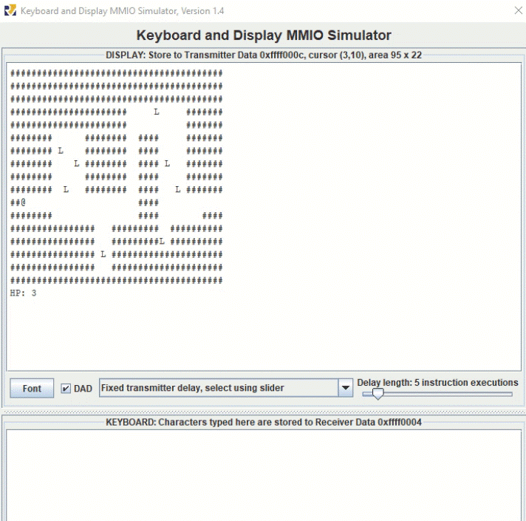
Game Overview
Legend
#: Dungeon Wall
L: Loot
E: Enemy
@: Agent
Space: Path

Slide 3

Program Arguments

Slide 4
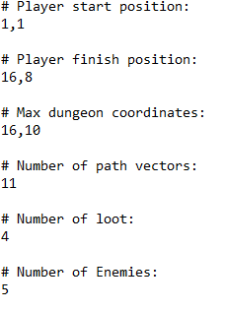
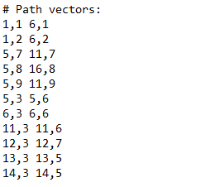
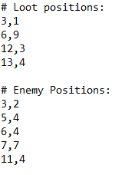
This is one of the input files provided to you:
smalldungeon.txt:

Slide 5
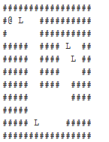
The input file defines a unique dungeon configuration
smalldungeon.txt:

Slide 6
Building the Dungeon
The provided common.s script parses the input file provided as a program argument into three designated arrays and some global variables:
Arrays:
Paths Array
Loot Array
Enemies Array
Global Variables:
PLAYER_X
PLAYER_Y
MAX_X
MAX_Y
FINISH_X
FINISH_Y

Slide 7
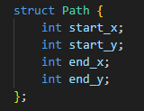
Paths Array
The paths array is an array of path “structs”. Each path struct contains four 32-bit integers that represent the start and end coordinates of a path: start x, start y, end x, end y.
A path can be imagined as this C struct

Slide 8
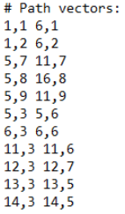
Paths Array
smalldungeon.txt:

Slide 9
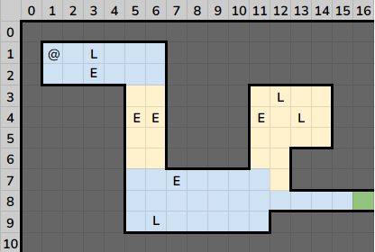
Blue: Horizontal paths
Yellow: Vertical paths
Green: Finish point

Slide 10

Loot Array
The loot array is an array of loot “structs”. Each loot struct contains two 32-bit integers that represent the coordinates of a loot item.
Loot can be imagined as this C struct.

Slide 11
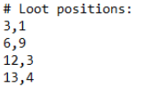
Loot Array
smalldungeon.txt:

Slide 13

Enemies Array
The enemies array is an array of enemy “structs”. Each enemy struct contains two 32-bit integers that represent the coordinates of an enemy.
An enemy can be imagined as this C struct.

Slide 14
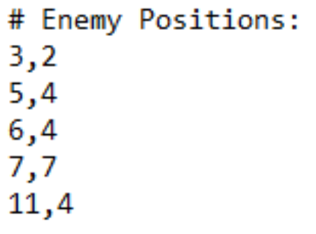
Enemies Array
smalldungeon.txt:

Slide 16
Representing the Dungeon Map as a 2D Array
Your program must use the data in the paths, loot, and enemy arrays to construct a 2D representation of the dungeon map.
Four pointers will be provided to your program’s primary function:
Pointer to the paths array
Pointer to the loot array
Pointer to the enemies array
Pointer to an empty array used to store the 2D representation of the dungeon

Slide 17
Representing the Dungeon Map as a 2D Array
[ 0 0 0 0 0 0 0 0 0 0 0 0 0 0 0 0 0 0 0 0
0 1 1 2 1 1 1 0 0 0 0 0 0 0 0 0 0 0 0 0
0 1 1 3 1 1 1 0 0 0 0 0 0 0 0 0 0 0 0 0 … ]

Slide 18
[ 0 0 0 0 0 0 0 0 0 0 0 0 0 0 0 0 0 0 0 0
0 1 1 2 1 1 1 0 0 0 0 0 0 0 0 0 0 0 0 0
0 1 1 3 1 1 1 0 0 0 0 0 0 0 0 0 0 0 0 0 … ]
Each element of the 2D array is a 32-bit integer:
0 = Dungeon wall
1 = Path
2 = Loot
3 = Hidden enemy
4 = Shown enemy

Slide 19
Provided Global Variables
PLAYER_X: Current x coordinate of the agent
PLAYER_Y: Current y coordinate of the agent
MAX_X: Maximum x coordinate of the map
MAX_Y: Maximum y coordinate of the map
FINISH_X: x coordinate of the exit point of the dungeon
FINISH_Y: y coordinate of the exit point of the dungeon

Slide 20
Gameplay Details

Slide 21
Timer
The game starts with 5 seconds on the timer. The timer decreases by 1 each second, implemented using timer interrupts.
If the timer reaches 0, the game will stop and you will lose.

Slide 22
Movement
The w,a,s,d keys are used to move the agent around the dungeon, implemented using keyboard interrupts.
The agent is only able to move along paths.

Slide 23
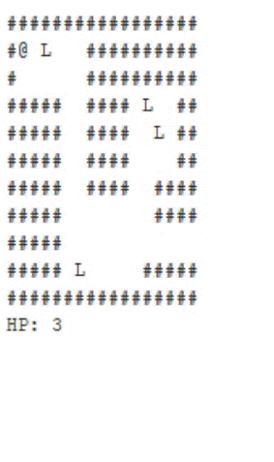
Encountering Loot
When your agent moves to a position that contains loot, 5 seconds are added to the timer and the loot is removed from the map.

Slide 24

Health Points
Your agent starts the game with 3 health points. Encountering enemies causes your agent to lose health points.
If your agent’s health points reach 0, the game stops and you lose.

Slide 25
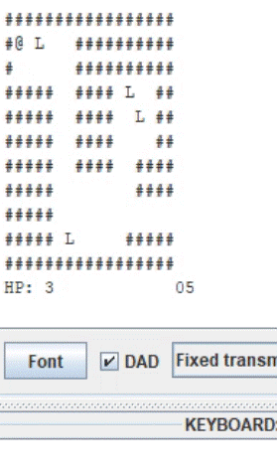
Encountering an enemy
Enemies are hidden until the agent encounters them.
When your agent moves to a position that contains an enemy, it will be unable to move until you press the spacebar to attack.

Slide 26
Encountering an enemy
Your agent’s health points decrease by 1 for each second that your agent is next to an enemy.

Slide 27
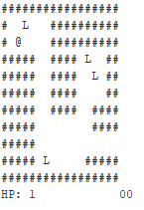
Win Conditions
To win the game, the following conditions must be true:
Your agent must reach the dungeon exit
There must be time remaining on the timer
The agent must have at least 1 health point remaining
All loot must be collected
Exit represented by a hole in the dungeon wall

Slide 28
Interrupts

Slide 29
Interrupts
The timer, player movement, and attack elements use external interrupts from hardware.
The rars timer tool is used to simulate RISC-V timing functionality, and is necessary for timer interrupts in this lab.
The rars keyboard and display MMIO simulator simulates printing to an external display device, and is necessary for keyboard interrupts in this lab.

Slide 30
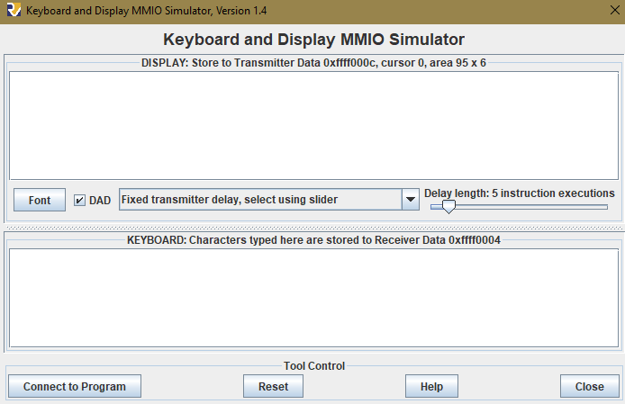
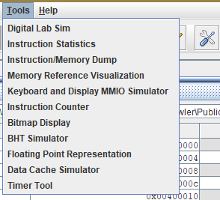
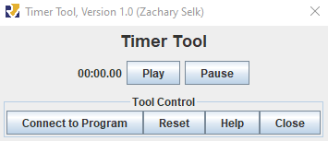
Required RARS Tools

Slide 31
Required RARS Tools

Slide 32
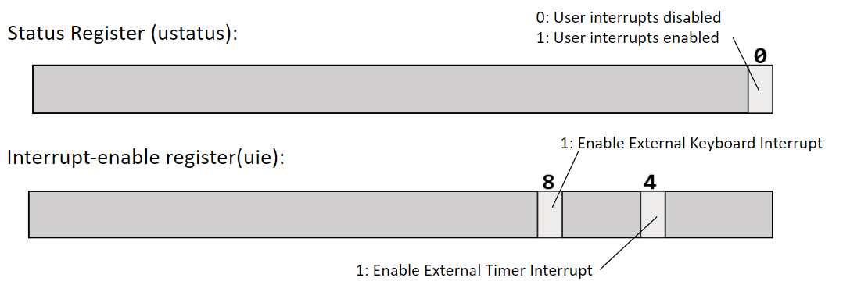
Enabling Interrupts using Control and Status Registers
Keyboard and timer interrupts are both user interrupts. The bits above need to be set to enable keyboard and timer interrupts.

Slide 33
Interrupts
When an enabled interrupt is raised (such as the player pressing the “w” key), the program is paused and execution is transferred to the interrupt handler.
You will write a custom interrupt handler to handle keyboard and timer interrupts.
To use your custom handler, the address of your handler must be stored in the utvec CSR (CSR #5).

Slide 34

Global flags
Setting global variable flags within your handler can signal to your main game loop what interrupt occurred. The main game loop can then update the game state accordingly after your program exits the handler.

Slide 35
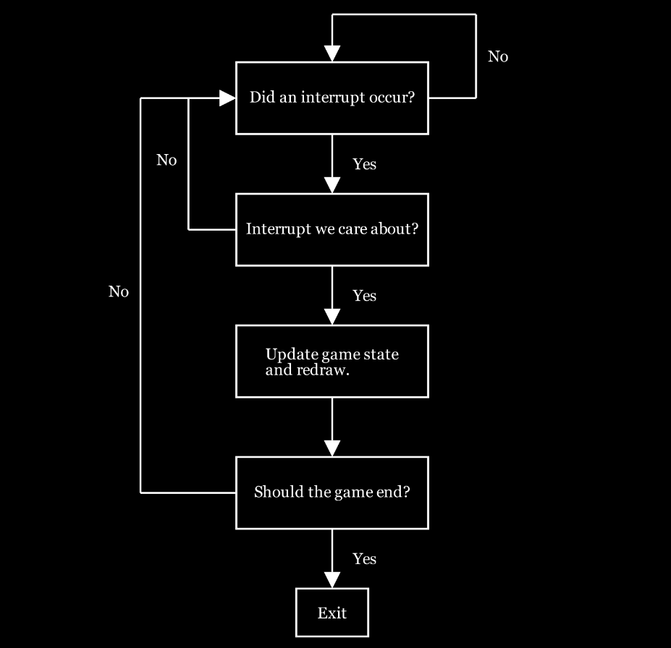
Example Gameflow

Slide 36
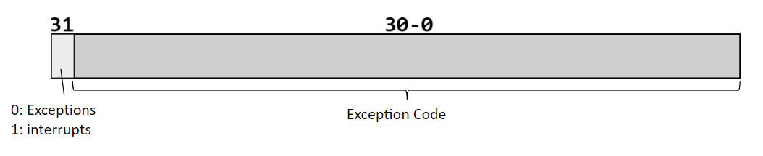
Ucause
The ucause register contains the current exception/interrupt that is raised. Note the 31st bit in the ucause register indicates if it was an exception or an interrupt.

Slide 37
Memory-Mapped IO

Slide 38
Memory-Mapped IO
Memory-mapped IO allows interaction with external devices through an interface pretending to be system memory. This mapping allows the processor to communicate with these devices using the load-word and store-word instructions.
In this lab, keyboard, time, and display I/O registers are important.

Slide 39
Keyboard Interrupts and MMIO Registers
Register Name | Memory Address | Description
Keyboard control | 0xFFFF0000 | For keyboard interrupts to be enabled, bit 1 of this register must be set to 1; after the keyboard interrupt occurs, this bit is automatically reset to 0.
Keyboard data | 0xFFFF0004 | The ASCII value of the last key pressed is stored here.

Slide 40
Time Interrupts and MMIO Registers
Register Name | Memory Address | Description
Time | 0xFFFF0018 | This is a read-only register that holds the time since the program has started in milliseconds.
Timecmp | 0xFFFF0020 | User-specified value. When less than or equal to the value in the Time register an interrupt is generated. Writing to this register is required to set up a timer.

Slide 41
Printing to MMIO Display using MMIO Registers
Register Name | Memory Address | Description
Display control | 0xFFFF0008 | Bit 0 of this register indicates whether the processor can write to the display. While this bit is 0 the processor cannot write to the display. Thus, the program must wait until this bit is 1.
Display data | 0xFFFF000C | When a character is placed into this register, given that the display control ready bit (bit 0) is 1, that character is drawn onto the display.

Slide 42
Note that direct communication to the display via the Display Data register has been implemented for you in the provided printChar and printStr functions.
Register Name | Memory Address | Description
Display control | 0xFFFF0008 | Bit 0 of this register indicates whether the processor can write to the display. While this bit is 0 the processor cannot write to the display. Thus, the program must wait until this bit is 1.
Display data | 0xFFFF000C | When a character is placed into this register, given that the display control ready bit (bit 0) is 1, that character is drawn onto the display.

Slide 43
Functions to implement in dungeon.s

Slide 44
dungeon:
This function is the entry point of the game and it executes the main gameplay loop.

Slide 45
handler:
This handler will catch and handle keyboard and timer interrupts.

Slide 46
buildPaths
This function adds the in-memory representation of the path positions in a 2D array of 32-bit integers.
[ 0 0 0 0 0 0 0 0 0 0 0 0 0 0 0 0 0 0 0 0
0 1 1 1 1 1 1 0 0 0 0 0 0 0 0 0 0 0 0 0
0 1 1 1 1 1 1 0 0 0 0 0 0 0 0 0 0 0 0 0 … ]

Slide 47
buildLootOrEnemies
This function adds the loot or hidden enemies (depending on the input arguments) to the 2D representation of the dungeon array.
[ 0 0 0 0 0 0 0 0 0 0 0 0 0 0 0 0 0 0 0 0
0 1 1 2 1 1 1 0 0 0 0 0 0 0 0 0 0 0 0 0
0 1 1 3 1 1 1 0 0 0 0 0 0 0 0 0 0 0 0 0 … ]

Slide 48
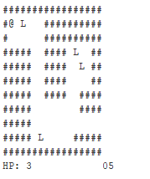
displayDungeon
This function handles the logic to print the map to the MMIO display.
2D dungeon array:
[ 0 0 0 0 0 0 0 0 0 0 0 0 0 0 0 0 0 0 0 0
0 1 1 2 1 1 1 0 0 0 0 0 0 0 0 0 0 0 0 0
0 1 1 3 1 1 1 0 0 0 0 0 0 0 0 0 0 0 0 0 … ]

Slide 49
getDestination
This function returns what type of element is located at a given x,y point in the 2D representation of the map array.
2D dungeon array:
[ 0 0 0 0 0 0 0 0 0 0 0 0 0 0 0 0 0 0 0 0
0 1 1 2 1 1 1 0 0 0 0 0 0 0 0 0 0 0 0 0
0 1 1 3 1 1 1 0 0 0 0 0 0 0 0 0 0 0 0 0 … ]
Get x = 3, y = 1

Slide 50
replacePoint
This function replaces the value at a given x,y point in the 2D representation of the map array with a new value.
2D dungeon array:
[ 0 0 0 0 0 0 0 0 0 0 0 0 0 0 0 0 0 0 0 0
0 1 1 1 1 1 1 0 0 0 0 0 0 0 0 0 0 0 0 0
0 1 1 3 1 1 1 0 0 0 0 0 0 0 0 0 0 0 0 0 … ]
Set x = 3, y = 1 to path

Slide 51
Functions provided to you in dungeon.s

Slide 52
printStr
Prints a string to the Keyboard and Display MMIO Simulator terminal at the x,y coordinates provided as arguments.

Slide 53
printChar:
Prints a single character to the Keyboard and Display MMIO Simulator terminal at the x,y coordinates provided as arguments.

Slide 54
intToStr:
Converts at most a two digit integer into its ascii equivalent.

Slide 55
Testing your solution

Slide 56
Test dungeons
Three test dungeon inputs are provided to you:
smalldungeon.txt
mediumdungeon.txt
largedungeon.txt

Slide 57
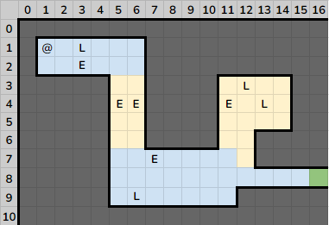
smalldungeon.txt

Slide 58
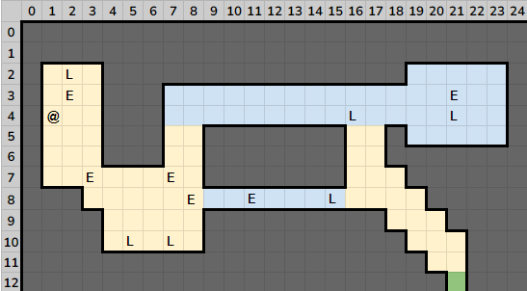
mediumdungeon.txt

Slide 59
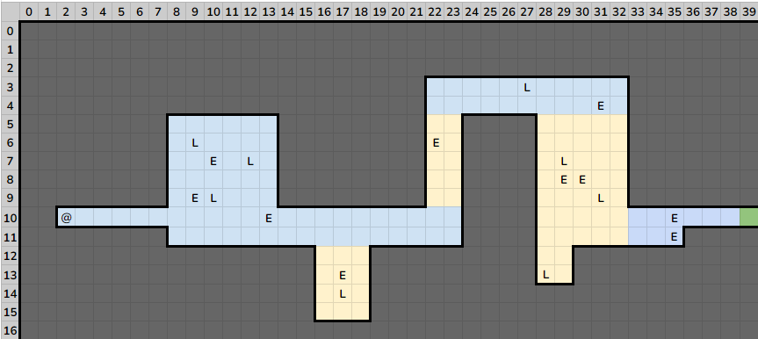
largedungeon.txt

Slide 60

Hints
Implementing the handler with timer and keyboard interrupts that work correctly will likely take longer than you would expect. Debugging can be tricky. It is highly recommended to start this lab early!

