Slide 1
Lab #4: Game of Life Bytes
CMPUT 229
Notes:
- Slides for the “Game of Life Bytes” lab.

Slide 2
Background
CMPUT 229
Notes:
This section introduces concepts required for the lab.
- What is the game of life?
- How to interrupts work?
- MMIO devices.

Slide 3
Overview
Simulating the Game of Life
In this lab you will write an interactive simulator for Conway’s Game of Life.
The simulation will use RISC-V’s interrupt handling facilities for keyboard input and timing.
Output will be performed using the MMIO terminal display in RARS.
Notes:
- In this lab you will write an interactive simulator of Conway’s game of life.
- The simulator will use interrupts.
- Will use keyboard and timer interrupts.
- Output will be performed using the MMIO terminal.

Slide 4
Conway’s Game of Life
Conway’s Game of Life
A simulation that follows the evolution of a square grid of cells.
Each cell can be either living or dead.
Each step of the simulation, every cell is updated according to a set of rules.
Simulation Rules
A living cell that has less than two living neighbours dies.
A living cell that has more than three living neighbours dies.
A dead cell that has exactly three living neighbours becomes alive.
Otherwise, the cell’s state doesn’t change.
Notes:
- What is the game of life?
- A simulation that follows the evolution over time of a square grid of cells.
- Each cell can be either living or dead.
- Each simulation step, every cell is updated according to a set of rules.
- What are the simulation rules?
- A living cell with less than two living neighbours dies.
- A living cell with more than three neighbours.
- A dead cell that has exactly three living neighbours becomes living.
- Otherwise, the cell’s state doesn’t change.

Slide 5
Example simulaiton:
These simple rules can lead to complex behaviour:
Notes:
- These simple rules can lead to complex behaviour.
- The following animation shows a “glider gun”, which produces an infinite number of travelling groups of cell.

Slide 6
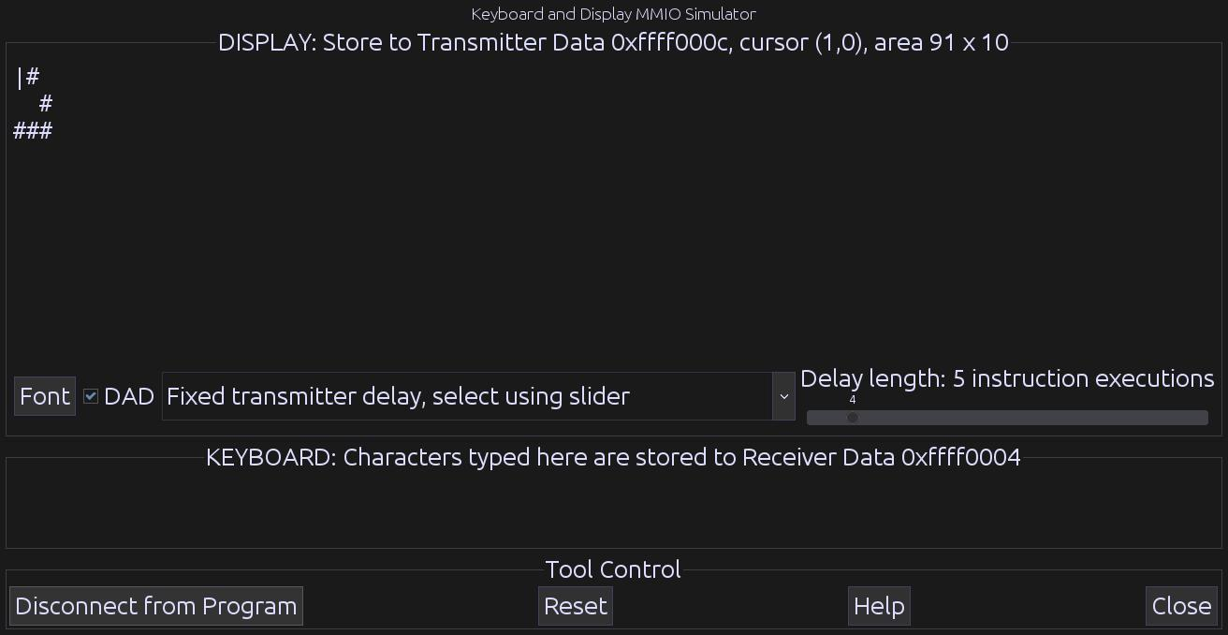
Interactive Simulator
Operation of the Simulator
The simulator will display a grid of cells and a cursor.
The user can control the simulation, and cause the simulation to update.
The simulation can be moved to a “running” state, where it steps automatically.
Notes:
- How does the simulator work?
- The simulator displays the grid of cells using printed characters.
- The user can control the simulation.
- The user can cause the simulation to update.
- The simulation can be put into a “running” state, in which the simulation steps every second.
- There will be more information in a later section.

Slide 7
Controling the Simulator
Interacting with the Simulator
Keyboard controls are used to interact with the simulator.
The cursor can be moved up, down, left, and right with the w, s, a, and d keys.
The cell that the cursor is on can be set to the living state with the j key, and set to the dead state with the k key.
A single step of the simulation can be performed using the space key.
The state of the simulator can be switched between the “paused” and “running” states by pressing the t key.
Pressing the q key exits the simulator.
Notes:
- Keyboard controls are used to interact with the simulator.
- The cursor can be moved up, down, left, and right.
- Cells can be set to the living or dead states.
- A single step of the simulation can be performed.
- The state of the simulation can be toggled between “paused” and “running” states.
- Can exit the simulator.

Slide 8
Interrupts
Interrupts
The simulator uses interrupts to interact with the hardware and external devices.
Specifically, the simulator uses timer and keyboard interrupts.
When an interrupt occurs (say a key press) the interrupt handler is called.
The interrupt handler must deal with the interrupt, then return control back to the running program.
Control and Status Registers
RISC-V uses “control and status” registers to configure interrupts.
Interrupts are disabled by default in RARS, so they must be enabled using these registers.
The address of the interrupt handler must also be set.
Refer to the website for specific information on which registers to use and how to use them.
Notes:
- What are interrupts?
- The simulator uses interrupts to interact with hardware devices.
- The simulator will use timer and keyboard interrupts.
- When an interrupt occurs, your interrupt handler will be called.
- The interrupt handler must correctly handle the interrupt, and return control back to the running program.
- RISC-V uses CSR registers to configure interrupts.
- Interrupts are disabled by default.
- The address of your interrupt handler must be set.
- Refer to the specification for specific information on the CSR’s.

Slide 9
RARS Keyboard & Timer Tools
Keyboard & Display Tool
Found under the “Keyboard and Display MMIO Simualtor” tab under the “Tools” menu in RARS.
After assembling your program, click the “Connect To Program” button.
If you resize your terminal, click the “Reset” button.
Timer Tool
Found under the “Timer Tool” tab under the “Tools” menu.
Press “Connect To Program” to connect the timer to your assembled program.
Notes:
- The simulator will use the keyboard and display tool in RARS
- Must be opened, then press “connect to program”.
- If you resize the display window, press the “reset” button.
- Your simulator will also use the timer tool.
- Must be opened, then press “start” and “connect to program”.

Slide 10
MMIO
Memory-Mapped IO
Memory-mapped IO allows interaction with external devices through an interface “pretending” to be system memory.
We can communicate with such devices using regular memory instructions.
Both the Keyboard / Display and the Timer tools use MMIO.
A list of the addresses of all MMIO registers can be found on the website.
Notes:
- What is MMIO?
- Maps external devices through system memory.
- If we use MMIO, then we can interact with the devices using regular load/store instructions.
- Both the keyboard/display and the timer use MMIO.
- You can find a list of the MMIO register addresses on the website.

Slide 11
Keyboard & Display MMIO
Keyboard MMIO Registers
Keyboard Control: Enables keyboard interrupts.
Keyboard Data: Contains the ASCII value of the last keypress.
Display MMIO Registers
Display Control: Indicates whether or not the display can be written to.
Display Data: When a character is stored here and the display is ready, the character is written to the display.
Notes:
- Descriptions of what each MMIO register does:
- Keyboard control: Enables keyboard interrupts.
- Keyboard data: Contains the ASCII value of the last keypress.
- Display control: Indicates whether or not the display can be written to.
- Display data: When a character is stored here & the display is ready, the character is written to the display.

Slide 12
Timer MMIO
Timer MMIO Registers
Time: Contains the time given in the timer tool. Stored in milliseconds.
Timecmp: When the value in this register is less than or equal to the value in the Time register, a timer interrupt occurs.
Notes:
- Time: Contains the current time from the timer tool. Stored in milliseconds (1s = 1000ms).
- Timecmp: When the value in this register is less than or equal to the value in the Time register, a timer interrupt occurs.
- Timer interrupts are only actived once the Timecmp register is written to, and only once per write.

Slide 13
Writing an Interrupt Handler
Writing an Interrupt Handler
An interrupt handler is similar to a regular function.
The interrupt handler is run during the execution of the program. Thus the interrupt handler cannot appear to change any of the registers.
Registers cannot be saved to the stack, since the stack pointer may be corrupted. For example, consider an exception thrown for a missaligned load using the stack pointer.
The uscratch register contains a pointer to memory that can be used by the handler.
This memory can be used to store the original values of registers that are used by the interrupt handler.
Notes:
- How to write an interrupt handler.
- Writing an interrupt handler is similar to writing a regular RISC-V program.
- However, there are a few key differences.
- The interrupt handler “interrupts” regular program execution.
- Thus the interrupt handler cannot appear to change any of the registers.
- Furthermore, registers cannot be saved to the stack, since the stack pointer may be corrupt.
- In this lab, the uscratch register contains a pointer to memory that can be used by the handler.
- This memory can be used to store the original values of registers that are used by the interrupt handler.

Slide 14
Simulator
CMPUT 229
Notes:
This section describes the details of the Game of Life simulator.

Slide 15
Game of Life Simulator
Input to the Simulator
The inital state of the cell grid is given by the input file.
This file is parsed and given to your solution as a cell grid buffer.
Stepping the Simulator
At each step of the simulation, the cells in the grid are updated according to the Game of Life rules.
We cannot use a single cell grid, since if we update the cells in place, the neighbour counts may change during the update.
This may cause the simulation to compute the next state incorrectly.
To solve this issue, we can use two buffers. One buffer contains the current state. During the simulation step, the results are written to the second buffer.
Notes:
- The initial state of the cell grid is given by the input file.
- This file is parsed for you and given to your solution in a buffer.
- At each step of the simulation, the cells in the grid are updated according the the GOL rules.
- If we update the cells in place, the neighbour counts may change during the update.
- This may cause the simulation to incorrectly compute the next state.
- To solve this issue, we can use to buffers.
- The cells are read from one buffer, and the results are written to another buffer.

Slide 16
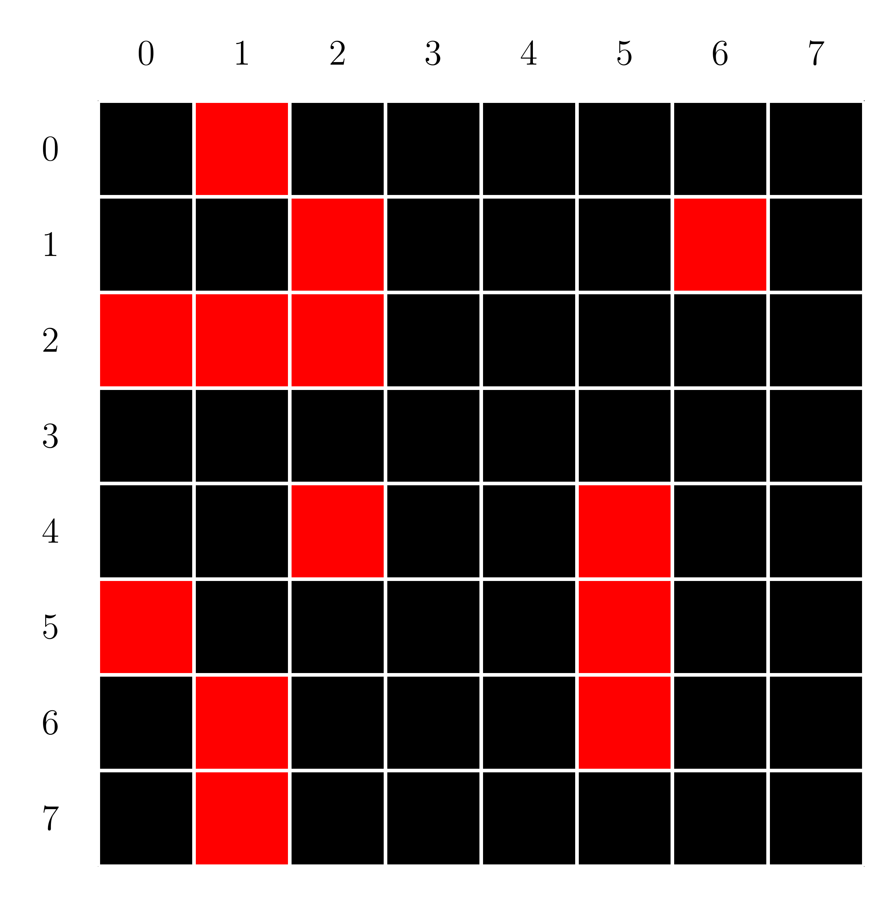
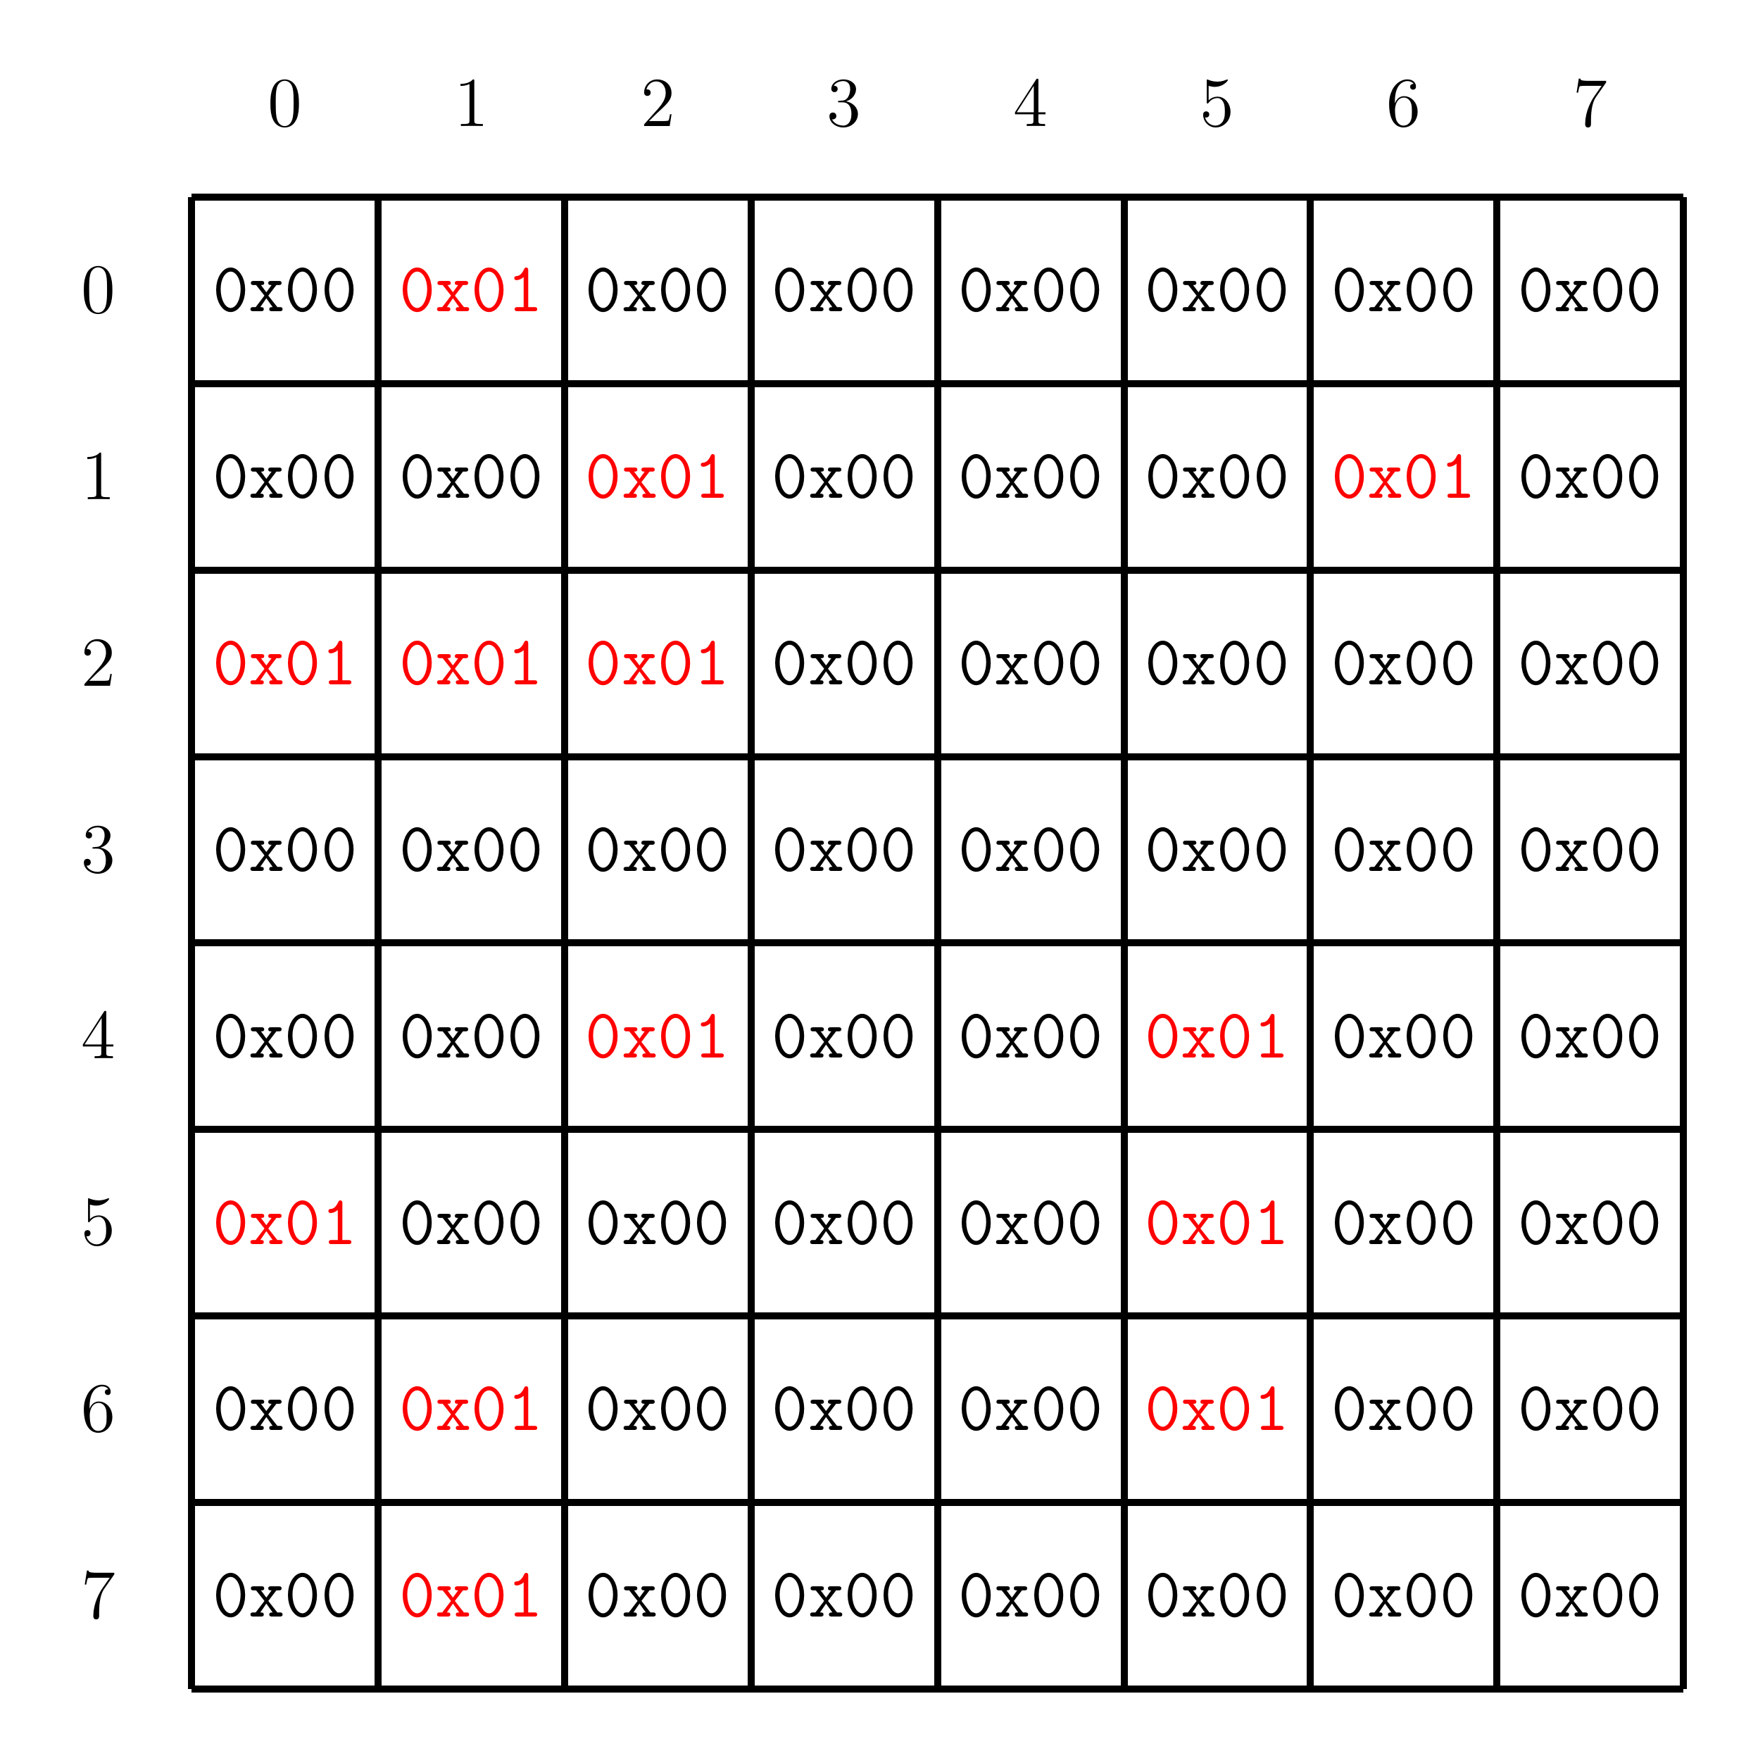
Cell Grids
Format of the Cell Grid
The state of the simulation is stored in a byte array, referred to as a “grid”.
The byte 0x00 represents a dead cell, while living cells are represented by 0x01.
Notes:
- Cell grids are stored as arrays of bytes.
- The byte 0x00 represents a dead cell, and the byte 0x01 represents a living cell. All other bytes are invalid.
- Consider the following grid of cells, with red cells as living, and black cells dead. (left picture)
- The cells have the following byte representations. (right picture)

Slide 17
Cell Grids in Memory
0x10001000 | 0x00000100
0x10001004 | 0x00000000
0x10001008 | 0x00010000
0x1000100c | 0x00010000
0x10001010 | 0x00010101
0x10001014 | 0x00000000
0x10001018 | 0x00000000
0x1000101c | 0x00000000
0x10001020 | 0x00010000
0x10001024 | 0x00000100
0x10001028 | 0x00000001
0x1000102c | 0x00000100
0x10001030 | 0x00000100
0x10001034 | 0x00000100
0x10001038 | 0x00000100
0x1000103c | 0x00000000
How are Cell Grids Stored?
Cell grids are stored in row-major order.
This grid:
Notes:
- Cell grids are stored in row-major order.
- Each row of the grid is placed one after the other into memory.

Slide 18
Wrapping the Grid
How Wrapping Works
When travelling off the edge of the simulation grid, the simulation wraps around to the opposite edge.
Any point (x, y) can be mapped to a grid with r rows and c columns using the following formula:
(x mod c, y mod r)
However, in this lab, we are only concerned with cells that are in the grid, or are one cell outside (including the corners).
Your solution only needs to handle these cases.
Notes:
- The simulation grid is of finite size.
- When travelling of one of the edges, you end up on the opposite edge.
- Any point (x, y) can be mapped to a grid with r rows and c columns using the following formula:
(x mod c, y mod r)
- However, in this lab we are only concerned with cells that are in the grid, or are a single cell outside (including the corners).
- As such, your solution only needs to handle these cases.

Slide 19
Printing to the Display
Printing to the MMIO Diplay:
The MMIO display cannot be printed to using ecall.
Instead, we provide the printCell function, which can print a single character to a given row and column of the display.
The characters to use for living cells, dead cells, and the cursor are given in the ALIVE_CHAR, DEAD_CHAR, and CURSOR_CHAR variables, respectively.
Notes:
How do we print to the MMIO display?
- We cannot print using an ecall.
- We have provided the printCell function, which can print a single character to a given row and column of the display.
- The characters used from printing living cells, dead cells, and the cursor are given in the ALIVE_CHAR, DEAD_CHAR, and CURSOR_CHAR variables.

Slide 20
printCell
Description:
Print a character to the MMIO text terminal at (row, col).
Parameters:
a0: Character to print as an ASCII byte.
a1: Row to print the character at.
a2: Column to print the character at.
Return Value:
N/A
Notes:
- Prints a single character to the MMIO text terminal.
- Takes in the character to print, and the row and column to print to.

Slide 21
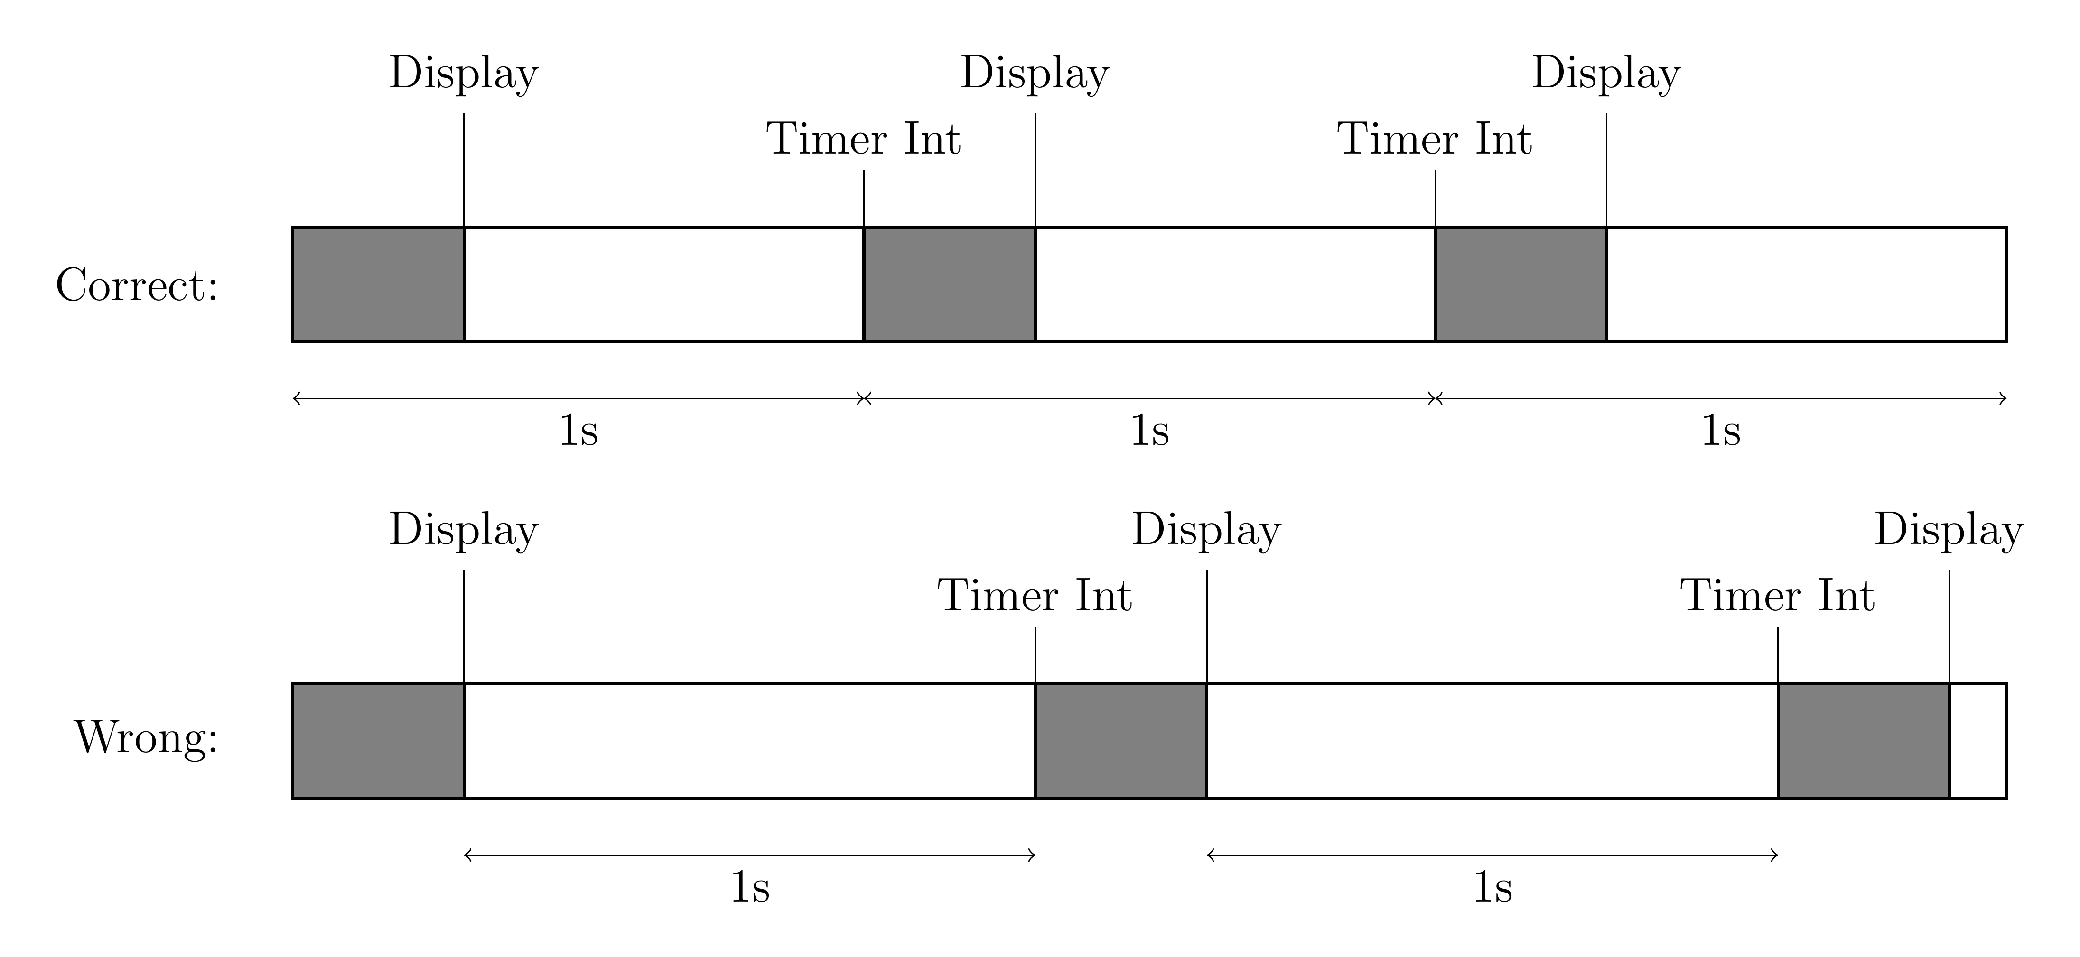
Timing
How Timing Works:
When the simulator is in the “running” state, an iteration of the simulation is performed once per second.
The timer must be reset before beginning to update the simulation.
Otherwise, the time between updates may be more than one second.
Notes:
- When the simulation is in the “running” state, an iteration of the simulation is performed once per second.
- The timer must be reset before beginning to update the simulation.
- Otherwise, the time between updates may be more than one second.
- This issue can be visualizied using the following diagram:
- The shaded gray region represents the time taken to step the simulation (user code).
- In the correct scheme, this time is included in the time between interrupts.
- Thus the simulation updates with the correct cadence.
- In the wrong scheme, this time is not included, leading to a longer time between updates.

Slide 22
Controlling the Simulator
Simulation Controls:
w
Move the cursor up one character, wrapping if needed. Then update the display.
s
Move the cursor down one character, wrapping if needed. Then update the display.
a
Move the cursor left one character, wrapping if needed. Then update the display.
d
Move the cursor right one character, wrapping if needed. Then update the display.
j
Set the cell at the cursor to the living state, then update the display.
k
Set the cell at the cursor to the dead state, then update the display.
t
Toggle the simulation between the “running” and “paused” states.
space
Step the simulation and update the display. Only works when in the “paused” state.
q
Exit the simulation.
Notes:
- The simulation is controled using the following keys:
- w: Moves the cursor up one character.
- s: Moves the cursor down one character.
- a: Moves the cursor left one character.
- d: Moves the cursor right one character.
- After moving the cursor, the display should be updated.
- j: Sets the cell at the cursor to be living.
- k: Sets the cell at the cursor to be dead.
- After setting the cell, the display should be updated.
- t: Toggle the simulation between the “paused” and the “running” states.
- space: When in the “paused” state, step the simulation. Otherwise this should do nothing.
- q: Exit the simulation.

Slide 23
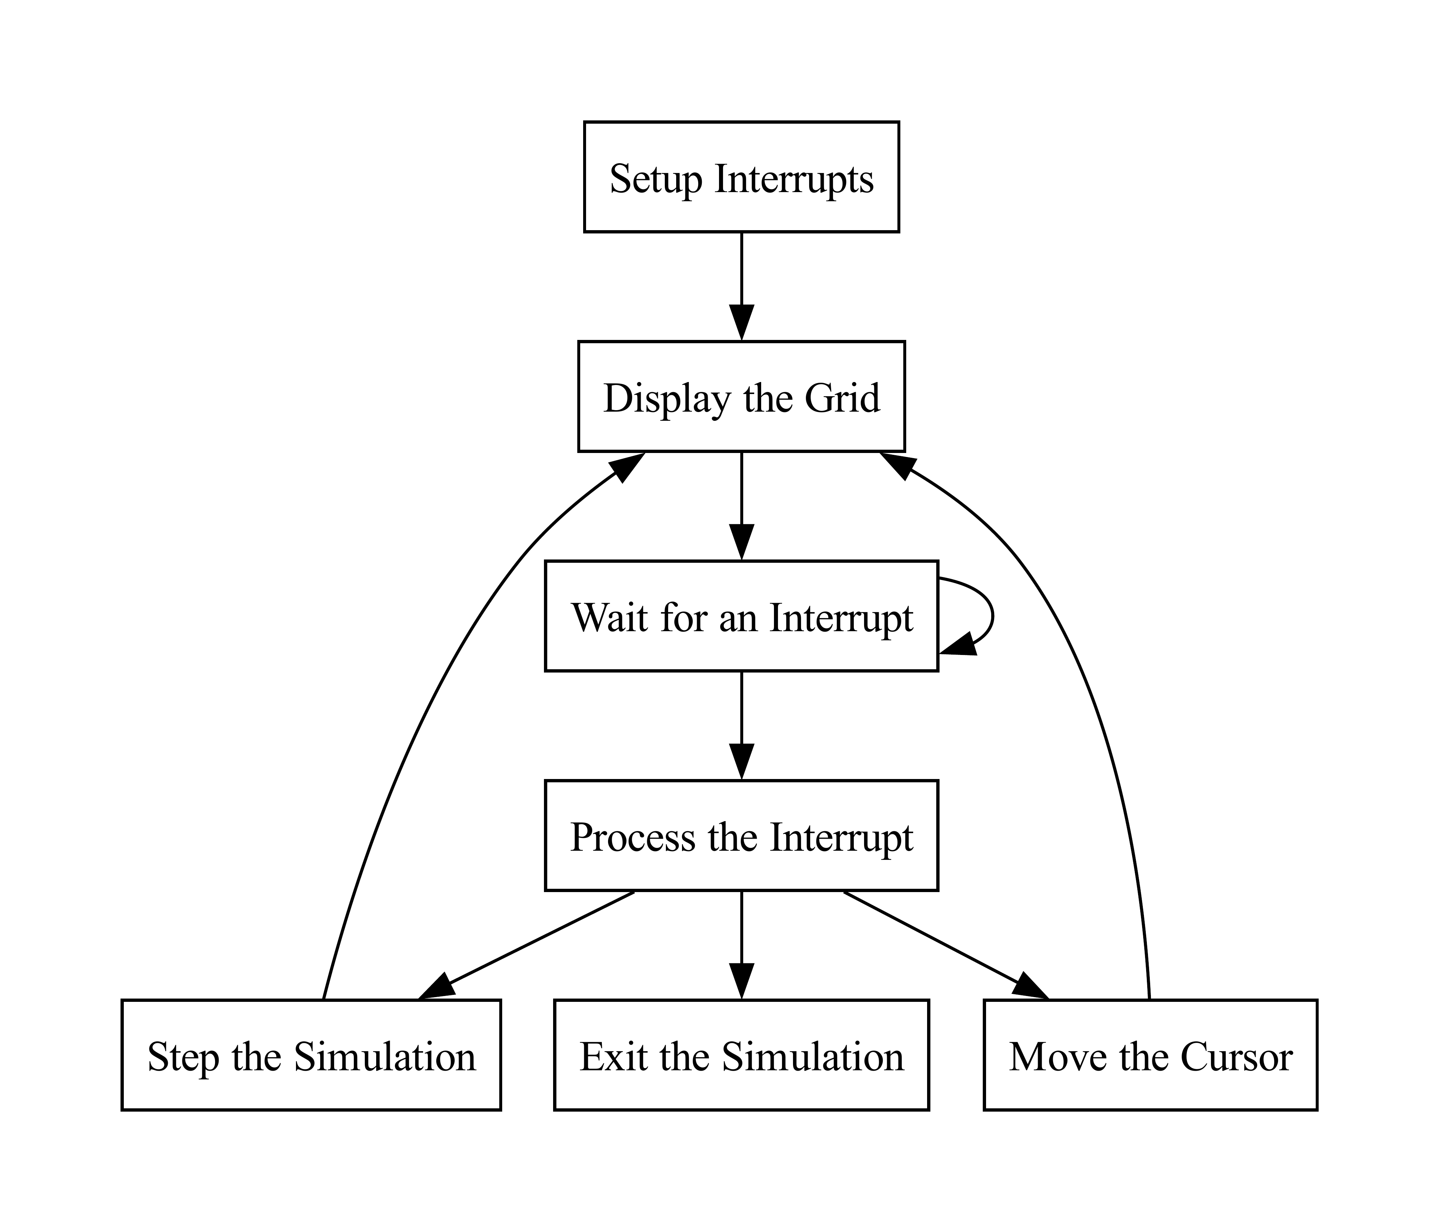
Flow of the simulator
Notes:
- The following diagram describes the flow through the simulator:
- Before any simulation occurs, interrupts must be setup.
- Next the grid must be displayed.
- Then, your solution should wait until an interrupt occurs.
- When an interrupt occurs, your solution must process the interrupt.
- Based on the type of interrupt, the required action must be performed.
- After the action is performed, move back to the display state.

Slide 24
Assignment
CMPUT 229
Notes:
This section desribes the required functions for this lab.

Slide 25
Overview of the lab
Overview:
In this lab, you must implement a series of funtions to create a simulator for the Game of Life.
You are required to implement all of the following functions.
Notes:
- You must implement all of the functions.

Slide 26
gameOfLife
Description:
Entry point for the Game of Life simulator.
Parameters:
a0: Number of rows in the grid.
a1: Number of columns in the grid.
a2: Pointer to grid buffer A (Initializied with the input state).
a3: Pointer to grid buffer B.
Return Value:
N/A
Notes:
- Is the “main” function (entry point).
- Takes in the number of rows / columns in the grid.
- Takes in two buffers, one of which holds the initial state.
- Is responsible for setting up interrupts, waiting for interrupts, and so on.

Slide 27
displayGrid
Description:
Display the given Game of Life grid to the MMIO terminal.
Parameters:
a0: Number of rows in the grid.
a1: Number of columns in the grid.
a2: Pointer to grid buffer to display.
Return Value:
N/A
Notes:
- Displays the given cell grid to the MMIO terminal.
- Takes in the number of rows / columns in the grid.
- Takes in a pointer to the cell grid.

Slide 28
updateGrid
Description:
Perform a single Game of Life simulation step. Reads from one buffer and writes the result to another.
Parameters:
a0: Number of rows in the grid.
a1: Number of columns in the grid.
a2: Pointer to the input grid buffer.
a3: Pointer to the output grid buffer.
Return Value:
N/A
Notes:
- This function performs a single simulation step. Reads cells from one buffer and writes the results to an different buffer.
- Takes in the number of rows/columns in the grid.
- Takes in a pointer to an input cell grid buffer, and an output cell grid buffer.
- This function should not modify the input cell grid buffer, and should not read from the output cell grid buffer.
- This function should not print to the MMIO display.

Slide 29
getCell
Description:
Get the value of a given cell. If the location is out of bounds, wrap around.
Parameters:
a0: Number of rows.
a3: Column of the cell.
a1: Number of columns.
a4: Pointer to the grid buffer.
a2: Row of the cell.
Return Value:
a0: Value of the cell.
Notes:
- Gets a the value of a single cell. Must wrap correctly.
- Takes in the number of rows/columns.
- Takes in the row/column of the cell to get.
- Takes in a pointer to a cell grid buffer.
- Returns the value of the cell.

Slide 30
setCell
Description:
Set the value of a given cell. If the location is out of bounds, wrap around.
Parameters:
a0: Number of rows.
a3: Column of the cell.
a1: Number of columns.
a4: Pointer to the grid buffer.
a2: Row of the cell.
a5: New value of the cell.
Return Value:
N/A
Notes:
- Sets the value of a cell. Must wrap correctly.
- Takes in the number of rows/columns in the grid.
- Takes in the row/column of the cell to set.
- Takes in a pointer to the cell grid buffer to modify.
- Takes in the new value of the cell.

Slide 31
handler
Description:
Interrupt handler for the Game of Life simulator.
Parameters:
N/A
Return Value:
N/A
Notes:
- Interrupt handler.
- Must handle both keyboard and timer interrupts.
- All other types of interrutps should call handlerTerminate.

Slide 32
Testing
CMPUT 229
Notes:
- Overview of how to test your lab.
- How to create test files.
- How to run a test.

Slide 33
Testing your Solution
Included tests:
We have provided some inputs for you to test your solution with.
These inputs are stored in the “Tests” directory as *.txt files.
Format of the test file:
Make sure the test file has the correct format (refer to the website).
RARS may need the full path to the test file.
Notes:
- Some included inputs, these input files are in the correct format.
- To test your solution, give the path to the input file in the program arguments.

