Slide 1
Introduction to Lab Maze Game
José Nelson Amaral

Slide 2
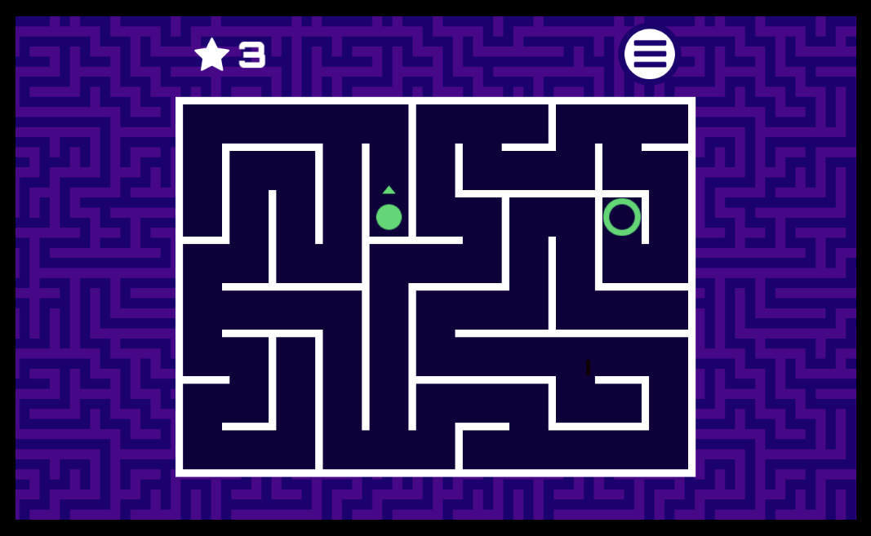
Maze Games

Slide 3
Two Screens
Preparation Screen:
Reads the level of the game
Game Screen:
Displays the maze
Player can move around by pressing using WASD.
Time remaining

Slide 5
Exceptions/Interruptions
Enable interrupts for both the timer and the keyboard
Create an exception handler
Notes:
While Rars has the option to have interruptions, the student creating the programs must enable them. Additionally, the student must create an exception handler to deal specifically with the interrupts they have enabled.

Slide 6
Enable Interrupts
Keyboard:
Keyboard Control (0xFFFF0000): Bit 1 of must be 1 for the keyboard to be enabled
Must be re-enabled after every keyboard interrupt
Keyboard Data (x0xFFFF0004): Contains the ASCII character after a key is pressed
Timer:
Timer (0x0xFFFF0018): Contains the current time
TimeCMP (0xFFFF0020): User-specified value. When matched by the timer an interrupt is generated
Interruption Control:
ustatus register (CSR#0): bit 0 must be set to 1 for user interrupts to be allowed.
uie register (CSR#4): Bits 4 and 8 must be 1 in order to enable keyboard and timer interrupts.
Notes:
Note, that everytime a keyboard interrupt occurs, i.e. a key is pressed, the bit 1 of the keyboard control must be reset everytime.

Slide 7
Saving Registers
An interrupt handler must save all the registers that it uses.
The label iTrapData designates a section of memory allocated for saving registers in the handler.
Outside of the handler, uscratch (CSR #64) should contain the address of the iTrapData section.
Use the cssrw instruction to swap a register with the uscratch and save all the required registers.

Slide 8
Exception Handler
The maze.s already contains the Handler Terminate section
The common.s file will already have the iTrapData section
Notes:
*** Look at the common.s file

Slide 9
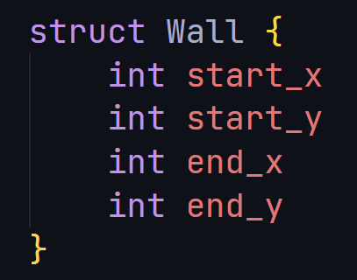
Wall Structs
Encodes the information regrading the walls in the maze
Can be thought of as a C struct like the one given on the left.
You will be given an array of these structs one for each wall in the maze.
Each struct will be laid out in the memory as:
Example the following is an array with 2 walls:
Check the lab specification page for explanatory videos.

Slide 10
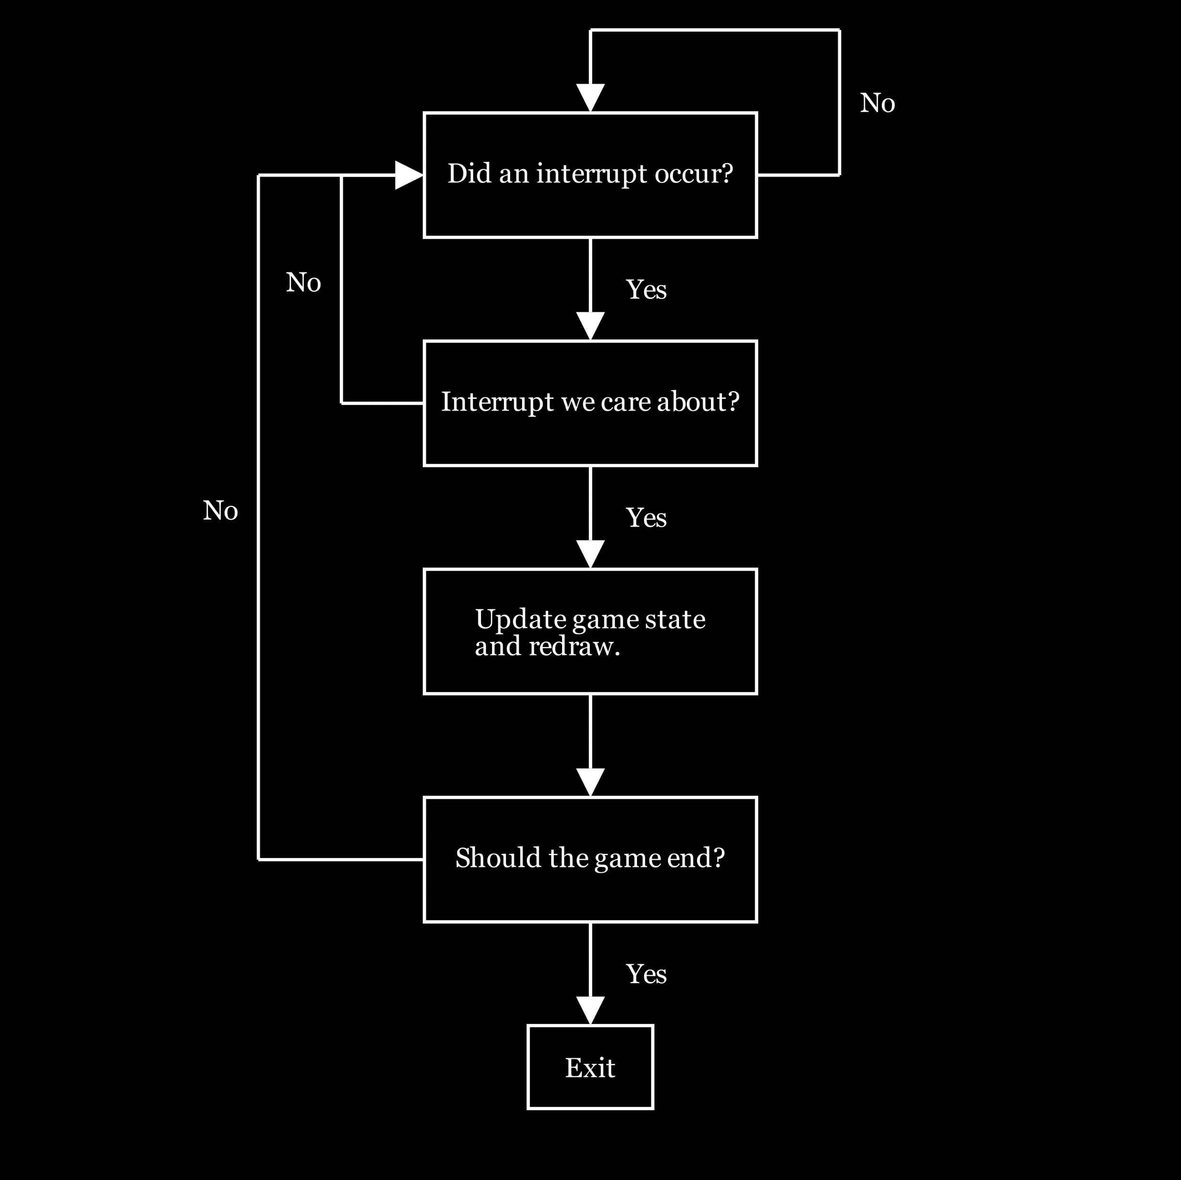
Game Loop

