Slide 1
Introduction to Lab Packet Forward – Handle Packet
J. Nelson Amaral

Slide 2
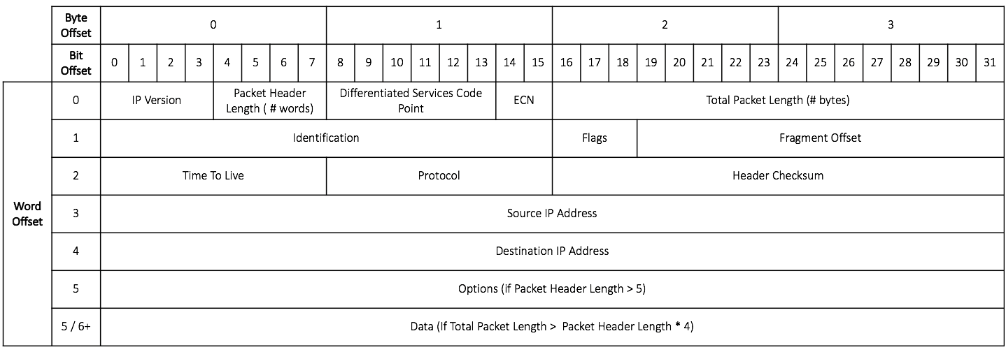

Slide 3
What is the input to your assignment?
a0: The address of an IP packet stored in memory

Slide 4
What handlePacket does
if the packet should be dropped
then
drop the packet and return reason for dropping
else
prepare the packet for forwarding

Slide 5
Reasons to Drop a Packet
Drop a packet if any of the following conditions are true:
It is not an IPv4 packet
TTL is less than or equal to one
Header Checksum fails
TTL: Time to Live

Slide 6
Preparing a Packet for Forwarding
To prepare a packet for forwarding you must:
Decrement TTL in the packet
Update Header Checksum

Slide 7
HandlePacket Return Values
if packet should be dropped
a0 = 0
a1 = 0: indicates Checksum failed
a1 = 1: indicates TTL less than or equal to one
a1 = 2: indicates invalid packet version
else
a0 = 1
a1 = address of the packet to be forwarded

Slide 8
Functions that you will write
HandlePacket:
ValidateIP: Is it an IPv4 packet?
validateTTL: Should it stay alive?
validateCheckSum: Does it have a correct checksum value?

Slide 9
Checksum Function
Assume that you are provided a correct implementation of the checksum function specified in the Lab Packet Forward - Checksum.

