Slide 1
Introduction to Lab Snake Game
José Nelson Amaral

Slide 2
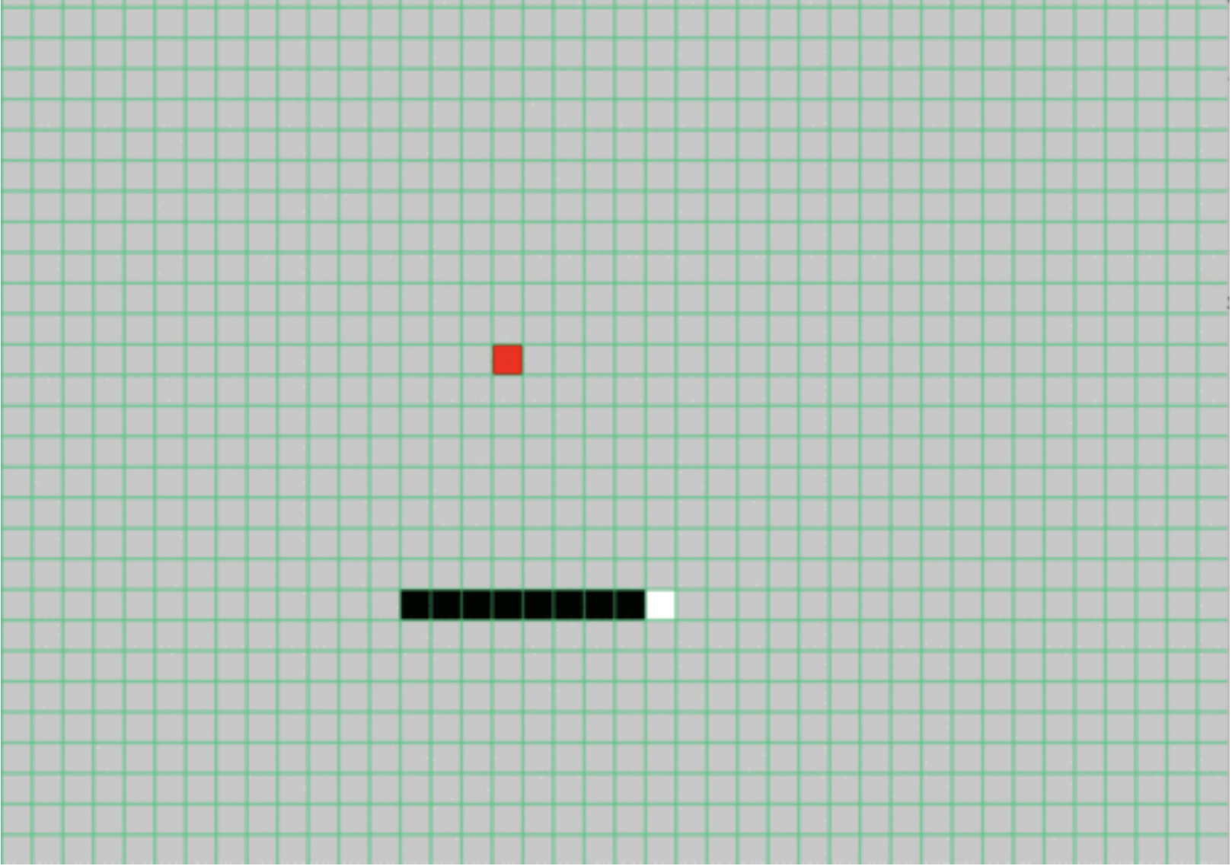
Snake Games
Snake games available online
Very famous games
Notes:
Typing games are common online and are used both for fun and for increasing skill of the user. These games can improve accuracy and speed of the user playing the game. Although the typing game that you as a student will be creating is simple, it still follows the basic structure of a game.

Slide 3
Our Snake Game is much simpler
We don't consider the situation when the snake hits its own body. The players just need to avoid this situation while playing this game.
After the snake eats the apple, the size of the snake body doesn't increase.

Slide 4
Two Screens
Preparation Screen:
Reads the level of the game
Game Screen:
Walls
Apple
Snake
Number of points
Time remaining

Slide 6
Random Coordinate
The coordinate (row, col) of the apple is randomly generated.
We need a random number generator.

Slide 7
Linear Congruential Generator
Notes:
A Linear Congruential Generator is a pseudo random generator. This allows numbers to be “randomly generated” to be used in this typing game. The Linear Congruential Generator is made up of four parts. The multiplier, the seed value, the increment and modulus. Each time the generator is used, you must save the generated value into the seed value spot, otherwise your generator will only produce one number.

Slide 8
Linear Congruential Generator Example
a = 5
X0 = 4
c = 13
m = 5
X1 = ( ( 5 * 4 ) + 13 ) % 5 = 3
X2 = ( ( 5 * 6 ) + 13 ) % 5 = ?
Notes:
This is an example of a linear congruential generator, with the multiplier value of 5, seed value of 4, increment of 13 and modulo of 5

Slide 9
Exceptions/Interruptions
Enable interrupts for both the timer and the keyboard
Create an exception handler
Notes:
While Rars has the option to have interruptions, the student creating the programs must enable them. Additionally, the student must create an exception handler to deal specifically with the interrupts they have enabled.

Slide 10
Enable Interrupts
Keyboard:
Keyboard Control - Bit 1 Must be 1 in order for the keyboard to be enabled
Must be reenabled after every keyboard interrupt
Keyboard Data: Contains the ASCII character after a key is pressed
Timer:
Timer: Contains the current time
TimeCMP: User-specified value. When matched by the timer an interrupt is generated
Interruption Control:
Ustatus register: bit 0 must be 1 in order for user interrupts to be allowed
Uie: Bits 4 and 8 must be 1 in order to enable keyboard and timer
Notes:
Note, that everytime a keyboard interrupt occurs, i.e. a key is pressed, the bit 1 of the keyboard control must be reset everytime.

Slide 11
Exception Handler
The snake.s already contains the Handler Terminate section
The common.s file will already have the iTrapData section
Notes:
*** Look at the common.s file

Slide 12
Saving Registers
An interrupt handler must save all the registers that it uses.
The label iTrapData designates a section of memory allocated for saving registers in the handler.
Outside of the handler, uscratch (CSR #64) should contain the address of the iTrapData section.
Use the cssrw instruction to swap a register with the uscratch and save all the required registers.

Slide 13
Modified Forever Loop
There's no change
Check for Change
There's a change
The game doesn't end
Execute Functions and Check for End of Game conditions
The game should end
End Game

