Slide 1
Introduction to Lab Typing Game
José Nelson Amaral

Slide 2
Typing Games
Typing games available online
Teaches Speed and Accuracy
Notes:
Typing games are common online and are used both for fun and for increasing skill of the user. These games can improve accuracy and speed of the user playing the game. Although the typing game that you as a student will be creating is simple, it still follows the basic structure of a game.

Slide 3
Two Screens
Preparation Screen:
  Reads the level of the game
Game Screen:
  Phrase to be typed
  Progress bar
  Number of points
  Time remaining

Slide 4
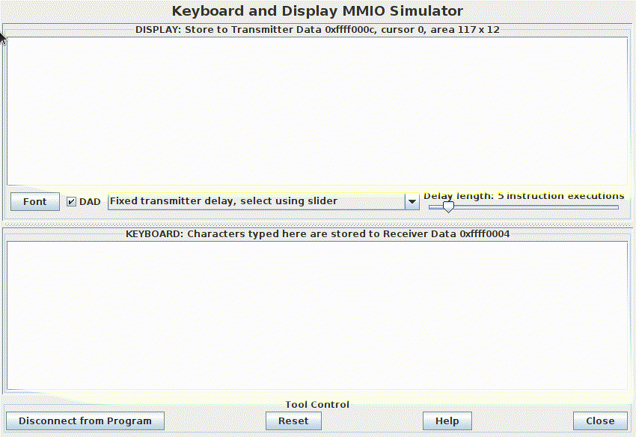

Slide 5
Random Selection
The phrase to be typed is randomly selected
from a list of phrases provided.
We need a random number generator.

Slide 6
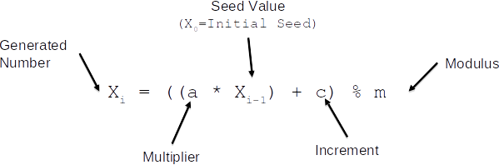
Linear Congruential Generator
Notes:
A Linear Congruential Generator is a pseudo random generator. This allows numbers to be “randomly generated” to be used in this typing game. The Linear Congruential Generator is made up of four parts. The multiplier, the seed value, the increment and modulus. Each time the generator is used, you must save the generated value into the seed value spot, otherwise your generator will only produce one number.

Slide 7
Linear Congruential Generator Example
a = 5
X0 = 4
c = 13
m = 5
X1 = ( ( 5 * 4 ) + 13 ) % 5 = 3
X2 = ( ( 5 * 6 ) + 13 ) % 5 = ?
Notes:
This is an example of a linear congruential generator, with the multiplier value of 5, seed value of 4, increment of 13 and modulo of 5

Slide 8
Exceptions/Interruptions
Enable interrupts for both the timer and the keyboard
Create an exception handler
Notes:
While Rars has the option to have interruptions, the student creating the programs must enable them. Additionally, the student must create an exception handler to deal specifically with the interrupts they have enabled.

Slide 9
Enable Interrupts
Keyboard:
  Keyboard Control - Bit 1 Must be 1 in order for the keyboard to be enabled
    Must be reenabled after every keyboard interrupt
  Keyboard Data: Contains the ASCII character after a key is pressed
Timer:
  Timer: Contains the current time
  TimeCMP: User-specified value. When matched by the timer an interrupt is generated
Interruption Control:
  Ustatus register: bit 0 must be 1 in order for user interrupts to be allowed
  Uie: Bits 4 and 8 must be 1 in order to enable keyboard and timer
Notes:
Note, that everytime a keyboard interrupt occurs, i.e. a key is pressed, the bit 1 of the keyboard control must be reset everytime.

Slide 10
Exception Handler
The typing.s already contains the Handler Terminate section
The common.s file will already have the iTrapData section
Notes:
*** Look at the common.s file

Slide 11
Saving Registers
An interrupt handler must save all the registers that it uses.
The label iTrapData designates a section of memory allocated for saving registers in the handler.
Outside of the handler, uscratch (CSR #64) should contain the address of the iTrapData section.
Use the cssrw instruction to swap a register with the uscratch and save all the required registers.

Slide 12
Array Format
Hell | 0x10001000
o Go | 0x10001004
odby | 0x10001008
e An | 0x1000100C
na i | 0x10001010
s fu | 0x10001014
n Su | 0x10001018
nshi | 0x1000101C
ne o | 0x10001020
utsi | 0x10001024
de | 0x10001028
Text File
Phrase Array
Hello
Goodbye
Anna is fun
Sunshine outside

Slide 13
Hell | 0x10001000
o Go | 0x10001004
odby | 0x10001008
e An | 0x1000100C
na i | 0x10001010
s fu | 0x10001014
n Su | 0x10001018
nshi | 0x1000101C
ne o | 0x10001020
utsi | 0x10001024
de | 0x10001028
This is used to create
the array of pointers
0x10001000 | 0x10001100
0x10001006 | 0x10001104
0x1000100E | 0x10001108
0x1000101A | 0x1000110C

Slide 14
Modified Forever Loop
Check for Change
Execute Functions and Check for End of Game conditions
End Game

Slide 15
Modified Forever Loop
Check for Change
Execute Functions and Check for End of Game conditions

