Slide 1
Lab #5: Control Flow Graph
CMPUT 229

Slide 2
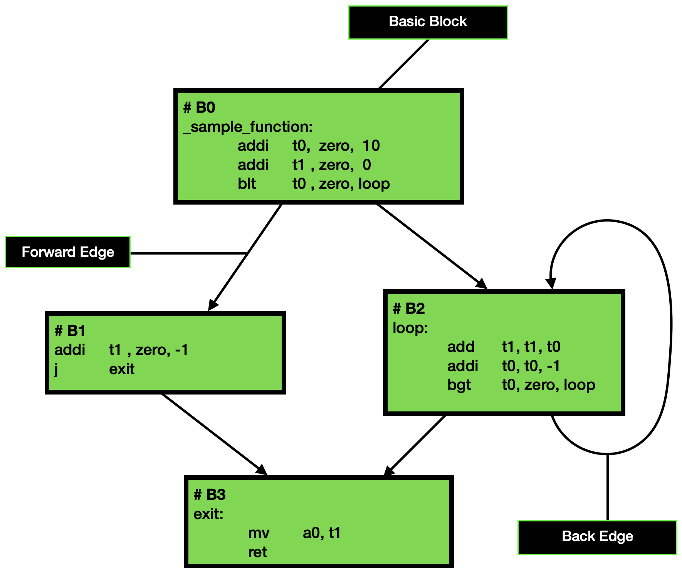
What is a Control Flow Graph?
A Control Flow Graph (CFG) shows all the possible execution paths of a program.

Slide 3
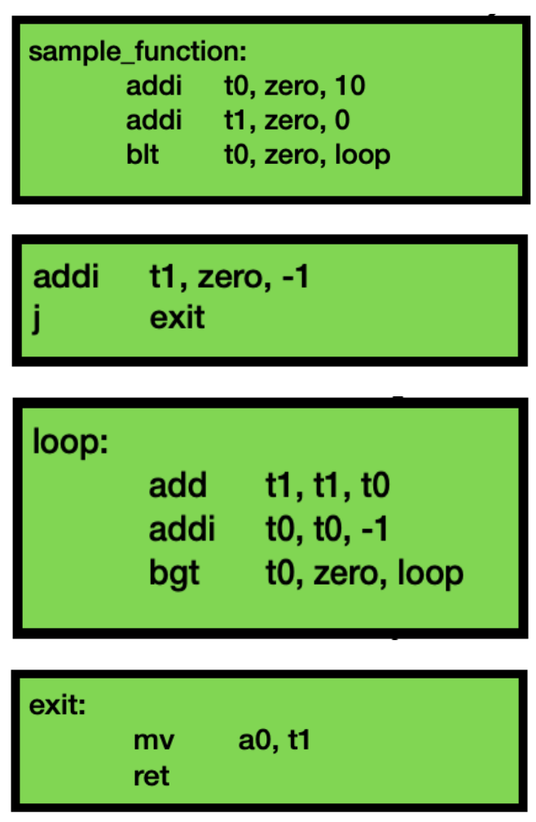
Basic Blocks
The nodes of a CFG are basic blocks.
A basic block is a segment of code where instructions execute in order from start to finish.
Once execution enters a block, all instructions in the block must be executed.
Only the first instruction of a basic block can be the target for a branch or jump instruction.

Slide 4
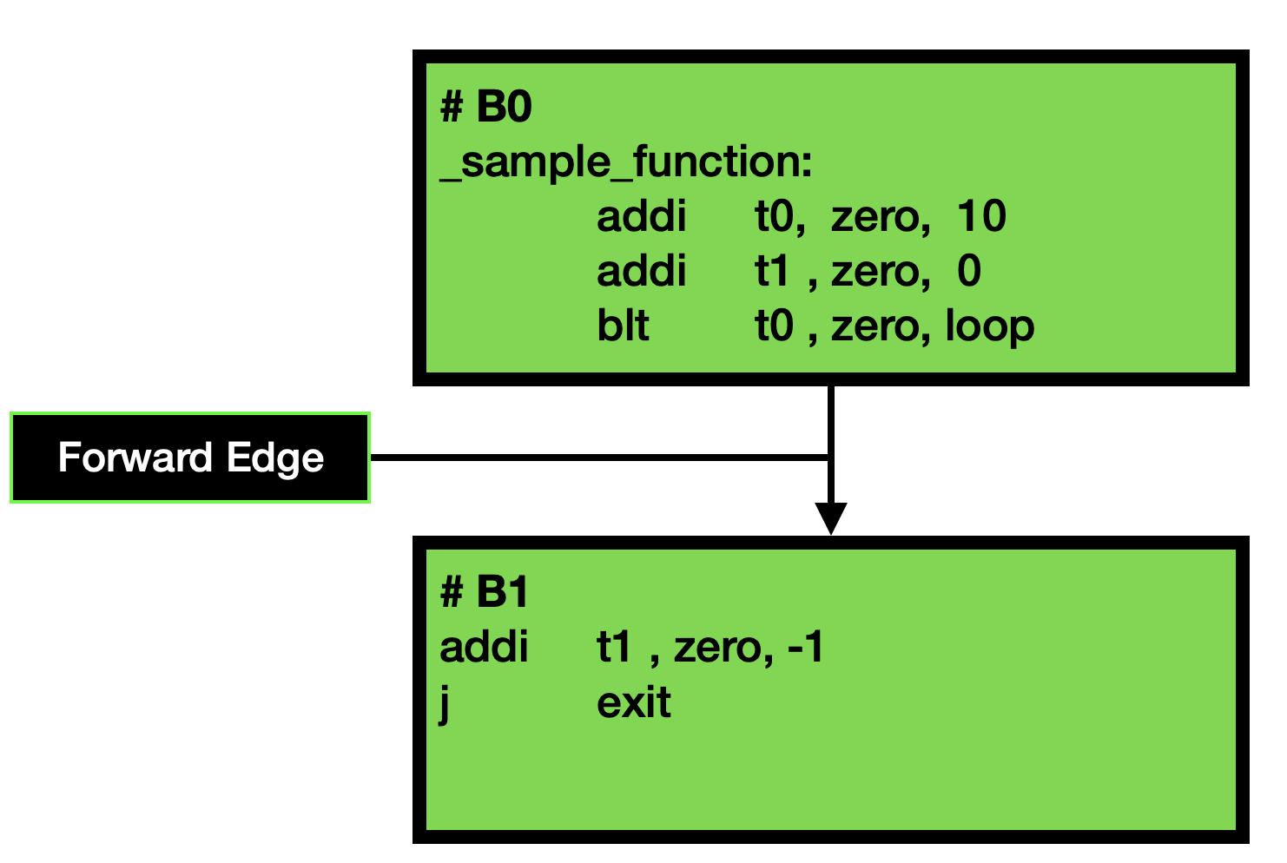
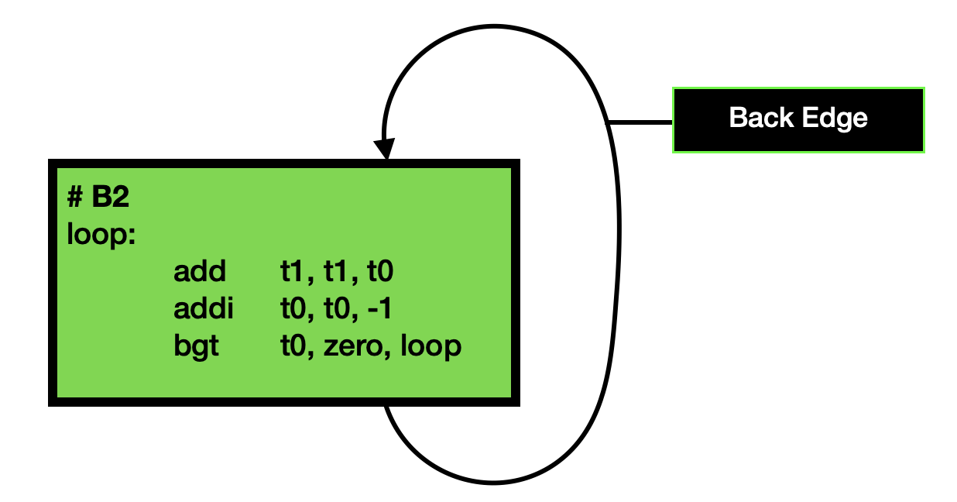
Edges
Edges denote directed control flow between basic blocks.
There are two types of edges:
- forward edge
- back edge.
Branches and jumps redirect control flow, creating multiple execution paths within a program.

Slide 5
Successors & Predecessors
addi t0, zero, 10
addi t1, zero, 0
blt t0, zero, loop
A successor of a block Bi is any block that can be reached from Bi.
Immediate successors of B0
An immediate successor of a block Bi directly follows Bi.
The concepts of predecessor and immediate predecessor are analogous.
Successors of B0

Slide 6
Successors & Predecessors
A successor of a block Bi is any block that can be reached from Bi.
B0
addi t0, zero, 10
addi t1, zero, 0
blt t0, zero, loop
Immediate successors of B0
An immediate successor of a block Bi directly follows Bi.
B1
addi t1, zero, -1
J exit
The concepts of predecessor and immediate predecessor are analogous.
Successors of B0

Slide 7
Assignment
Lab #5: Control Flow Graph

Slide 8
Overview
Goal: to generate control flow information for a single function.
These functions will populate data structures that represent control flow constructs:
- basic blocks, edges, successors, and predecessors.
Each function’s implementation should accurately populate these custom data structures.
The common.s file initializes the data structures and runs tests on your implementation. It also helps to parse the populated data structures.

Slide 9
Overview
Goal: generate control flow information for a single function.
Task: write functions that populate data structures that represent control flow constructs:
Basic blocks
Edges
Successors
Predecessors
Resources: the common.s file:
initializes the data structures
runs tests on your implementation
helps to parse the populated data structures.

Slide 10
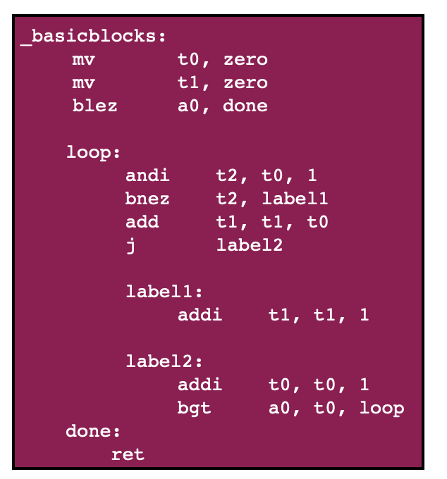
A Sample Input Function
The _basicblocks function below serves as an example of an intended input for the lab. It will be used as a reference to explain the custom data structures.

Slide 11
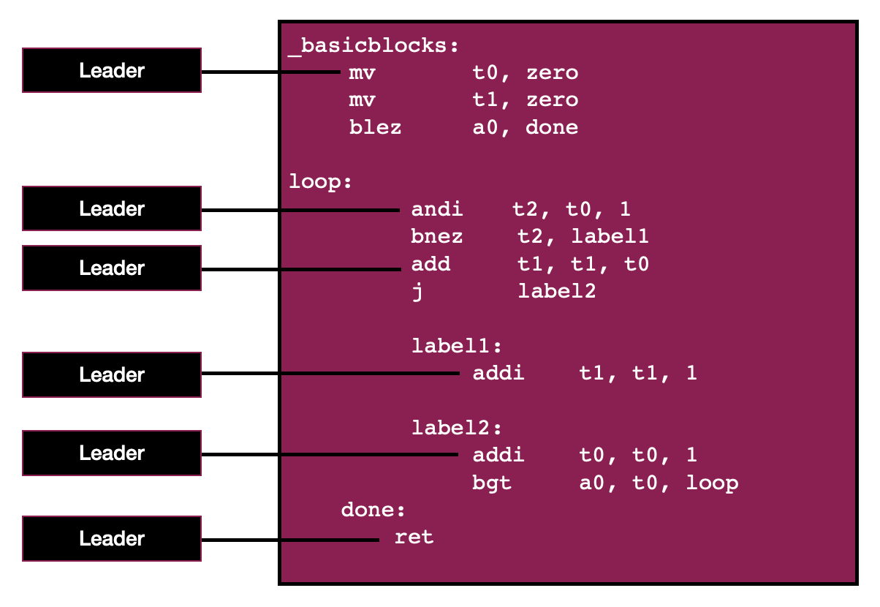
Basic Block Leaders
Basic-block leaders:
The first statement in a function
Any statement that is the target of a branch/jump
Any statement that immediately follows a branch or jump

Slide 12
Forming Basic Blocks
B0
A basic-block is a leader and all instructions after the leader up to, but not including the next leader.
B1

Slide 13
Building the Control Flow Graph
B0
A basic-block is a leader and all instructions after the leader up to, but not including the next leader.
B1

Slide 14
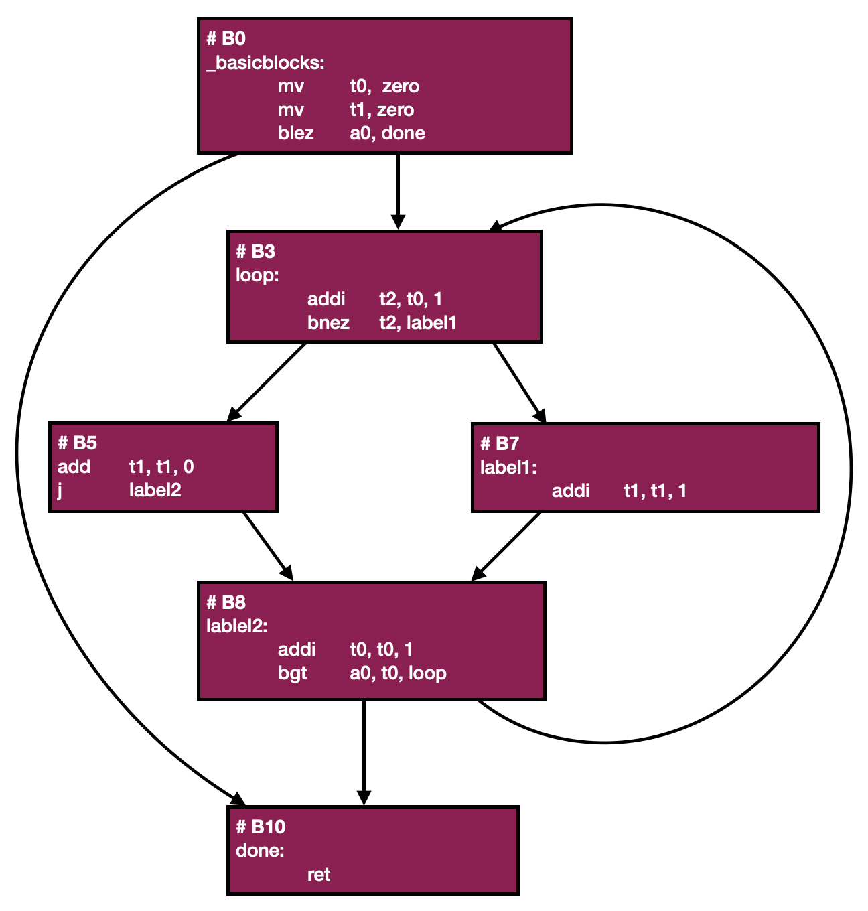
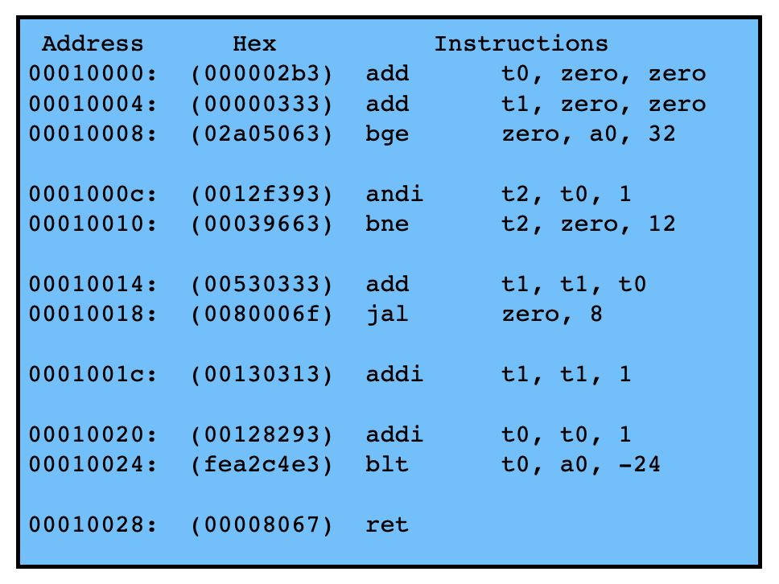
Basic Block Identifiers
To uniquely identify blocks, we use the offsets (in words) of their leaders from the function’s base address in memory.
E.g., The second block starts 3 words away from the function’s base address so its ID is 3.

Slide 15
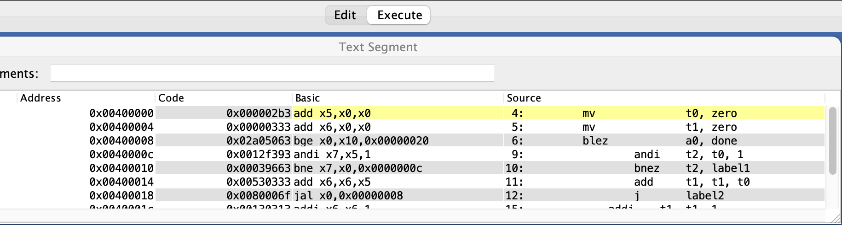
Pseudo Instructions and Labels
Pseudo-instructions in RISC-V simplify assembly code by representing higher-level operations.
For example, 'mv t0, zero' translates to 'add t0, zero, zero' during assembly, which copies the value 0 into the register t0 as well.
Labels are symbolic pointers to specific instructions used for branch or jump offsets and do not appear in the executable code. They are also used to simplify assembly.
Notes:
Note on beqz a0, End instruction translation.
The offset for the instruction seems confusing for branches. The beqz a0, End instruction should move the program counter two instructions ahead to mv a0, s0. However, the offset for this instruction is only 4. This seems to suggest that the beqz a0, End instruction moves the PC to the j loop instruction.
This is a confusing situation because by default, branch instructions increment the PC by 4. Thus, the offset of 4 will actually point 2 instructions ahead as we intended.

Slide 16
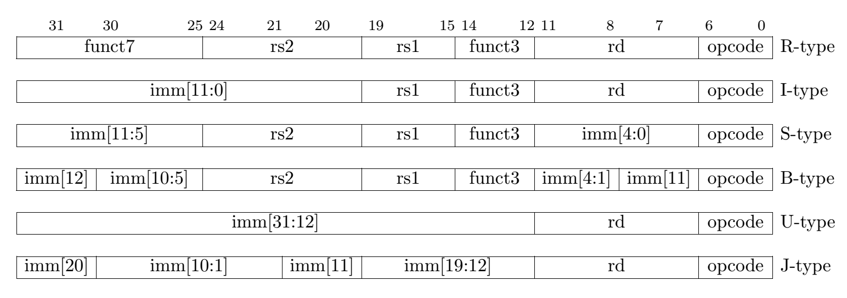
Decoding Instructions
RISC-V instruction formats are differentiated by their opcode, while funct3 distinguishes instructions within each format.
Decoding the fourth instruction (0x0012f393) of the _basicblocks function as an example:
0x0012f393 = 0000 0000 0001 0010 1111 0011 1001 0011
opcode = 001 0011 (I-type instruction)
funct3 = 111 (andi instruction)

Slide 17
Data Structures
Lab #5: Control Flow Graph

Slide 18
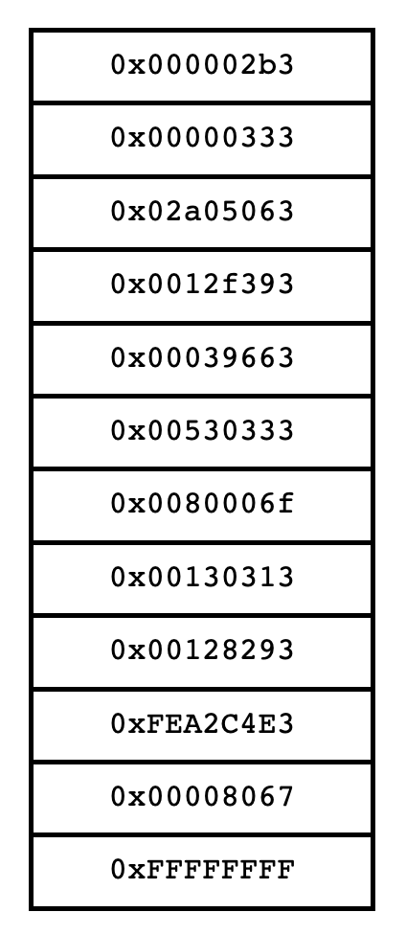
instructionsArray
An array of words that contains the instructions of the input function.
Ends with a sentinel value of -1.

Slide 19
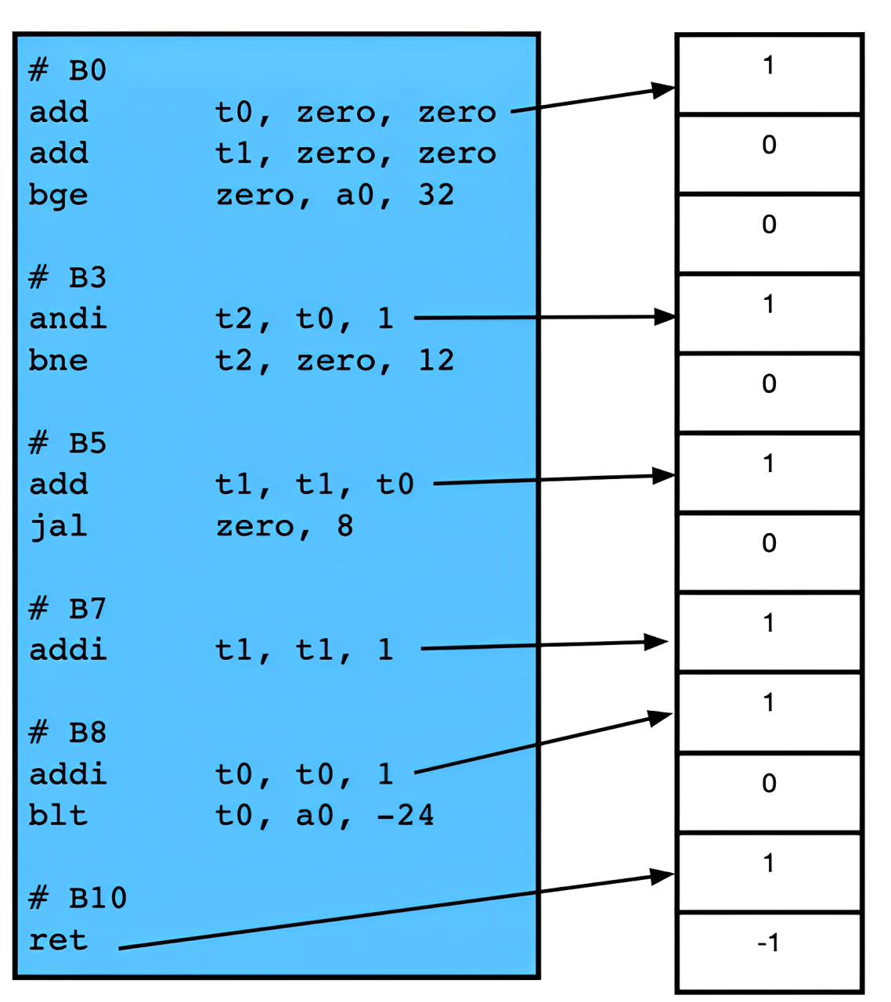
leadersArray
An array of bytes representing the leadership status of each instruction.
Each byte corresponds directly to an instruction in the instructionsArray.
If an instruction is a leader, its corresponding byte will be 1; otherwise, it will be 0.
Ends with a sentinel value of -1.

Slide 20
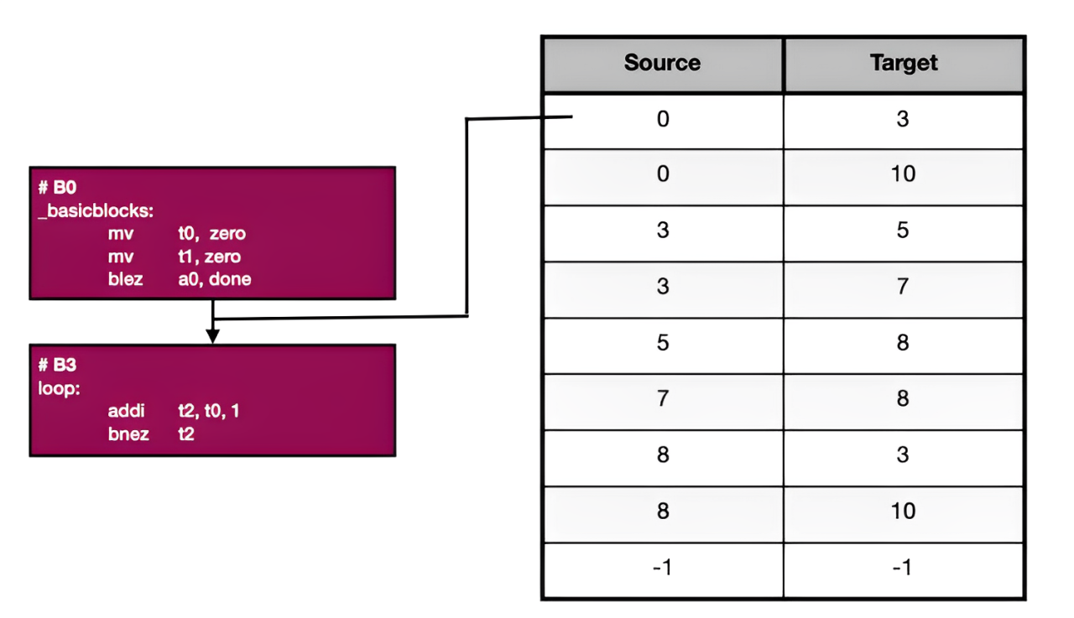
edgesList
A 2D byte array which stores all the edges within a function’s CFG.
In an entry: the first byte indicates the source, and the second byte indicates the target.
Ends with a sentinel value of -1 in both bytes.

Slide 21
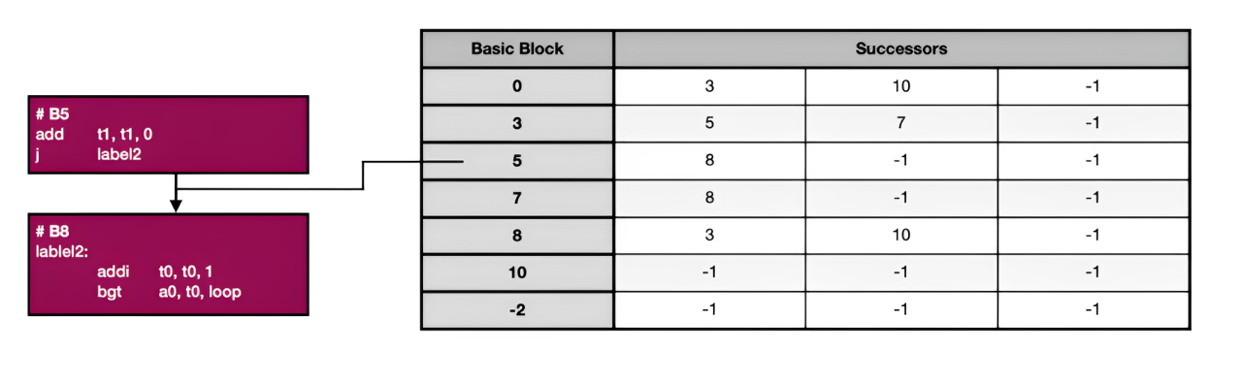
successorsTable
A 2D byte array storing immediate successors for each basic block in a function's CFG.
In an entry: the first byte indicates the block, followed by 2 bytes for its successorsList.
Each successorsList ends with -1, while the basic blocks column ends with -2 (indicating the table’s end).
Notes:
A 2D array of bytes initialized to -1 (0XFF).
Each entry in the table corresponds to a basic block, where the first byte indicates the block, and the following 2 bytes store its successorsList (a list of its immediate successor blocks).
Every basic block within the CFG is represented, regardless of whether it has successors.
Every basic block's successorsList ends with -1.
The table ends with a sentinel value of -2 (0xFE) in column reserved for basic blocks.

Slide 22
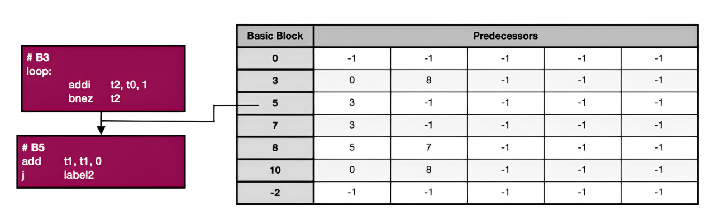
predecessorsTable
A 2D byte array storing immediate predecessors for each basic block in a function's CFG.
In an entry: the first byte indicates the block, followed by 4 bytes for its predecessorsList.
Each predecessorsList ends with -1, while the basic blocks column ends with -2 (indicating the table’s end).
Notes:
A 2D array of bytes initialized to -1 (0XFF).
Each entry in the table corresponds to a basic block, where the first byte indicates the block, and the following 4 bytes store its predecessorsList (a list of its immediate predecessor blocks).
Every basic block within the CFG is represented, regardless of whether it has predecessors.
Every basic block's predecessorsList ends with -1 (0xFF).
The table ends with a sentinel value of -2 (0xFE) in the basic blocks column.

Slide 23
Function Signatures
Lab #5: Control Flow Graph

Slide 24
getControlFlowGraph
Description:
The main function called from common.s to retrieve information about a function's control flow graph.
Arguments:
a0: a pointer to the instructionsArray
a1: a pointer to the leadersArray
a2: a pointer to the edgesList
a3: a pointer to the successorsTable
a4: a pointer to the predecessorsTable
Returns:
None

Slide 25
getLeaders
Description:
Identifies the basic block leaders within a function's instructions.
Arguments:
a0: a pointer to the instructionsArray
a1: a pointer to the leadersArray
Returns:
None

Slide 26
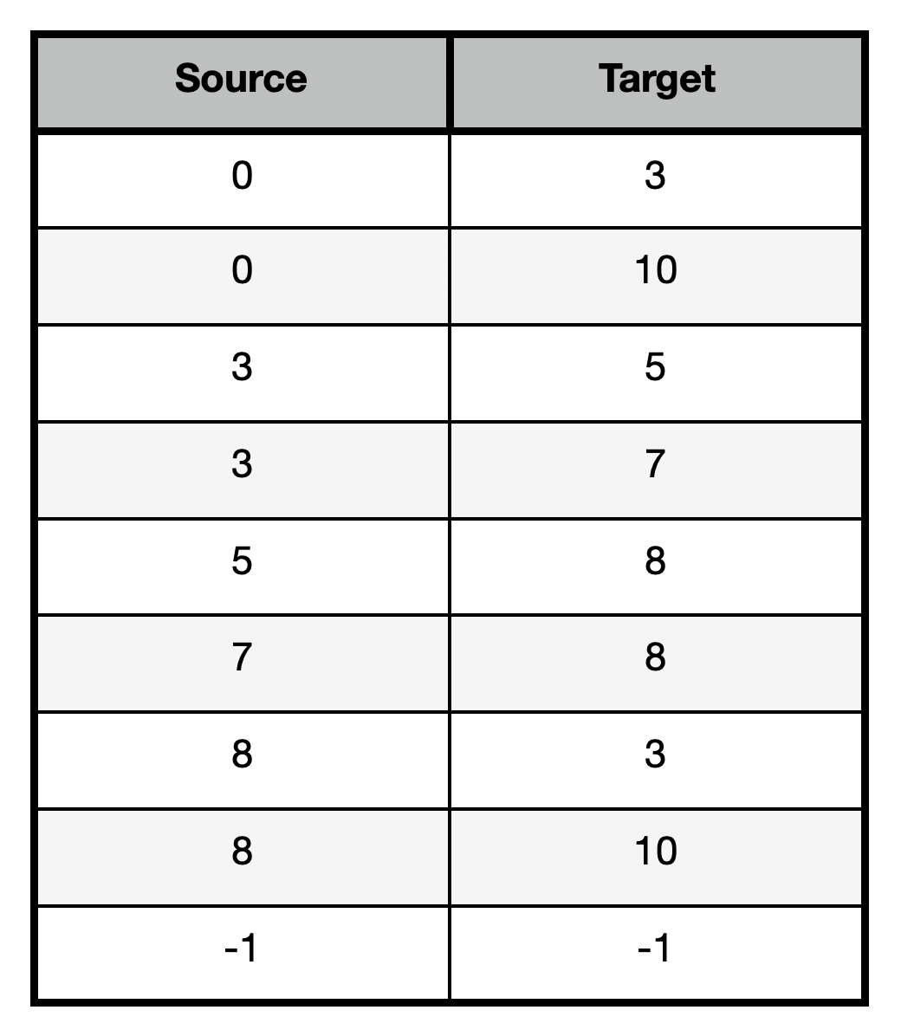
getEdges
Description:
Creates a list of edges between basic blocks within a function's control flow graph.
Arguments:
a0: a pointer to the instructionsArray
a1: a pointer to the leadersArray
a2: a pointer to the edgesList
Returns:
None

Slide 27
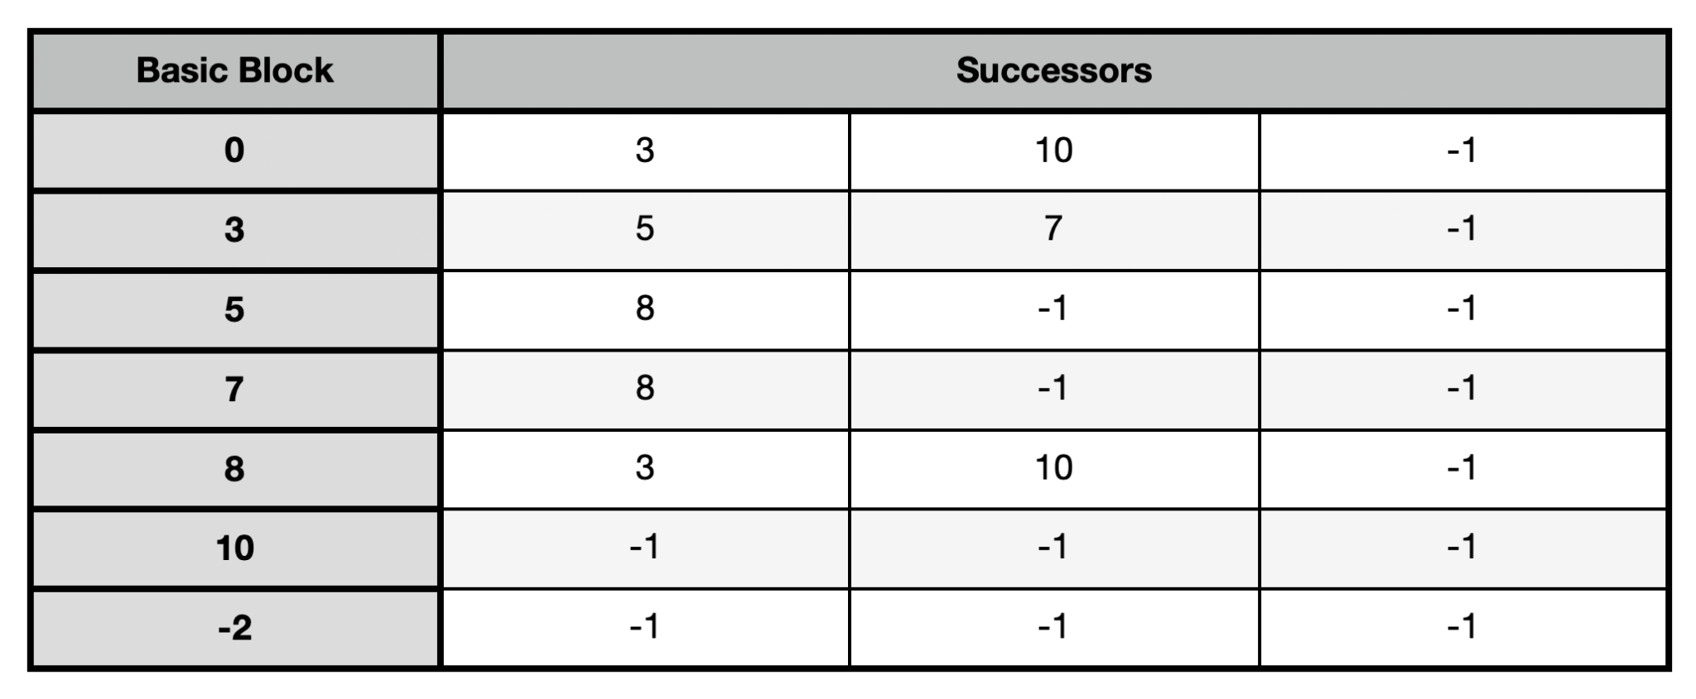
getSuccessors
Description:
Creates a list of immediate successors for each basic block within a function’s control flow graph.
Arguments:
a0: a pointer to the instructionsArray
a1: a pointer to the leadersArray
a2: a pointer to the successorsTable
Returns:
None

Slide 28
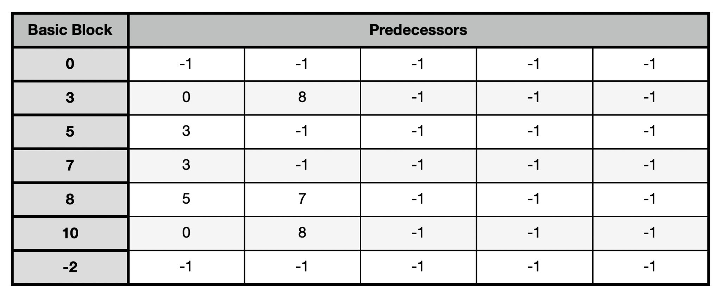
getPredecessors
Description:
Creates a list of immediate predecessors for each basic block within a function’s control flow graph.
Arguments:
a0: a pointer to the instructionsArray
a1: a pointer to the leadersArray
a2: a pointer to the predecessorsTable
Returns:
None

Slide 29
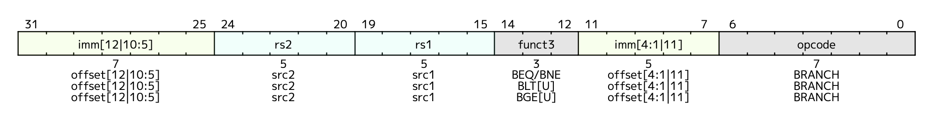
getBranchImm (helper)
Description:
Takes a branch instruction (SB-type) and extracts the sign-extended immediate
Arguments:
a0: a branch instruction word
Returns:
a0: a sign extended immediate

Slide 30
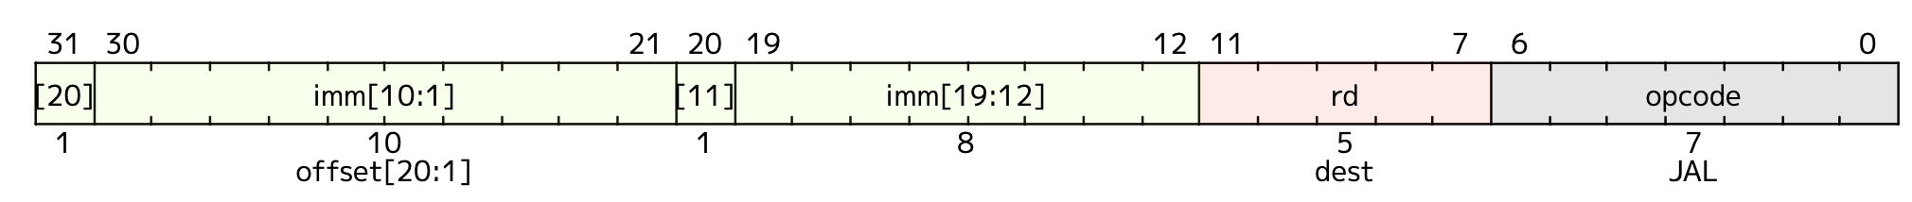
getJalImm (optional helper)
Description:
Takes a jump instruction (UJ-type) and extracts the sign-extended immediate
Arguments:
a0: a jal instruction word
Returns:
a0: a sign extended immediate

Slide 31
Testing
Lab #5: Control Flow Graph

Slide 32
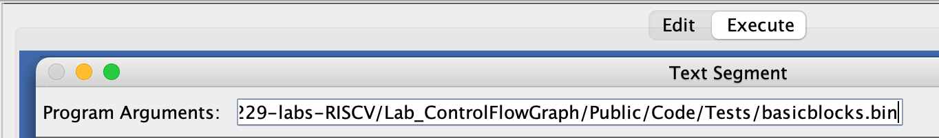
Program Arguments
We have provided some test inputs and expected outputs in the Tests folder.
One argument required for controlFlowGraph.s: the full path to the binary file of an assembled RISC-V function.
Ensure there are no quotation marks or spaces in the path.

Slide 33
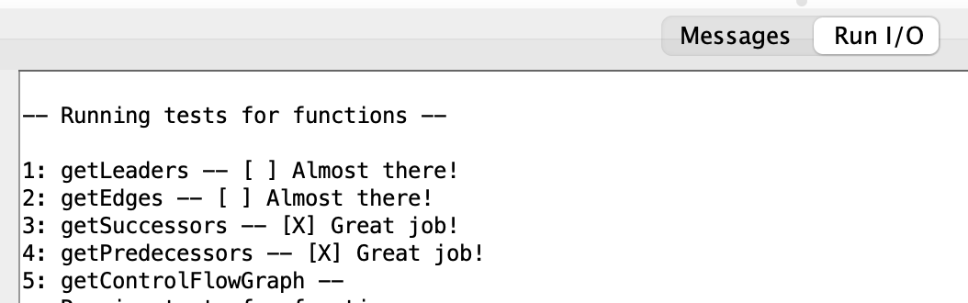
Unit Tests
The common.s file will run unit tests on the functions in controlFlowGraph.s.
Tests are hardcoded and do not use the file set as the program argument.
Check out the .data section in the common.s file to see how they are set up.
You can view the results in the “Run I/O” panel of RARS.

Slide 34
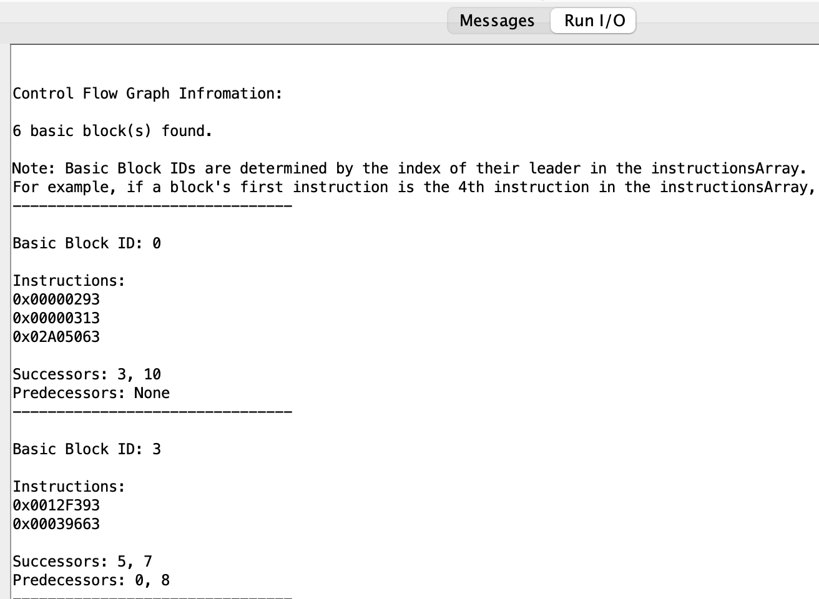
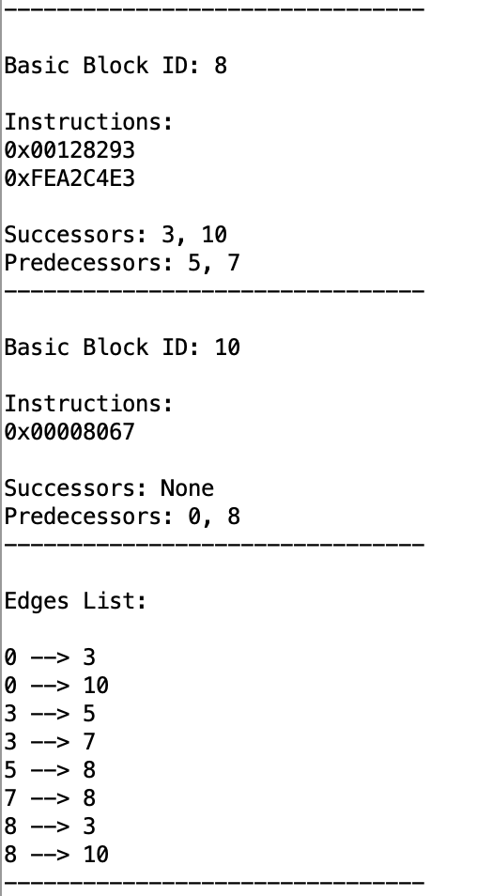
Parsed Control Flow Graph
The common.s file also parses the data structures populated by controlFlowGraph.s.
All structures must end with a sentinel value to be parsed properly.
You can view the results in the “Run I/O” panel of RARS following the unit tests.

Slide 35
Tests Folder
There are three tests: basicblocks, nestedloop, singleinstruction.
Each test has the following:
- A .s file containing the assembly code of the input function.
A .bin (binary) file containing the assembled function (program argument).
A .out file containing the correct output for the test.

Slide 36
Creating Tests
Unit tests and provided tests are not extensive.
Create your own tests to ensure your lab handles corner cases as well.
To create a test, do the following:
Write the test function in assembly file (e.g., test.s).
Create the binary file for your function i.e., execute the command “rars a dump .text Binary test.bin test.s”.
You can now execute controlFlowGraph.s with the program argument set to the full path of test.bin.

Slide 37
Disassembler
Lab #5: Control Flow Graph

Slide 38
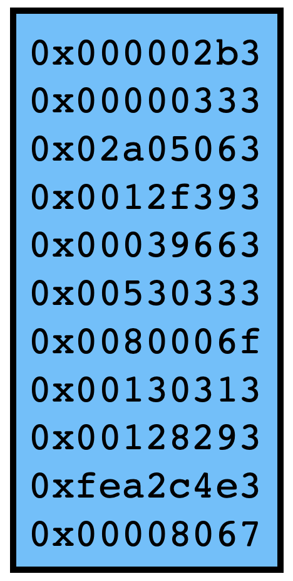
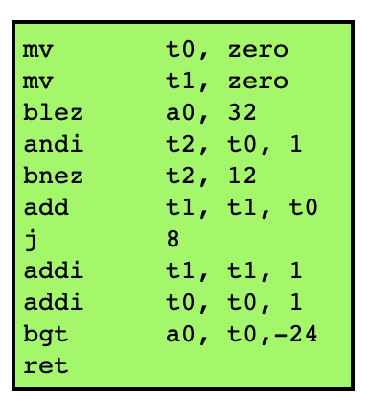
What is a Disassembler?
RARS is a RISC-V Assembler that translates RISC-V instructions to executable binary.
A Disassembler does the opposite.
For this lab, we will use an Open-Source RISC-V Disassembler (https://github.com/michaeljclark/riscv-disassembler)

Slide 39
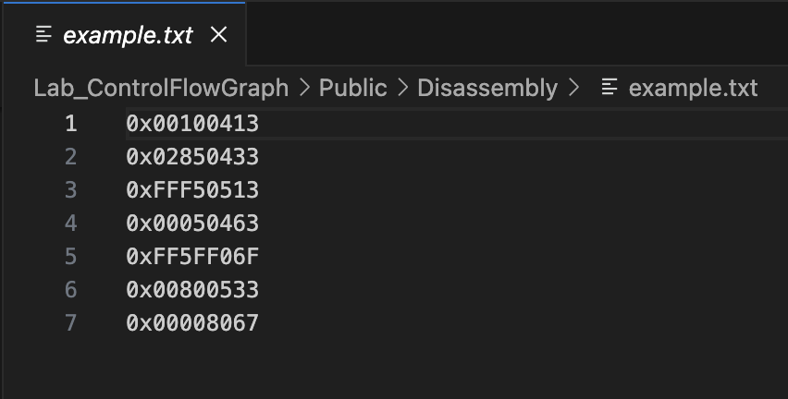
How to Use the Disassembler
There is a Disassembly folder in the Code folder.
There is a file called “print-instructions.c” in this folder that prints the equivalent instructions for hexadecimal words.
First, compile “print-instructions.c” i.e., execute the command “gcc print-instructions.c”
Next, create a text file containing hexadecimal instructions. The file should look like this:

Slide 40
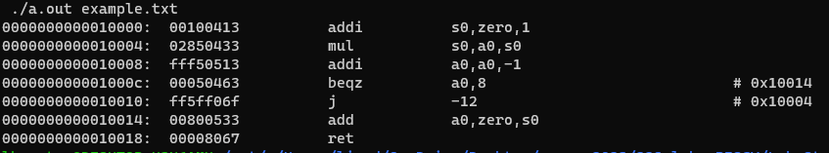
How to Use the Disassembler (cont.)
Once you have an executable for print-instructions.c (a.out) and a text file with hexadecimal instructions (example.txt), execute “./a.out example.txt”
Here is the disassembled instructions from example.txt:

Slide 41
Notes on the Disassembler
The disassembler translates addi t0, t0, 0 to mv t0, zero. Keep this in mind to avoid confusion with addi instructions.
The disassembler will not translate a sentinel value (0xFFFFFFFF) as expected.

Slide 42
What to Submit?
A single file, called controlFlowGraph.s.
Keep the file in the Code folder of the git repository.
Do not modify the name of any function.
Do not remove the CMPUT 229 Student Submission License.
Do not modify the line .include "common.s".
Do not modify the common.s file.
Push your repository to GitHub before the deadline.

Slide 43
Good Luck!
Lab #5: Control Flow Graph

