Slide 1
Lab #6: Dead Code Elimination
CMPUT 229

Slide 2
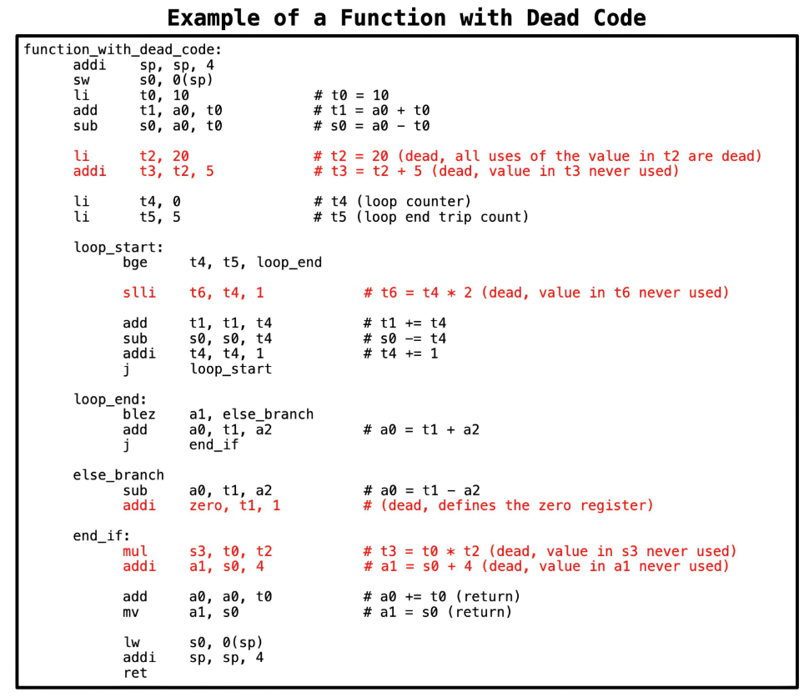
What is Dead Code?
Dead Code refers to any line or block of code that is either unreachable (no execution path leads to that code) or it is redundant i.e. if it is executed the code has no visible effect on the output of the program.

Slide 3
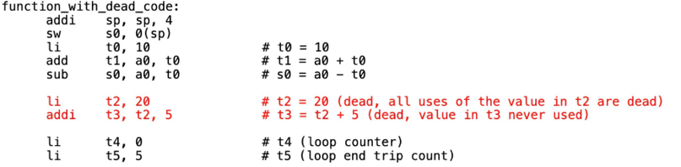
What is Dead Code?
A Closer Look
Dead Code refers to any line or block of code that is either unreachable (no execution path leads to that code) or it is redundant i.e. if it is executed the code has no visible effect on the output of the program.
Let’s study an example from the sample function
Instruction: li t2, 20
▸ Dead because it only feeds into a subsequent dead instruction.
Instruction: addi t3, t2, 5
▸ Dead as its result (t3) is never used later in the program.

Slide 4
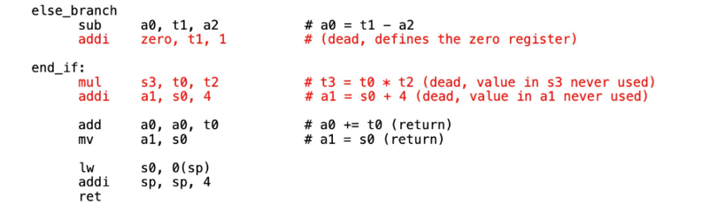
What is Dead Code?
A Closer Look
Dead Code refers to any line or block of code that is either unreachable (no execution path leads to that code) or it is redundant i.e. if it is executed the code has no visible effect on the output of the program.
Example:
Instruction: addi zero t1, 1
▸ Dead because it is trying to set the zero register which is immutable.
Instruction: mul s3, t0, t2
▸ Dead as its result (s3) is never used
Instruction: addi a1, s0, 4
▸ Dead because the result (a1) Is discarded immediately

Slide 5
Liveness Analysis
A variable is said to be live at a particular point in a program if its current value might be used later meaning it hasn’t been overwritten or discarded yet.

Slide 6
Liveness Analysis
Two Levels of Liveness Analysis
Block-Level Analysis
▸ Identifies live variables at the entry and exit of each basic block.
Instruction-Level Analysis
▸ Tracks liveness at the granularity of individual instructions.
▸ Especially useful for catching transitively dead code that block-level analysis may overlook.

Slide 7
Block-Level Liveness Analysis
Block-level liveness analysis uses a fixed-point algorithm to figure out which variables are still needed at the end of each basic block in a program's control flow.
The algorithm iteratively computes the sets of variables that are live at the entry and exit of each basic block in the CFG. It continues until a fixed point is reached, where further iterations do not change the sets of live variables.

Slide 8
Pseudo Code for Fixed-Point Iteration (Block-Level Liveness Analysis)
liveness_analysis:
for each block in cfg.blocks:
block.live_in = empty_set
block.live_out = empty_set
intialize worklist
worklist.add(exit_block)
while worklist not empty:
block = worklist.pop()
new_live_out = empty_set
if block == exit_block:
new_live_out = function_live_out
for each succ in block.successors:
new_live_out = new_live_out ∪ succ.live_in
new_live_in = block.gen ∪ (new_live_out - block.kill)
if new_live_out != block.live_out or new_live_in != block.live_in:
block.live_out = new_live_out
block.live_in = new_live_in
for each pred in block.predecessors
if pred not in worklist:
worklist = worklist.add(pred)
Initially, all sets are empty.
Then:
Start by adding the exit block to the worklist.
For each block, calculate its new live out set by combining the live in sets of its successors.
Compute the new live in set using the formula:
live_in = gen ∪ (live_out - kill)
If either set changes, update them and re-add the block's predecessors to the worklist.
This continues until no further changes occur in any set, indicating fixed-point convergence.

Slide 9
Instruction-Level Liveness Analysis
After reaching fixed-point convergence at the block level, we can perform a finer, instruction-level liveness analysis to catch more precise instances of dead code.
Block-level analysis may miss definitions that are never used before being redefined within the same block, these are effectively dead but still appear live at the block level.
Instruction-level analysis resolves this by examining each instruction in reverse (from last to first) within a block. This reverse pass catches redefinitions that hide unused values, allowing us to more accurately identify dead code.

Slide 10
Pseudo Code for Dead Code Identification (Instruction-Level Liveness Analysis)
find_dead_code:
for each block in cfg.blocks:
current_live_out = block.live_out
for each instruction in block (iterate from end to start):
if instruction is already marked as dead:
continue to next instruction
new_live_in = instruction.gen ∪ (current_live_out - kill)
if instruction.kill:
if instruction.kill not in current_live_out or zero_register in instruction.kill:
mark instruction as dead
current_live_out = new_live_in
The algorithm initializes current_live_out with the block's live_out set.
It then walks through each instruction in reverse. For each instruction:
If it's already marked dead, skip it.
Compute live_in = gen ∪ (live_out - kill).
If it defines a register that isn't live out (and isn't zero), mark it as dead.
Update current_live_out to reflect the new liveness state.

Slide 11
Data Structures
Lab #6: Dead Code Elimination

Slide 12
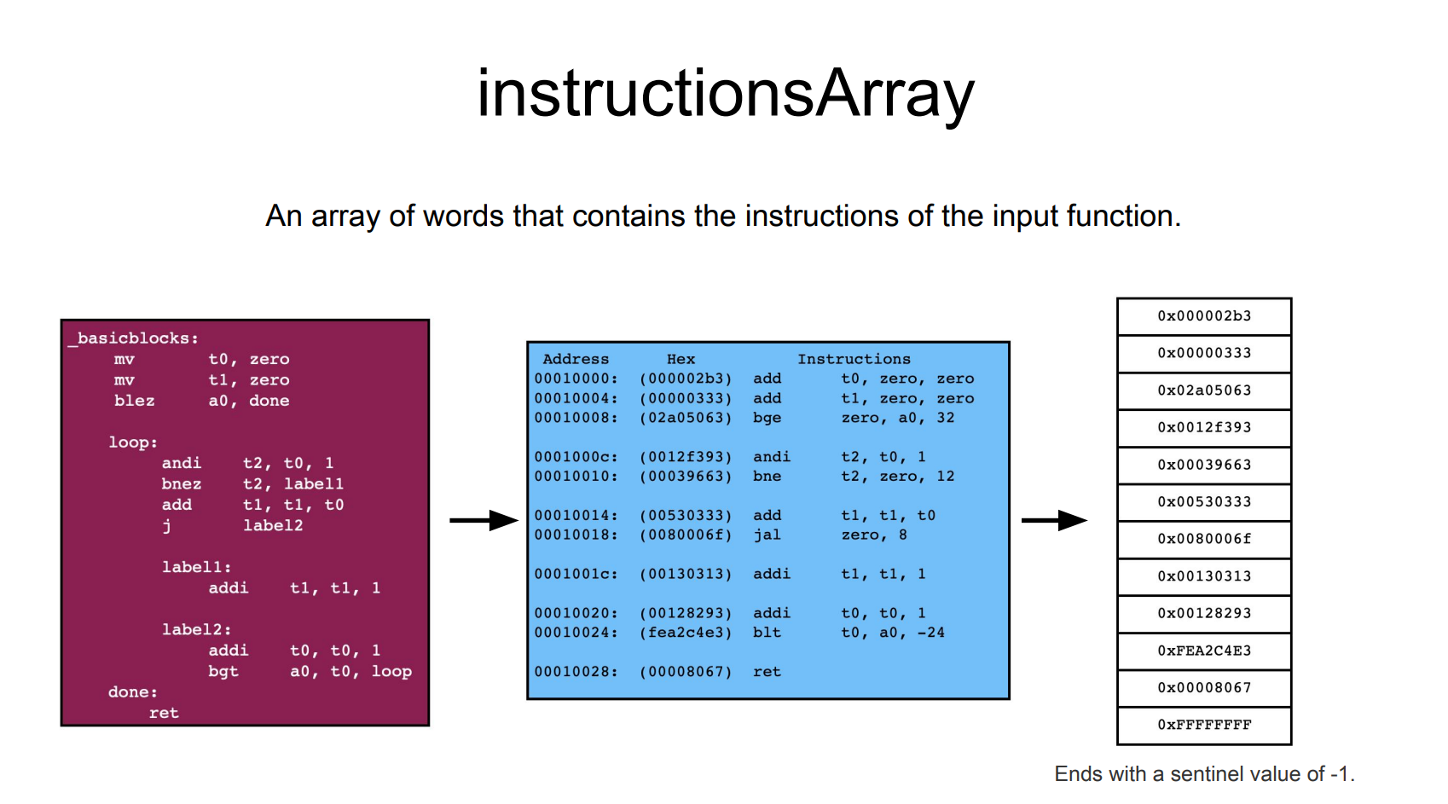

Slide 13
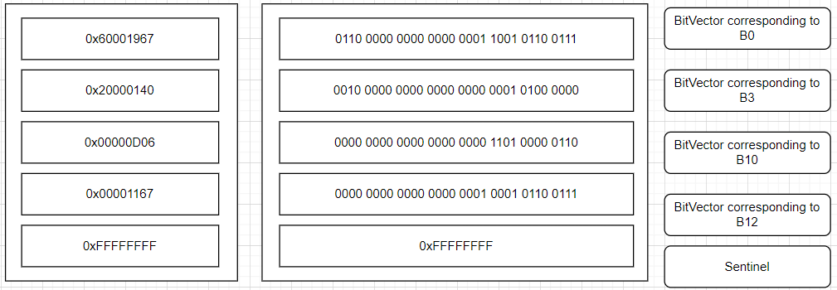
genArray
Imagine some RISC-V Assembly function with basic blocks B0, B3, B10, B12. Then consider the genArray for foo, an array of words, where each word-entry corresponds to a block in the CFG for foo and each such word is a bitvector which represents the gen-set for that block.
Every bit that is set (i.e. the bits that are 1) represents the registers that are generated or defined within a block before any of them are killed by another instruction in the same block.
Example: if bit 23 is set in the third element of the genArray, that means register x23 is part of the genset for the 3rd block (B10 in the picture)

Slide 14
killArray
An array of words representing the kill sets for each basic block in the input function's CFG.
Each word is a bit vector where each bit corresponds to a register that is killed (overwritten or redefined) in that block.
Ends with a sentinel value of -1 (0xFFFFFFFF).

Slide 15
liveInArray
An array of words representing the live-in sets for each basic block in the input function's CFG.
Each word is a bit vector where each bit corresponds to a register that is in the live-in of a given block.
Ends with a sentinel value of -1 (0xFFFFFFFF).

Slide 16
liveOutArray
An array of words representing the live-out sets for each basic block in the input function's CFG.
Each word is a bit vector where each bit corresponds to a register that is in the live-out of a given block.
Ends with a sentinel value of -1 (0xFFFFFFFF).

Slide 17
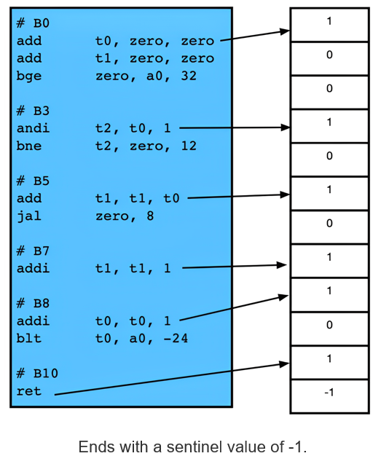
deadCodeArray
An array of bytes representing the dead code status of each instruction in the input function.
Each byte corresponds directly to an instruction.
If the instruction is identified as dead code, its corresponding byte will be 1; if it is not dead code, the byte will be 0.
Example may not be representative of an actual function with dead code, only for illustration

Slide 18
workList
worklist:
The workList is a circular queue used to manage a list of items to be processed. It operates with a fixed size and maintains two indices:
- workListHeadIndex: Points to the position in the list where the next item will be removed.
- workListTailIndex: Points to the position in the list where the next item will be added.
The workList uses an array where:
- An entry of -1 (0xFF) indicates an empty slot.
- When the list is full, adding a new item will result in an error if there is no space.
- When the list is empty, removing an item will return an error if there are no items to remove.
The workList is implemented as a circular queue, meaning that when the tail index reaches the end of the array, it wraps around to the beginning, and similarly for the head index.

Slide 19
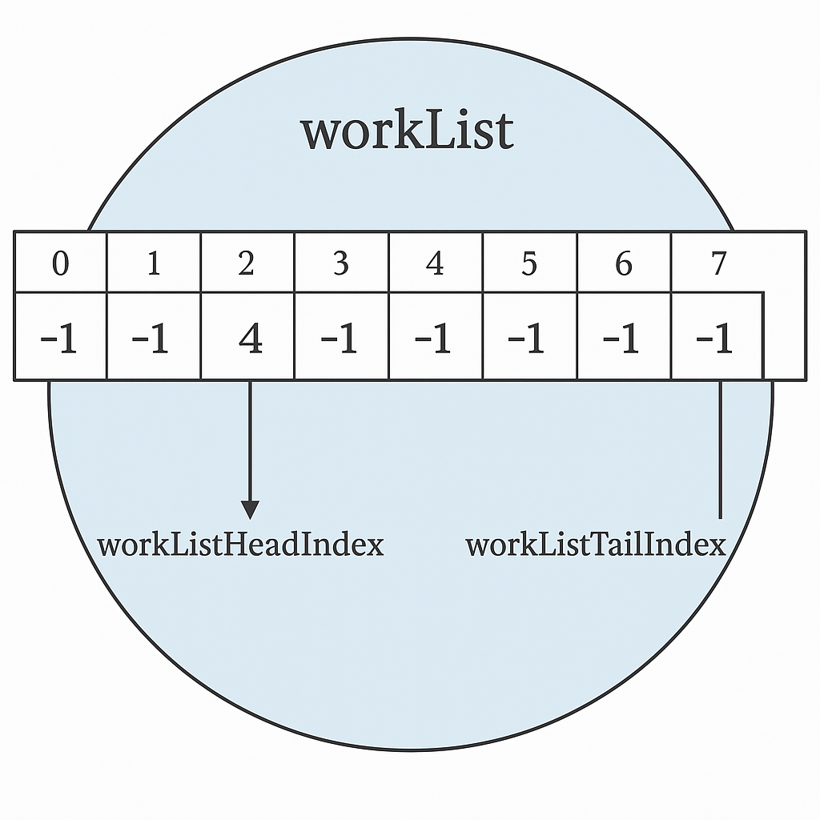
workList

Slide 20
inWorkListArray
An array of bytes corresponding to each block in the input function's CFG.
Each byte represents whether the block is currently in the worklist.
If the block is in the worklist, the byte will be set to 1; otherwise, it will be set to 0.
Ends with a sentinel value of -1 (0xFF).

Slide 21
Function Signatures
Lab #6: Dead Code Elimination

Slide 22
deadCodeElimination
Performs an iterative analysis to remove dead code from the input. This is the main entry point of the solution.
Follow the recommended flow given in the lab description.
Arguments:
a0: Pointer to the instructionsArray.
a1: Pointer to the genArray.
a2: Pointer to the killArray.
a3: Pointer to the liveInArray.
a4: Pointer to the liveOutArray.
a5: Input function's live-out set.
a6: Pointer to the deadCodeArray.
a7: Pointer to the refinedInstructionsArray.
Returns:
None.

Slide 23
getGenKillSets
Processes each basic block to compute GEN and KILL sets for later use.
GEN sets mark registers read before defined in the block.
KILL sets mark registers defined within the block.
Instructions marked dead are skipped.
For each instruction in a block:
- Used registers that have not already been killed are added to GEN.
- Defined registers are added to KILL.
The computed GEN and KILL sets for each block are stored in the provided arrays.
Arguments:
a0: Pointer to the instructionsArray.
a1: Pointer to the deadCodeArray.
a2: Pointer to the genArray.
a3: Pointer to the killArray.
Returns:
None.

Slide 24
getLiveSets
Iteratively computes live-in and live-out sets for each basic block
until they reach a fixed point. Refer to the lab description for details on the algorithm.
The live-in and live-out sets are stored back in the provided arrays.
Arguments:
a0: Pointer to the genArray.
a1: Pointer to the killArray.
a2: Pointer to the liveInArray.
a3: Pointer to the liveOutArray.
a4: Function's live-out set.
Returns:
None.

Slide 25
markDeadCode
Performs dead code identification analysis by iterating backwards through each basic block's instructions.
For each instruction (starting from the block's last instruction), marks each instruction as 0 or 1 (alive or dead) and returns 1 if dead code marked, 0 otherwise.
Arguments:
a0: Pointer to the instructionsArray.
a1: Pointer to the liveOutArray.
a2: Pointer to the deadCodeArray.
Returns:
a0: Dead code status (1 if dead code found, 0 otherwise).

Slide 26
fixTargets
Description:
Adjusts branch and jump instruction targets based on the presence of dead code.
Arguments:
a0: Pointer to the instructionsArray.
a1: Pointer to the deadCodeArray.
Returns:
None.

Slide 27
removeDeadCode
Description:
Removes dead code from the input function by filling the refinedInstructionsArray with only the
instructions marked as not dead in the deadCodeArray.
Arguments:
a0: Pointer to the instructionsArray.
a1: Pointer to the deadCodeArray.
a2: Pointer to the refinedInstructionsArray.
Returns:
None.

Slide 28
decodeInstruction
Description:
Decodes a given instruction to determine its defined and used registers and returns them as bit vectors.
Arguments:
a0: An instruction word.
Returns:
a0: Bit vector of the defined register.
a1: Bit vector of the used registers.
For this lab, only the following opcodes are relevant:
I-type (load): 0000011
I-type (arithmetic with immediate): 0010011
U-type (load upper immediate): 0110111
S-type (store): 0100011
SB-type (branch): 1100011
R-type (arithmetic): 0110011
Jump instructions are not considered to define or use any registers in this lab.

Slide 29
workList Functions
addToWorkList:
Adds an item to the workList. Returns an error if the list is full.
Arguments:
a0: Item to add to workList.
Returns:
a0: 0 on success, -1 (0xFF) if workList is full.
initliazeWorkList:
Initializes the head and tail indices of the workList to zero.
Sets up the workList to be empty and ready for new entries.
Arguments:
None.
Returns:
None.
popFromWorkList:
Pops an item from the workList.
Arguments:
None.
Returns:
a0: Item from workList or -1 (0xFF) if workList is empty.

Slide 30
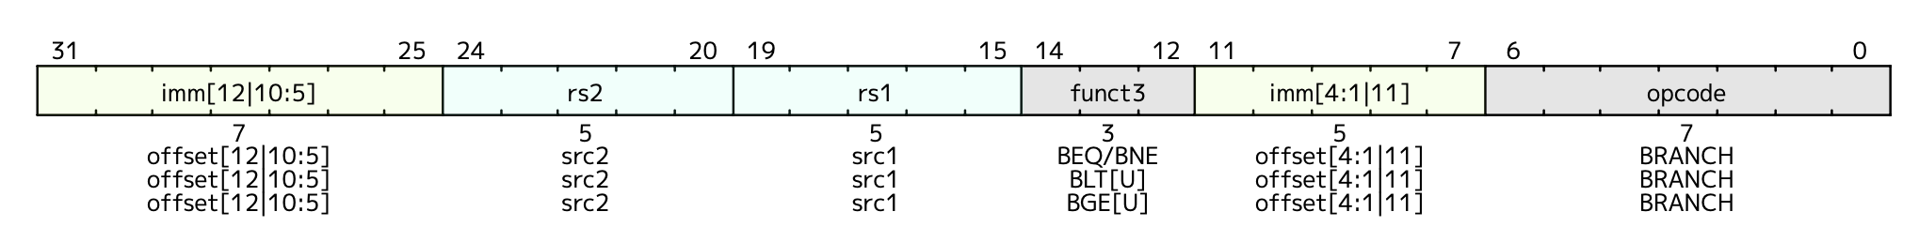
adjustBranchImm (optional helper)
Description:
Takes a branch instruction (SB-type) and extracts the sign-extended immediate
Arguments:
a0: A branch instruction.
a1: New immediate value.
Returns:
a0: Branch instruction with updated immediate.

Slide 31
adjustJalImm (optional helper)
Description:
Updates the immediate value of a jump instruction (jal) (UJ type).
Arguments:
a0: A jal instruction.
a1: New immediate value.
Returns:
a0: Jump instruction with updated immediate.

Slide 32
Flow of Implementation
Recommended Program Flow
Call getControlFlowGraph to populate the CFG data structures.
Initialize the deadCodeArray with all instructions set as unmarked.
Perform the iterative analysis as follows:
      Call genKillSets to compute the generation and killing sets.
Call getLiveSets to determine the live-in and live-out sets for each basic block.
Call markDeadCode to identify and mark the dead code based on the live sets.
If markDeadCode indicates that new dead code was found, return to step 3.
4. Once the loop exits (when no new dead code is found), call fixTargets to adjust any targets affected by the dead code removal.
5. Finally, call removeDeadCode to eliminate the marked dead code from the program.

Slide 33
Testing
Lab #6: Dead Code Elimination

Slide 34
CFG_simulator tool
In the Code/test_case_validator folder you will find an executable called cfg_verifier.
To create a test case, write a RISC-V function (e.g., INPUT_FUNCTION.s) in an assembly file to begin with. Then, type in the following command in the terminal: rars a dump .text Binary <INPUT_FUNCTION.bin> <INPUT_FUNCTION.s>.
The binary file generated by this command can serve as a program argument to the CFG_simulator tool included with this lab. The cfg_verifier tool will parse the file and output another binary file (the cfg.bin) which can be used as an argument to the deadCodeElimination.s file.
Run as ./cfg_verifier <INPUT_FUNCTION.bin>

Slide 35
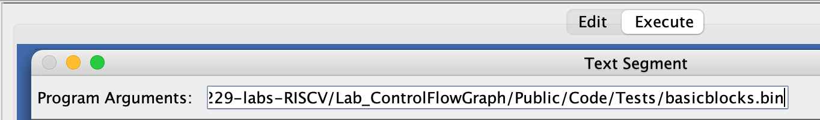
Program Arguments
We have provided some test inputs and expected outputs in the Tests folder.
Two arguments required for deadCodeElimination.s: the full path to the binary file cfg.bin (output from the cfg_verifier tool) and the final live-out array of the function.
Ensure there are no quotation marks or spaces in the path.

Slide 36
Tests Folder
There are three tests: basicblocks, nestedloop, singleinstruction.
Each test has the following:
- A .s file containing the assembly code of the input function.
A .bin (binary) file containing the assembled function (program argument).
A .txt file containing the correct output for the test.

Slide 37
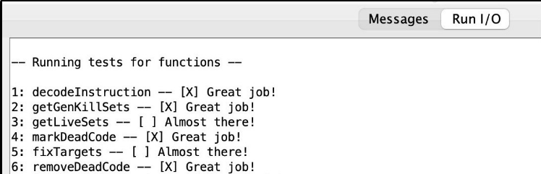
Unit Tests
The common.s file will run unit tests on the functions in deadCodeElimination.s.
Tests are hardcoded and do not use the file set as the program argument.
Check out the .data section in the common.s file to see how they are set up.
You can view the results in the “Run I/O” panel of RARS.

Slide 38
Disassembler
Lab #6: Dead Code Elimination

Slide 39
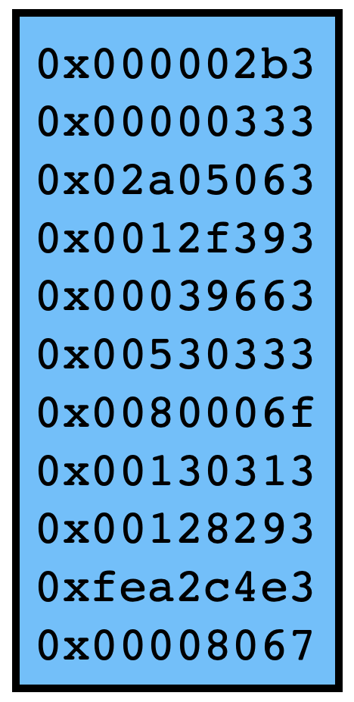
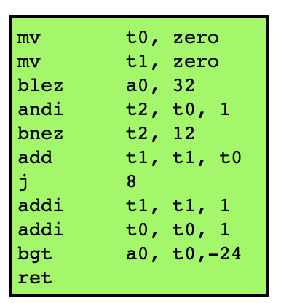
What is a Disassembler?
RARS is a RISC-V Assembler that translates RISC-V instructions to executable binary.
A Disassembler does the opposite.
For this lab, we will use an Open-Source RISC-V Disassembler (https://github.com/michaeljclark/riscv-disassembler)

Slide 40
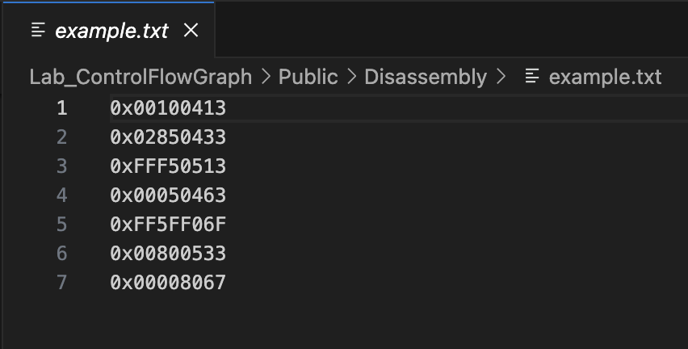
How to Use the Disassembler
There is a Disassembly folder in the Code folder.
There is a file called “print-instructions.c” in this folder that prints the equivalent instructions for hexadecimal words.
First, compile “print-instructions.c” by running e.g. “gcc print-instructions.c”
Next, create a text file containing hexadecimal instructions. The file should look like this:

Slide 41
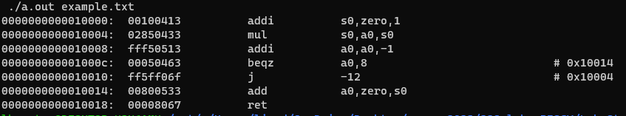
How to Use the Disassembler (cont.)
Once you have an executable for print-instructions.c (a.out) and a text file with hexadecimal instructions (example.txt), execute “./a.out example.txt”
Here is the disassembled instructions from example.txt:

Slide 42
Notes on the Disassembler
The disassembler translates addi t0, t0, 0 to mv t0, zero. Keep this in mind to avoid confusion with addi instructions.
The disassembler will not translate a sentinel value (0xFFFFFFFF) as expected.

Slide 43
What to Submit?
A single file, called controlFlowGraph.s.
Keep the file in the Code folder of the git repository.
Do not modify the name of any function.
Do not remove the CMPUT 229 Student Submission License.
Do not modify the line .include "common.s".
Do not modify the common.s file.
Push your repository to GitHub before the deadline.

Slide 44
Good Luck!
Lab #6: Dead Code Elimination

