Slide 1
Pipelining Simulator
CMPUT 229 LAB 6
Saumya Patel

Slide 2
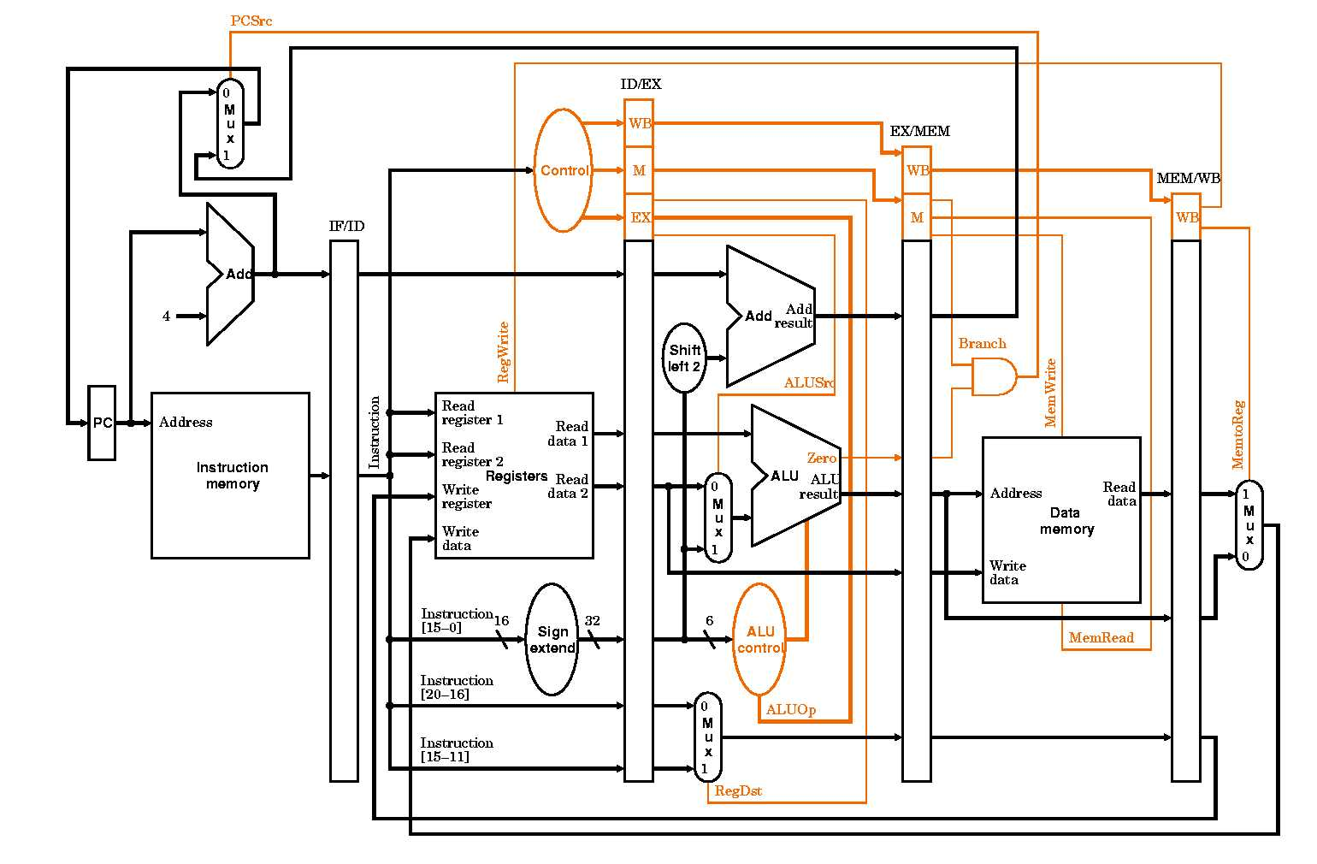
GOAL
Simulate the operation of a 5-stage pipelined RISC-V CPU in software.
Allow users to step through program execution one instruction at a time.
Visualize instruction flow through each pipeline stage:
  Instruction Fetch (IF)
  Instruction Decode/Register Fetch (ID)
  Execute/Address Calculation (EX)
  Memory Access (MEM)
  Write Back (WB)

Slide 3
GOAL ( Continued )
Enable observation of how instructions overlap in the pipeline during parallel execution.
Demonstrate how the pipeline handles different types of hazards:
  Data hazards: when one instruction depends on the result of another.
  Control hazards: typically caused by branch instructions.
  Structural hazards: due to insufficient hardware resources (described but not simulated).
Model cache behavior for memory instructions (loads and stores):
  Check for cache hits and misses.
  Introduce memory delays (stalls) on a cache miss to show impact on pipeline execution.

Slide 4
Collect and display performance metrics throughout simulation.
Allow analysis of the performance impact of hazards, stalls, and cache behavior.
Notes:
These are the performance metrics for the lab
Number of cycles
Number of instructions executed.
Number of branches encountered.
Branch predictions and mispredictions.
Cache hits and misses.
CPI

Slide 5
BACKGROUND
Pipelining:
  Technique used in computer architecture to improve CPU performance
  Allows multiple instructions to be executed simultaneously
  Divides processing into stages with each performing specific operations
  Output of one stage becomes input for the next stage

Slide 6
Background ( Continued )
Five pipeline stages:
  IF (Instruction Fetch)
    Instruction is fetched from memory
  ID (Instruction Decode/Register Fetch)
    Instruction is decoded and registers read
  EX (Execute/Address Calculation)
    Operation performed or effective address calculated
  MEM (Memory Access)
    Data memory accessed for load/store instructions
  WB (Write Back)
    Result written back to register file

Slide 7
Background ( Continued )
Pipeline hazards:
  Data hazards
    When instruction depends on result of previous instruction not yet completed
  Control hazards
    When pipeline makes decision based on unresolved branch instruction
  Structural hazards
    When multiple instructions require same resource simultaneously
Notes:
NOTE ---> THIS LAB ONLY SIMULATES CONTROL AND DATA HAZARDS ( IM NOT YELLING : ( )

Slide 8
Memory Mapped Register and Register Table
Register Table (or register file) = array of 32 words.
Each word represents a register.
If the address of the Register table is 0x40004000 then the first register ie x0 has the address 0x40004000, register x1 has the value 0x40004004 , etc
Register Table stored in the global variable RegisterTable

Slide 9
The Simulator
The entire simulator requires using and calling the 5 stages of the pipeline in a reverse order.
Example
  WriteBack();
  Memory();
  Execution();
  Decode();
  InstructionFetch();
Simulate Control Hazards like handling branches along with data hazards.
Modeling cache behaviors and introducing cache delays for cache misses.

Slide 10
Pipeline Latches - Overview
Pipeline latches hold instruction information between stages.
Each latch stores:
  Instn ( 32 bit )
  Valid bit (shows if actual instruction is in latch)
  Instruction-specific fields required for the next pipeline stage

Slide 11
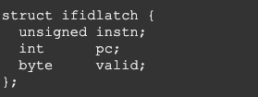
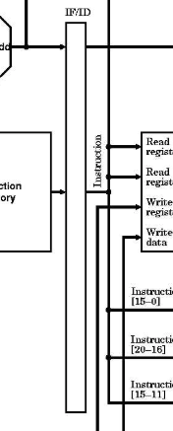
IF/ID Latch
Purpose: Holds instruction just fetched, ready for decode.
Holds:
  Fetched instruction (raw 32 bits)
  Program Counter (PC) of fetched instruction
  Valid bit (1 if latch holds a real instruction, 0 otherwise)
Note: Enables step-wise handoff of instruction to decoding stage.

Slide 12
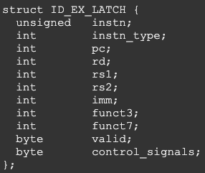
ID/EX Latch
Purpose: Holds decoded information, ready for execution.
Holds:
  Instruction
  Instruction type (R, I, S, SB, UJ)
  Register indices: rs1, rs2, rd
  Immediate value (sign-extended, format-dependent)
  funct3 field
  Funct7 field
  Control signals
  Program Counter (PC)
  Valid bit
Notes:
Note: Prepares all control and operand fields required for ALU or memory access.

Slide 13
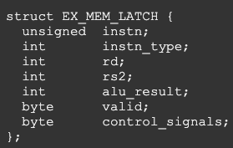
EX/MEM Latch
Purpose: Holds execution/ALU results and address calculation for memory access.
Holds:
  Result from ALU (arithmetic/logical result, or effective memory address)
  Second source register ( rs2 )
  Register destination (rd)
  Branch evaluation (taken/not taken) (if instruction is branch)
  Value to write to memory (for store instructions)
  Control signals
  Valid bit
Notes:
Note: Passes on all necessary data for memory operation orresult propagation.

Slide 14
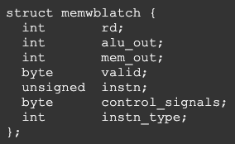
MEM/WB Latch
Purpose: Holds results of memory or ALU operation for final write-back.
Holds:
  Data from memory (for load)
  Data from ALU (if not a load)
  Destination register (rd)
  Control signals
  Valid bit
  InstructionType
Notes:
Note: Contains all info needed for writing result to registertable.

Slide 15
Inserting into the pipeline
A helper function called InsertIntoPipeline gives a detailed overview.
"CurrentPipeline" is used to store the current state of the pipeline at any given cycle. It is an array of 5 words representing the 5 stages of the pipeline.
When an instruction is inserted, all the other instructions shift to the right and the last instruction (write back stage) gets retired from the pipeline.

Slide 16
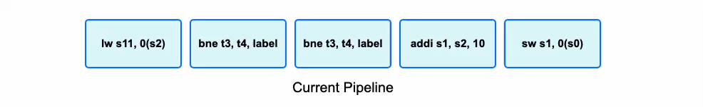

Slide 17
Pipeline Stages

Slide 18
Instruction Fetch
Reads the program counter
Gets the instructions at the program counter. Inserts the instructions into the pipeline.
Turns on valid bit for the IF/ID latch
Increments Program Counter

Slide 19
Decode
Extracts the instructions from the IF/ID latch
Calculate all the operands needed for the ID/EX latch
Sets the control signals
Transfers the values to the ID/EX latch

Slide 20
Execute Stage
Extracts the values from the ID/EX latch.
Calculates the values stored in each of the registers
Implements the forwarding and/or load use hazard detection and handles them
Gets the outcome of a branch and changes the PC if the branch is taken but keeps the PC the same when the branch is not taken.

Slide 21
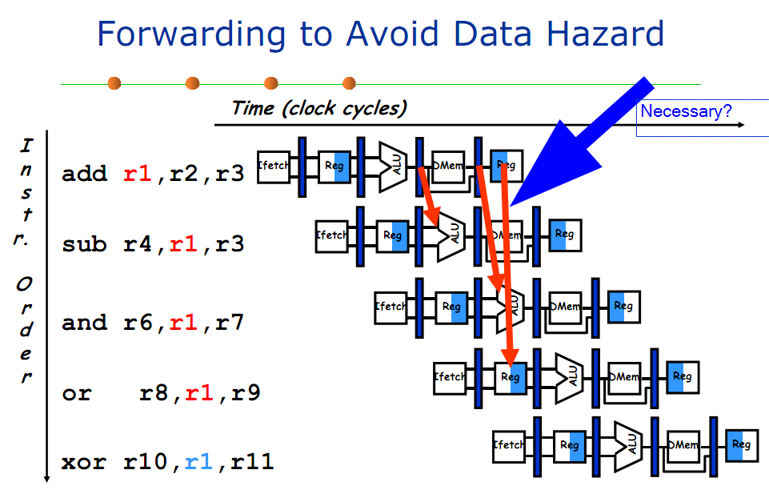
Data Hazards and Forwarding
In the case of a data hazard where the destination register of the instruction in the memory stage is the same as one of the source registers, forwarding will need to be applied.
In the case of a load use dependency, involving a use of after a load, the following things will happen in the simulator
  The value will be taken from the necessary latch and there will be a stall.

Slide 22
Branch Prediction
A simple static branch predictor is required to be implemented in this lab. All branches are predicted to be not taken.
If a branch is taken you increment the number of mispredictions by 1.
  This would require converting the instructions in the latches and the current pipeline into a NOOP signified by a –2 in the pipeline
If a branch is not taken you increment the number of correct predictions by 1.

Slide 23
Memory Stage
Extracts the instructions from the EX/MEM latch
Gets the control signal and masks the control signals based on whether a memory access is needed or not.
There are instructions that don’t need to access memory, and that can be checked by masking the ControlSignal byte for specific control signals
Notes:
Specific control signals --> let the students figure it out : )

Slide 24
Memory Stage ( Continued )
If memory access is needed, you might have to load from memory or write to memory. Use the ControlSignal field of the EX/MEM latch to determine if memory should be accessed.
Write the necessary values to the MEM/WB latch

Slide 25
Modeling the Cache Behavior
The pipeline also simulates cache delays caused by memory accesses.
Cache misses cause a 3 cycle delay.
This lab requires implementing the SimulateHitOrMiss which generates a pseudorandom number using the LCG (Linear congruential generator) algorithm, to determine if a memory access results in a hit or miss.

Slide 26
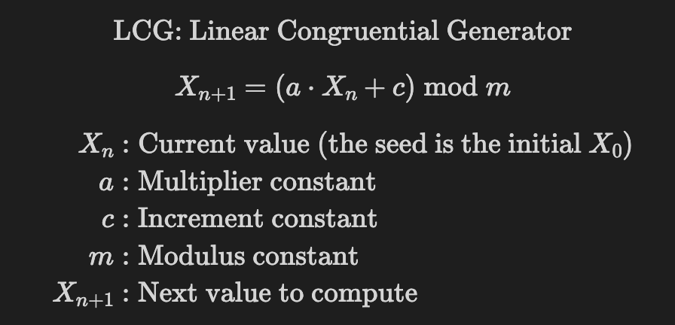
Modeling the Cache Behaviour ( Continued )
The values of a , c , m , and the initial X_{n} ( seed ) is given in Common.s
X_{n+1} is written back into X_{n}which is a variable ( mentioned in"common.s" )
(X_{n+1} < 10 ) ? (Cache miss) : (Cache hit)

Slide 27
Write Back Stage
Extract values from the MEM/WB latch
This stage involves writing values into the register file if necessary.
That can be done by masking out the ControlSignal field of the MEM/WB latch and extracting the necessary signals.
Notes:
"extracting the necessary signals" being purposefully vague. Let the students figure it out. Im evil like dat

Slide 28
Output
The output is divided into 3 parts
  The Pipeline Stages
  The Register Table
  Simulation summary
The pipeline stages involve printing the current state of the pipeline after every cycle
The register table section visualizes the values of the memory-mapped registers in the RegisterTable.

Slide 29
Output ( Continued )
The simulation summary contains
  Total Cycles
  Instructions Executed
  Cycles Per Instruction (CPI)
  Number of Branches
  Cache Hits and Misses
  Branch mispredictions and Correct Predictions
  Instructions that involve memory accesses

Slide 30
Functions to implement
PipeliningSimulator
  Main function that calls the functions i.e the 5 stages, updates the cycle count, handles the stalls, and is involved with printing the current state of the pipeline, the register table and the end statistics.
InstructionFetchStage
  Performs the instruction fetch stage by fetching the instruction at the current program counter, and performs the operations of the instruction fetch stage, and setting the IF/ID latch

Slide 31
Functions to implement ( Continued )
DecodeStage
  Processes the instruction fetched in the previous stage. This stage is responsible for determining the instruction type, Extracting operand registers, immediates and funct3 codes, and also generating the correct control signals for each type of instruction.
ExecutionStage
  Performs arithmetic, logical, and address calculations based on instruction type. This stage is responsible for executing ALU operations for R-type and I-type instructions, computing branch conditions, preparing effective addresses for S-type and UJ-type instructions, propagating results and control signals to the EX/MEM pipeline latch.

Slide 32
Functions to implement ( Continued )
MemoryStage
  Handles all memory access operations as determined by the control signals. This stage is responsible for performing memory reads or writes using the address computed in the EX stage, propagating relevant data and control information to the MEM/WB latch

Slide 33
Functions to implement ( Continued )
WriteBackStage
  Write-back stage: writes result to register file if RegWrite is set and valid. Selects value from memory or ALU based on the control signal;
PreDecode
  Takes in the instruction type and instruction hex as arguments and returns indeces of rs1, rs2, rd, funct3, funct7, immediate
SimulateHitOrMiss
  Simulates a cache hit or miss for a given register using a Linear Congruential Generator (LCG). Updates global counters for cache hits and misses, and increments cycles on a miss.

Slide 34
Data Structures And Global Variables
Global variables are given to manage the state of the pipeline, print the simulation stats, etc
The data structures include the pipeline latches.
The following global variables are given
  CurrentPipeline
  ZeroFlag
  Cycles
  CorrectBranchPredictions
  BranchMispredictions
  NumBranches
  PCWrite
  RegisterTable
  SimulatedMemory
  NumMemAccess
  NumCacheMisses
  NumCacheHits
  NumInstructions
  CacheMissFlag
  DelayCounter
  CacheMissFlag

Slide 35
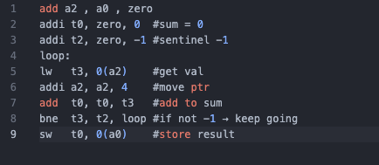
Test Cases
All test cases are standalone RISC-V assembly files (no assembler directives or global variables).
Common.s sets up a 256-byte SimulatedMemory (found in the data structures section ) and initializes a0 to point to it.
Supported Instructions
  R-type: add, sub
  I-type: lw, addi
  S-type: sw
  SB-type: beq, bne

Slide 36
Test Cases ( Continued )
Execution Context
  Test cases run without inputs and only access SimulatedMemory for load/store.
Purpose
  Validate pipeline correctness with varied scenarios (array sums, arithmetic, branching).
Students are encouraged to design additional test cases beyond those provided.

Slide 37
Tips and Tricks
Read Chapter 4 : The Processor in the textbook!
Use a Disassembler to decode the binary representation of the instruction to debug the pipelining stages functions! You can find one online ( https://luplab.gitlab.io/rvcodecjs/ )

