Slide 1
Lab #6: Stack Manipulation
CMPUT 229

Slide 2
Background
CMPUT 229

Slide 3
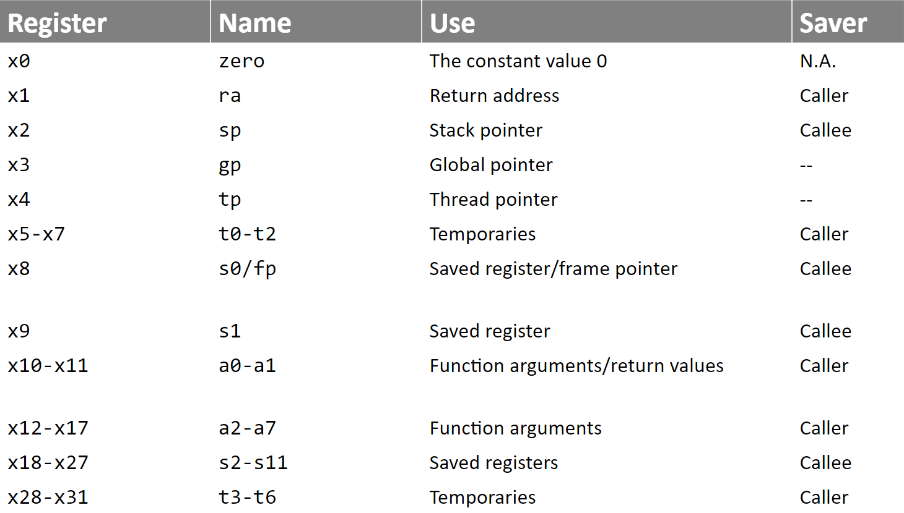
Register Calling Conventions

Slide 4
Register-Saving and Register-Restoring Instructions
The register calling conventions specifies which registers a callee function needs to save if the value in the register is modified.
Factorial:
addi sp, sp, -4
sw s0, 0(sp)
li s0, 1
Loop:
mul s0, a0, s0
addi a0, a0, -1
beqz a0, End
j Loop
End:
mv a0, s0
lw s0, 0(sp)
addi sp, sp, 4
jalr x0, ra, 0
Factorial:
li s0, 1
Loop:
mul s0, a0, s0
addi a0, a0, -1
beqz a0, End
j Loop
End:
mv a0, s0
jalr x0, ra, 0
In this lab, these are called register-saving instructions
In this lab, these are called register-restoring instructions
Factorial stores to s0, a0, x0.
According to our calling convention, the callee only needs to save s0.

Slide 5
RISC-V Instructions as Hexadecimal
Factorial:
0x01000 li s0, 1
Loop:
0x01004 mul s0, a0, s0
0x01008 addi a0, a0, -1
0x0100C beqz a0, End
0x01010 j Loop
End:
0x01014 mv a0, s0
0x01018 jalr x0, ra, 0
Factorial:
0x01000 0x00100413
0x01004 0x02850433
0x01008 0xFFF50513
0x0100C 0x00050463
0x01010 0xFF5FF06F
0x01014 0x00800533
0x01018 0x00008067
Refer to the RISC-V Green Sheet and try to translate the instructions on the left to hexadecimal to confirm .

Slide 6
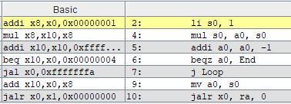
A Note on Pseudo Instructions
When writing RISC-V code it can be helpful to use pseudo instructions that are not actually specified on your RISC-V green sheet, but are supported by RARS.
Factorial:
li s0, 1
Loop:
mul s0, a0, s0
addi a0, a0, -1
beqz a0, End
j Loop
End:
mv a0, s0
jalr x0, ra, 0
The li s0, 1 pseudo instruction translates to addi s0, x0, 1
Labels don’t exist in the binary of your code. RARS uses labels like Factorial, Loop and End to simplify assembly coding.
So the beqz a0, End pseudo instruction translates to beq a0, x0, 4.
Also, j Loop translates to jal x0, -8
mv a0, s0 translates to add a0, x0, s0
Notes:
Note on beqz a0, End instruction translation.
The offset for the instruction seems confusing for branches. The beqz a0, End instruction should move the program counter two instructions ahead to mv a0, s0. However, the offset for this instruction is only 4. This seems to suggest that the beqz a0, End instruction moves the PC to the j loop instruction.
This is a confusing situation because by default, branch instructions increment the PC by 4. Thus, the offset of 4 will actually point 2 instructions ahead as we intended.

Slide 7
Input to the Lab
The input for this lab is a sequence of RISC-V instructions ending with a sentinel value (0xFFFFFFFF)
Factorial:
0x01000 0x00100413
0x01004 0x02850433
0x01008 0xFFF50513
0x0100C 0x00050463
0x01010 0xFF5FF06F
0x01014 0x00800533
0x01018 0x00008067
Here’s what the factorial function as input would look like:
[0x00100413, 0x02850433, 0xFFF50513, 0x00050463, 0xFF5FF06F, 0x00800533, 0x00008067, 0xFFFFFFFF]
This lab will provide the address of the first instruction as input. In this example, the input to stackManipulation would be 0x01000 (a pointer to 0x00100413, the first instruction in factorial).
The instructions are stored in an array in memory, ending with the sentinel value (0xFFFFFFFF).
A solution to this lab will parse through the instructions.

Slide 8
Understanding what Hexadecimal Instructions do
Understanding the hexadecimal representation of instructions can seem intimidating. Luckily, RISC-V’s simplistic architecture makes this process more manageable.
RISC-V Instruction Formats are distinguished by their opcode.
funct3 distinguishes the instructions within that instruction format.
For example, let’s try disassembling the first instruction (0x00100413) from the factorial function.
0x00100413 = 0000 0000 0001 0000 0000 0100 0001 0011
opcode = 001 0011, funct3 = 000
From the opcode, this is an I-type instruction. From the funct3, this is an addi instruction.

Slide 9
Determining Which Instructions Write to Registers
A solution to this lab must parse through the input function and determine which registers it writes to.
RISC-V simplifies this problem through the core instruction formats.
The following instruction types all have a rd: R, I, U, UJ.
If an instruction is of any of the above types, then it writes to register rd.
The remaining instruction types do not write: S, SB.
S instructions include sb, sh, sw, sd.
SB instructions include beq, bne, blt, bge, bltu, bgeu.

Slide 10
Register Bitmaps
A register bitmap is 32 bits where each bit represents a register. This maps bits to register numbers.
0 0 0 0 0 0 0 0 0 0 0 0 0 0 0 0 0 0 0 0 0 0 0 0 0 0 0 0 0 0 0
1
In this example, all bits except bit 27 are 0. In hexadecimal, this is represented as 0x0800 0000

Slide 11
Using a Bitmap to Represent Register Calling Conventions
0
0
1
0
0
000
1
1
00
000000
1111111111
0000
So, the register bit map representing the default RISC-V calling conventions is 0x0FFC 0304
= 0000 1111 1111 1100 0000 0011 0000 0100
= 0x0FFC 0304

Slide 12
Assignment
CMPUT 229

Slide 13
stackManipulation
Description:
This is the main function called from common.s.
Convert a RISC-V function into its stack-manipulated variation.
Parameter:
a0: address of the first element of an array of RISC-V instructions ending with a sentinel value (0xFFFFFFFF)
a1: register calling conventions for the RISC-V function
Return Value:
a0: address of the first element of a stack manipulated variation of the array of RISC-V instructions ending with a sentinel value (0xFFFFFFFF).

Slide 14
findWrites
Description:
Find all the register writes in a RISC-V function.
Parameter:
a0: address of the first element of an array of RISC-V instructions ending with a sentinel value (0xFFFFFFFF)
Return Value:
a0: bit map of the registers written to in the RISC-V function

Slide 15
findWrites Example:
Factorial:
li s0, 1
Loop:
mul s0, a0, s0
addi a0, a0, -1
beqz a0, End
j Loop
End:
mv a0, s0
jalr x0, ra, 0
store to x8
store to x8
bit 8 is already set
store to x10
doesn’t store
store to x0
j Loop is a pseudo instruction for jal x0, -12
store to x10
bit 10 is already set
store to x0
bit 0 is already set
Register Bit Map
0000 0000 0000 0000 0000 0 0 0000 000
1
1
1
0
0
0
=0x0000 0501
With the factorial function as input, findWrites should return 0x00000501 in a0.

Slide 16
storeStackInstructions
Description:
Inserts the register-saving or register-restoring to a specified memory location. Store the sentinel value (0xFFFFFFFF) at the end of the register-saving/restoring instructions.
Parameter:
a0: Boolean value. If 0, store register-saving instructions. If 1, store register-restoring instructions
a1: address of the location to store register-saving/restoring instructions.
a2: bit map indicating which registers to save to the stack.
Return Value:
None.

Slide 17
storeStackInstructions Register-Saving Example:
Let’s continue using the factorial function
Factorial:
li s0, 1
Loop:
mul s0, a0, s0
addi a0, a0, -1
beqz a0, End
j Loop
End:
mv a0, s0
jalr x0, ra, 0
Inputs to storeStackInstructions:
registerSavingInstructions:
addi sp, sp, -4
sw s0, 0(sp)
a0: 0 (we’re storing the register-saving instructions)
a1: where we want to store instructions
a2: 0x0000 0100
From findWrites, we know that factorial stores to 0x0000 0501 and our default register conventions are 0x0FFC 0304.
ANDing these together we get 0x0000 0100
So, the only register that writes and we need to save is x8 (s0).
0x00812023
[0xFFC10113,
, 0xFFFFFFFF]
Remember to store the sentinel value (0xFFFFFFFF) at the end of the instructions

Slide 18
storeStackInstructions Register-Restoring Example
Let’s continue using the factorial function
Factorial:
li s0, 1
Loop:
mul s0, a0, s0
addi a0, a0, -1
beqz a0, End
j Loop
End:
mv a0, s0
jalr x0, ra, 0
Inputs to storeStackInstructions:
registerRestoringInstructions:
lw s0, 0(sp)
addi sp, sp, 4
a0: 1 (we’re storing the register-restoring instructions)
a1: where we want to store instructions
a2: 0x0000 0100
, 0xFFFFFFFF]
0x00410113
[0x00012403,
Remember to store the sentinel value (0xFFFFFFFF) at the end of the instructions

Slide 19
Is that all?
Using the functions findWrites and storeStackInstructions, a naïve solution to the problem of missing register saving/restoring instructions could be implemented.
However, a solution to this lab will go further and consider the consequences of inserting instructions into already assembled code.
In this lab, we’ll focus on how inserted instructions affect jumps and accesses to the data section.

Slide 20
How Inserted Instructions Affect Jumps
Inserting instructions into the binary of a function could change the behaviour of the function.
Let’s see how our factorial example is affected by inserted instructions:
Factorial:
0x01000 li s0, 1
Loop:
0x01004 mul s0, a0, s0
0x01008 addi a0, a0, -1
0x0100C beqz a0, End (beqz a0, 4)
0x01010 j Loop (jal x0, -12)
End:
0x01014 mv a0, s0
0x01018 jalr x0, ra, 0
0x01000 addi sp, sp, -4
0x01004 sw s0, 0(sp)
0x01008 li s0, 1
0x0100C mul s0, a0, s0
0x01010 addi a0, a0, -1
0x01014 beqz a0, 4
0x01018 jal x0, -12
0x0101C mv a0, s0
0x01020 lw s0, 0(sp)
0x01024 addi sp, sp, 4
0x01028 jalr x0, ra, 0
Notice how the address of the instructions in memory has changed. Our j Loop (pseudo instruction for jal x0, -12) has changed from 0x01010 to 0x01018.
Luckily, jal instructions in RISC-V are relative to the current program counter. So, since the Loop instruction we want to execute is still located 12 bytes behind the j Loop instruction, the function is still correct.

Slide 21
How Inserted Instructions Affect Jumps cont.
In the last slide, we found that jumps within the function body still operate the same even with our inserted instructions.
Let’s consider a variation of Factorial that calls another function to print the answer.
Factorial_Print:
0x01000 li s0, 1
Loop:
0x01004 mul s0, a0, s0
0x01008 addi a0, a0, -1
0x0100C beqz a0, End
0x01010 j Loop
End:
0x01014 mv a0, s0
0x01018 jal Print_Int (jal ra, 8)
0x0101C jalr x0, ra, 0
Print_Int:
0x01020 li a7, 1
0x01024 ecall
0x01028 jalr x0, ra, 0
0x01000 addi sp, sp, -4
0x01004 sw s0, 0(sp)
0x01008 li s0, 1
0x0100C mul s0, a0, s0
0x01010 addi a0, a0, -1
0x01014 beqz a0, 4
0x01018 jal x0, -12
0x0101C mv a0, s0
0x01020 jal ra, 8
0x01024 lw s0, 0(sp)
0x01028 addi sp, sp, 4
0x0102C jalr x0, ra, 0 0x01030 li a7, 1
0x01034 ecall
0x01038 jalr x0, ra, 0
The jump within the function still behaves the same.
The jump outside the function DOES NOT behave the same.
Since the stack-restoring instructions were inserted at the end of the function, the jal offset is incorrect.

Slide 22
Fixing Jumps Outside of the Function Body
With inserted instructions, jumps within the function behave the same. However, jumps outside of the function (calls to other functions) need to be corrected.
0x01000 addi sp, sp, -4
0x01004 sw s0, 0(sp)
0x01008 li s0, 1
0x0100C mul s0, a0, s0
0x01010 addi a0, a0, -1
0x01014 beqz a0, 4
0x01018 jal x0, -12
0x0101C mv a0, s0
0x01020
0x01024 lw s0, 0(sp)
0x01028 addi sp, sp, 4
0x0102C jalr x0, ra, 0 0x01030 li a7, 1
0x01034 ecall
0x01038 jalr x0, ra, 0
To fix this forward jump outside the function body, we need to account for the inserted instructions.
Since we inserted 8 bytes at the end of the function, add 8 bytes to the jal immediate.
jal ra, 8 → jal ra, 16
jal ra, 8
jal ra, 16
Now the function behaves the same even with our compiler pass!!
If this jump was backwards, subtract the number of bytes inserted at the start of the function from the jal immediate.

Slide 23
How Inserted Instructions Affect Data Accesses
Now that the solution has accounted for calls to other functions, let’s also consider accesses to the data section.
Let’s consider a function called Increment that increments a counter in memory:
Increment:
la s0, counter # s0 <- pointer to counter
lw t0, 0(s0) # t0 <- counter
addi t0, t0, 1 # increment counter
sw t0, 0(s0) # store incremented counter
jalr x0, ra, 0 # return
Increment:
0x0040000 auipc s0, 0x0fc10
0x0040004 addi s0, s0, 0
0x0040008 lw t0, 0(s0)
0x004000C addi t0, t0, 1
0x0040010 sw t0, 0(s0)
0x0040014 jalr x0, ra, 0
la s0, counter is a pseudo instruction
RARS translates this to the following instructions:
auipc s0, 0x?????
addi s0, s0, 0x???
auipc (add upper immediate to program counter) will do the following:
s0 <- PC + 0x0fc10000
Then addi will adjust the bottom 3 bytes of s0
s0 <- s0 + 0x00000000
To simplify things, just remember that RARS uses auipc and addi to ensure that accesses to the data section are relative to the PC and any location in the instructions can access any location in the data section.

Slide 24
How Inserted Instructions Affect Data Accesses cont.
The load address instruction is relative to the program counter (because of the auipc instruction).
Since the compiler pass inserts register-saving instructions, the load address will occur from a different PC.
Increment:
0x0040000 auipc s0, 0x0fc10
0x0040004 addi s0, s0, 0
0x0040008 lw t0, 0(s0)
0x004000C addi t0, t0, 1
0x0040010 sw t0, 0(s0)
0x0040014 jalr x0, ra, 0
Increment:
0x00400000 addi sp, sp, -4
0x00400004 sw s0, 0(sp)
0x00400008 auipc s0, 0x0fc10
0x0040000C addi s0, s0, 0
0x00400010 lw t0, 0(s0)
0x00400014 addi t0, t0, 1
0x00400018 sw t0, 0(s0)
0x0040001C lw s0, 0(sp)
0x00400020 addi sp, sp, 4
0x00400024 jalr x0, ra, 0
s0 <- PC + 0x0fc10000
= 0x00400008 + 0x0FC10000
s0 = 0x1001 0008
Counter:
0x10010000 1
OtherData:
0x10010004 2
0x10010008 3
Since the inserted instructions affect the PC and the accesses to the data section are relative to the PC, the access to counter is incorrect.

Slide 25
Fixing Data Accesses
From the last slide, load address instructions will behave incorrectly after inserting the stack instructions. Let’s consider the same example to try to fix the load addresses.
Increment:
0x00400000 addi sp, sp, -4
0x00400004 sw s0, 0(sp)
0x00400008 auipc s0, 0x0fc10
0x0040000C
0x00400010 lw t0, 0(s0)
0x00400014 addi t0, t0, 1
0x00400018 sw t0, 0(s0)
0x0040001C lw s0, 0(sp)
0x00400020 addi sp, sp, 4
0x00400024 jalr x0, ra, 0
s0 <- 0x1001 0008
s0 <- 0x1001 0000
The inserted stack instructions changed the PC when auipc is executed. To correct this, subtract the change in the PC.
In this case, the 2 register-restoring instructions changed the PC by 8 bytes.
Let’s subtract 8 bytes from the addi immediate to correct this.
addi s0, s0, 0 -> addi s0, s0, -8
addi s0, s0, -8
addi s0, s0, 0
Counter:
0x10010000 1
The load address is fixed!!!

Slide 26
fixAccesses
Description:
Correct the accesses in a RISC-V function that may have bytes inserted at the start and end.
Adjust the immediates in jal and la instructions.
Parameter:
a0: address of the first element of an array of RISC-V instructions ending with a sentinel value (0xFFFFFFFF)
a1: number of bytes inserted at the start of the function.
a2: number of bytes inserted at the end of the function.
Return Value:
None.

Slide 27
Almost There…
Lastly, consider the case that a function has multiple return statements. Where should the register-restoring instructions be inserted?
They could be inserted before every return statement.
But, this would lead to unnecessary insertions and could complicate calculating the jump immediates from the last function.

Slide 28
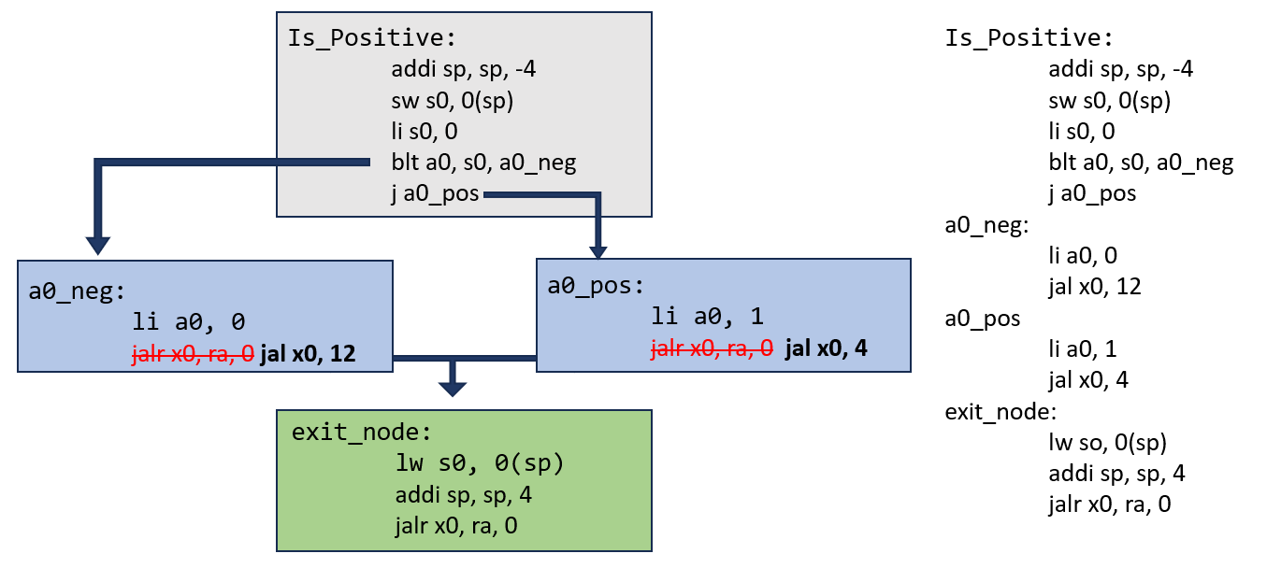
Creating an Exit Node
Create an exit node that starts on the first register-restoring instruction ( lw x0-31, 0(sp) )
A solution should change every return instruction (even if there’s just one) to jump to the exit node.

Slide 29
redirectReturns
Description:
Converts all return statements in the function to jump to an exit node.
Parameter:
a0: address of the first element of an array of RISC-V instructions ending with a sentinel value (0xFFFFFFFF).
a1: pointer to exit node.
Return Value:
None.

Slide 30
Program Flow for stackManipulation
Call findWrites to get the register bitmap of registers written to in the function.
Call fixAccesses to correct any jal or la instructions. By calling fixAccesses this early, it is simpler to determine whether a jal instruction jumps outside the function body.
Call storeStackInstructions to insert the register-saving instructions.
Copy the body of the function to space where the outputted instruction sequence will live.
Call storeStackInstructions to insert the register-restoring instructions. Remember to keep a pointer to the first instruction in the register-restoring instructions as this will be the start of the exit node.
Call redirectReturns to redirect all return statements to the exit node.
Insert the return statement at the end of the exit node, followed by the sentinel value (0xFFFFFFFF).

Slide 31
Testing
CMPUT 229

Slide 32
Program Arguments
We have provided some test inputs and outputs for you to confirm that your lab is working.
There are two program arguments for stackmanipulation.s. The first is a path to the .binary file, the second is the register saving conventions. For example,
Tests/la.binary 1234FFFF

Slide 33
Unit Tests
The common.s file will run unit tests on the functions in stackmanipulation.s.
The unit tests are hardcoded in the common.s file. The unit tests do not use the program arguments file at all. To see the input and expected output, check the common file.
1: findWrites -- [X] Great job!
2: storeStackInstructions -- [ ] Almost there!
3: fixAccesses -- [X] Great job!
4: redirectReturns -- [X] Great job!
5: stackManipulation -- [ ] Almost there!

Slide 34
Tests Folder
In the Tests Folder, there are 4 test functions: add, la, isPos, factorial.
Each test has the following:
A .s file containing the assembly for the function
A .binary file for the function. This is what should be used in the program arguments. It was created using (rars “test.s” a dump .text Binary “test.binary”).
A .correct file. This file contains the correct output for the test and some comments on particular parts of the code.

Slide 35
Creating Tests
You are encouraged to create your own tests to confirm that your lab is working.
To create your own test do the following:
Write the function you want to test in assembly (say my_test.s)
Create the binary file for your function.
- Execute the command rars my_test.s a dump .text Binary my_test.binary
3. Now you can execute stackmanipulation.s with a register convention of your choice. program arguments = my_test.binary FFFF1234.

Slide 36
Creating Complex Tests
If you want to test only one function from a file with many functions, you need to specify to the common file which function you want to test.
Use the dummy statement “addi x0, x0, 229” immediately before the start of the function you want to test and immediately after the end of the function.
… # functions not included in test
addi x0, x0, 229 # THIS TELLS THE COMMON.S FILE THAT THE FUNCTION STARTS ON THE NEXT LINE.
factorial:
…
ret
addi x0, x0, 229 # THIS TELLS THE COMMON.S FILE THAT THE FUNCTION ENDED ON THE PREVIOUS LINE.
… # more functions down here
Only factorial will be inputted to stackManipulation
Here is an excerpt from Tests/factorial.s which uses a complex test

Slide 37
Disassembler
CMPUT 229

Slide 38
What is a Disassembler?
RARS is a RISC-V Assembler that translates RISC-V Instructions to executable binary.
A Disassembler is the opposite. It converts binary to RISC-V instructions.
For this lab, we will use an Open-Source RISC-V Disassembler from: https://github.com/michaeljclark/riscv-disassembler

Slide 39
How to Use the Disassembler
In the Code folder of the lab, we have created a disassembly folder.
In the disassembly folder, we have created a file called “print-instructions.c” that uses functions from the disassembler.
First, compiler “print-instructions.c” using a C compiler. For example, execute the command “gcc print-instructions.c” or “clang print-instructions.c”.
Next, create a text file containing hexadecimal instructions. The file should look like this:
0x00100413
0x02850433
0xFFF50513
0x00050463
0xFF5FF06F
0x00800533
0x00008067

Slide 40
How to Use the Disassembler cont.
Once you have an executable for print-instructions.c (a.out) and a text file with hexadecimal instructions (example.txt), execute “./a.out example.txt”
Here is the disassembled instructions from example.txt. This is a factorial function.

Slide 41
Issues/Confusions with the Disassembler
While testing, we have noticed some issues with the disassembler:
Firstly, the disassembler gets auipc immediates incorrect. Since a solution should not change auipc immediates, we recommend ignoring them in the disassembler output.
Secondly, the disassembler translates “addi t0, t0, 0” to “mv t0, t0”. Be aware of this to avoid any confusion when working with addi instructions.
Lastly, The disassembler will not translate the sentinel value. This is as expected.

Slide 42
What to Submit?
A single file, called stackmanipulation.s.
Make sure the file does not contain a main procedure.

