Slide 1
Register Value Analyzer
J. Nelson Amaral

Slide 2
Rajan Maghera
Nathan Ulmer

Slide 3
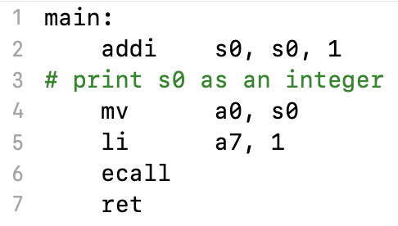

Slide 4
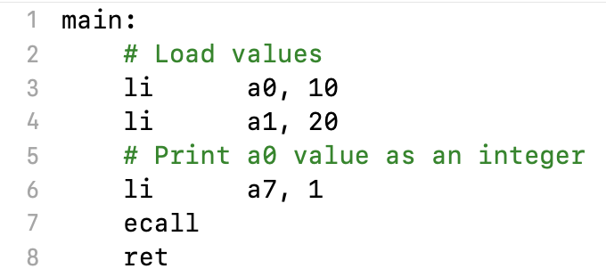

Slide 5
Register Value Analyzer
https://www.perforce.com/blog/qac/what-is-linting

Slide 6
S0 is live before it is defined
define
use
live = {s0}
s0
s0
live = {s0}
a0
s0
live = {a0}
a7
live = {a0,a7}
a0,a7
live = { }
live = { }

Slide 7
define
use
live = {s0}
s0
s0
live = {s0}
a0
s0
live = {a0}
a7
live = {a0,a7}
a0,a7
live = { }
live = { }

Slide 8
define
use
Address
Binary Code
a0
a7
s0
a0
a7
s0
0x00801014
0xFFFFFFFF
0x00801010
0x00008067
0x0080100C
0x00000073
0x00801008
0x00100893
0x00801004
0x09899533
0x00801000
0x00140413

Slide 9
define
use
live = {s0}
s0
s0
live = {s0}
a0
s0
live = {a0}
a7
live = {a0,a7}
a0,a7
live = { }
live = { }
define
use
Address
Binary Code
a0
a7
s0
a0
a7
s0
0x00801014
0xFFFFFFFF
0x00801010
0x00008067
0
0
1
0
0
1
0x0080100C
0x00000073
1
0
0
0
0
1
0x00801008
0x00100893
0
1
0
0
0
0
0x00801004
0x09899533
0
0
0
1
1
0
0x00801000
0x00140413
0
0
0
0
0
0

Slide 10
a0=x10; a7=x17; s0=x8
Address
Binary Code
define
use
0x00801014
0xFFFFFFFF
0x00801010
0x00008067
00000000000000000000000100000000
00000000000000000000000100000000
0x0080100C
0x00000073
00000000000000000000010000000000
00000000000000000000000100000000
0x00801008
0x00100893
00000000000000100000000000000000
00000000000000000000000000000000
0x00801004
0x09899533
00000000000000000000000000000000
00000000000000100000010000000000
0x00801000
0x00140413
00000000000000000000000000000000
00000000000000000000000000000000

Slide 11
a1 is not live immediately
after its definition

